Slide 1
Present Day

Slide 2
1761 structures on Present Day Map
Locations very interpretive due to map distortion, and variable scales

Slide 3
1761 & 1775 structures on Present Day Map
Red – 1761
Blue – 1775
Locations of 1775 likely to be more accurate than 1761, but geographic scope is limited (e.g. near church, and to east of area)

Slide 4
1761 & 1775 structures on Present Day Map
Red – 1761
Blue – 1775
Green – “Post 1761”
Locations of 1775 likely to be more accurate than 1761 and “Post 1761”, but geographic scope is limted
Health Warning – Do not believe specific locations of specific structures. Considerable interpretation was needed and there is a lot of uncertainty in specific locations. However, the bottom line is that in this area of Inkpen, in all cases but one (see below), where there are clusters or lines of houses today there were houses there in the late 18th century. The exception is the string of structures east of the eastern end of Weavers Lane, trending ESE, north of Pottery Lane. Locating them relative to any current features is difficult so locations are even less accurate than the others.

Slide 5
Individual maps

Slide 6
1761 structures interpretation

Slide 7
1775 structures interpretation

Slide 8
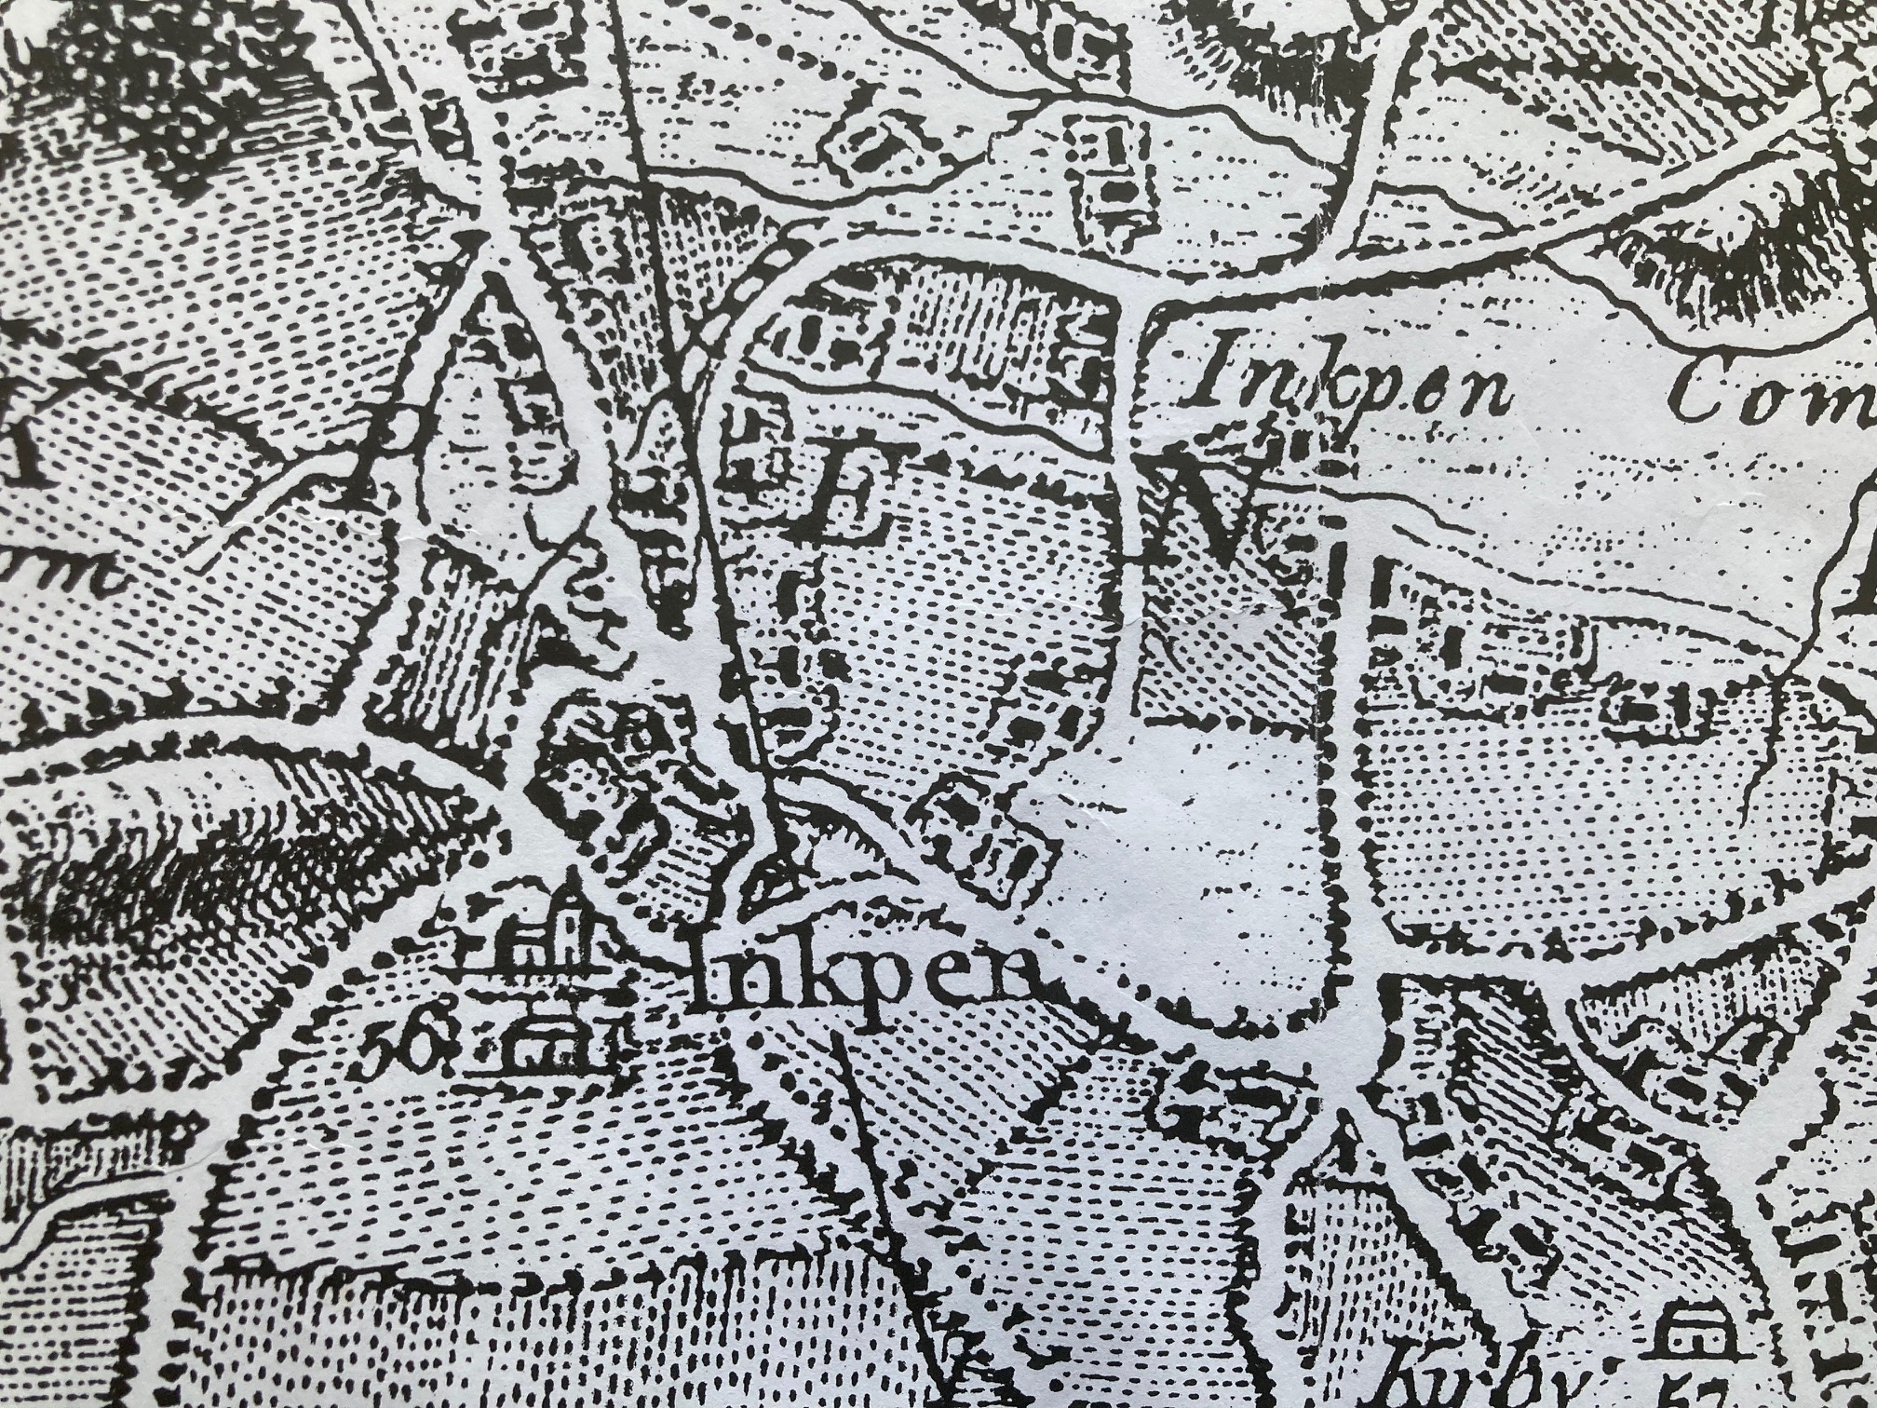
“Post 1761” structures interpretation.
Note that the age of this map is uncertain – it could be before, after or the same age as the 1761 map. Key differences to the 1761 Map (which is the map in the RCT cited as 1761) are a the depictions of significant buildings (e.g. church, Kirby House) b. the concentric lines – maybe miles from London?) and modern spelling of Inkpen.

