Slide 1
Industry and Revolution starts at a location and then spreads out. (def – revolution - a great change in conditions, ways of working, beliefs, etc. that affects large numbers of people. def – industry - the production of goods from raw materials)

Slide 2
So, where does Inkpen fit in ?

Slide 3
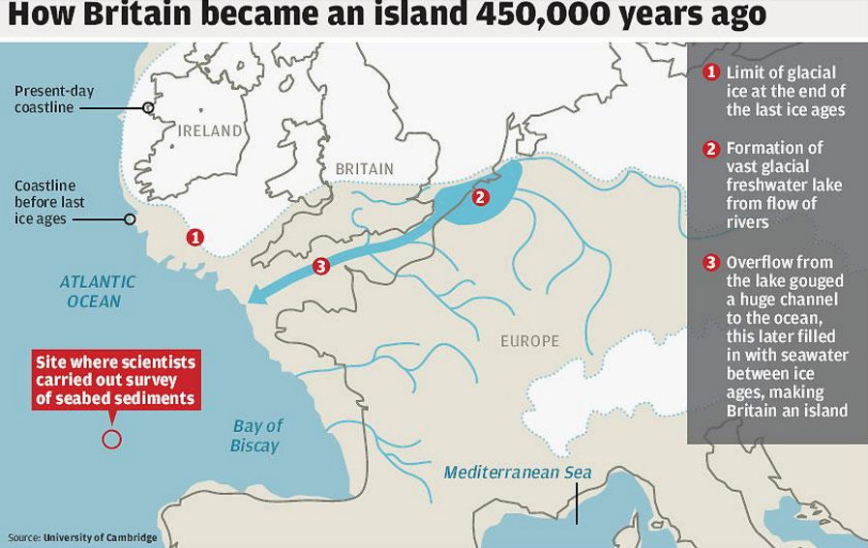
Two rivers – the Avon and Kennet/Thames

Slide 4
Last Glacial Period - 110,000 years ago, Britain was part of mainland Europe

Slide 5
The last glacial period started 110,000 years ago. As the glacial period drew to a close and temperatures began to rise, there were two final cold snaps.
First, the chilly "Older Dryas" of 14,700 to 13,400 years ago transformed most of Europe from forest to tundra, like modern-day Siberia.
After a brief respite, the Younger Dryas, between 12,800 to 11,500 years ago, froze Europe solid within a matter of months.
(Warming points 15000, 13000 and from 11500 years ago to the present day)

Slide 6
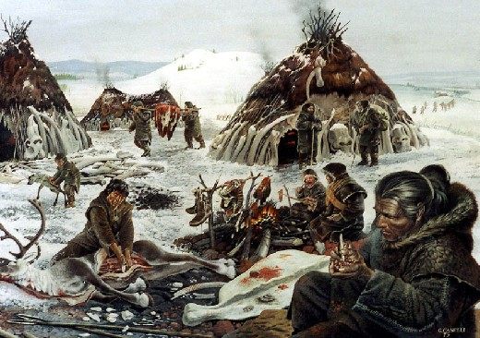
Thatcham Inhabited/Visited for 13,000 years Nomadic lifestyle
Hand Axe

Slide 7
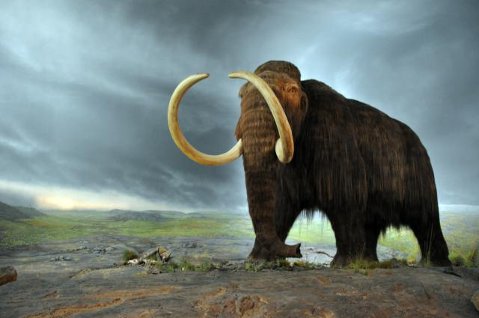
Woolly Mammoth

Slide 8
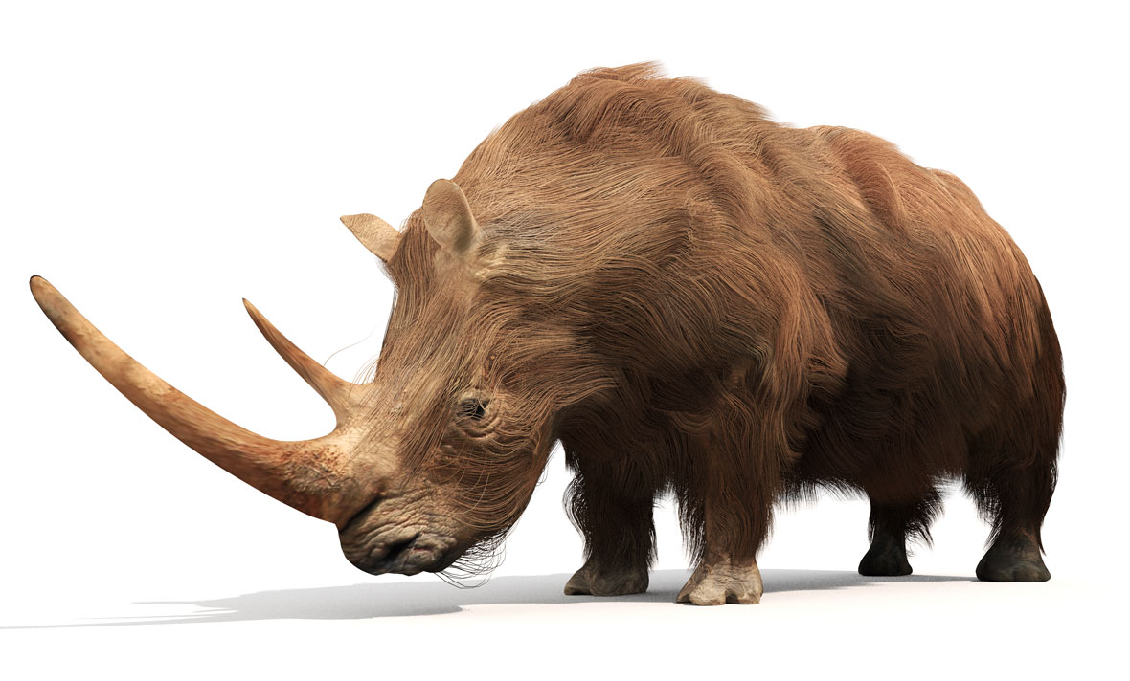
Woolly Rhino

Slide 10
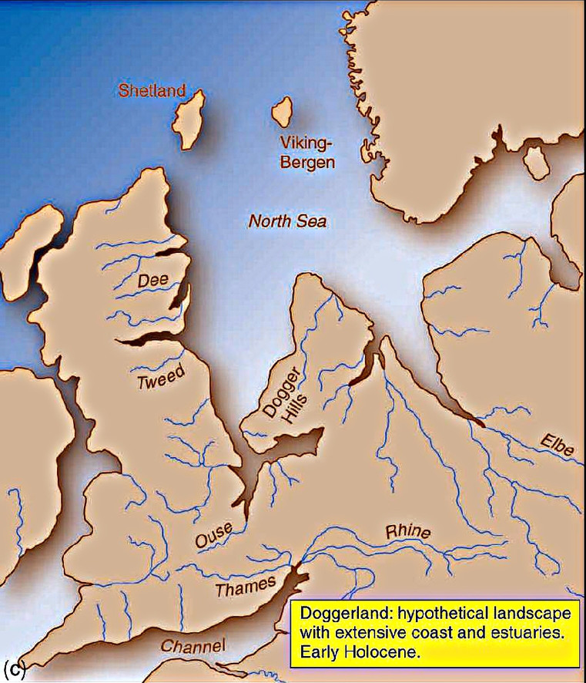
Between 11,500 and 11000 years ago, the ice melted and sea levels rose.
The Thames was a landmark for visitors, a route guide.

Slide 11
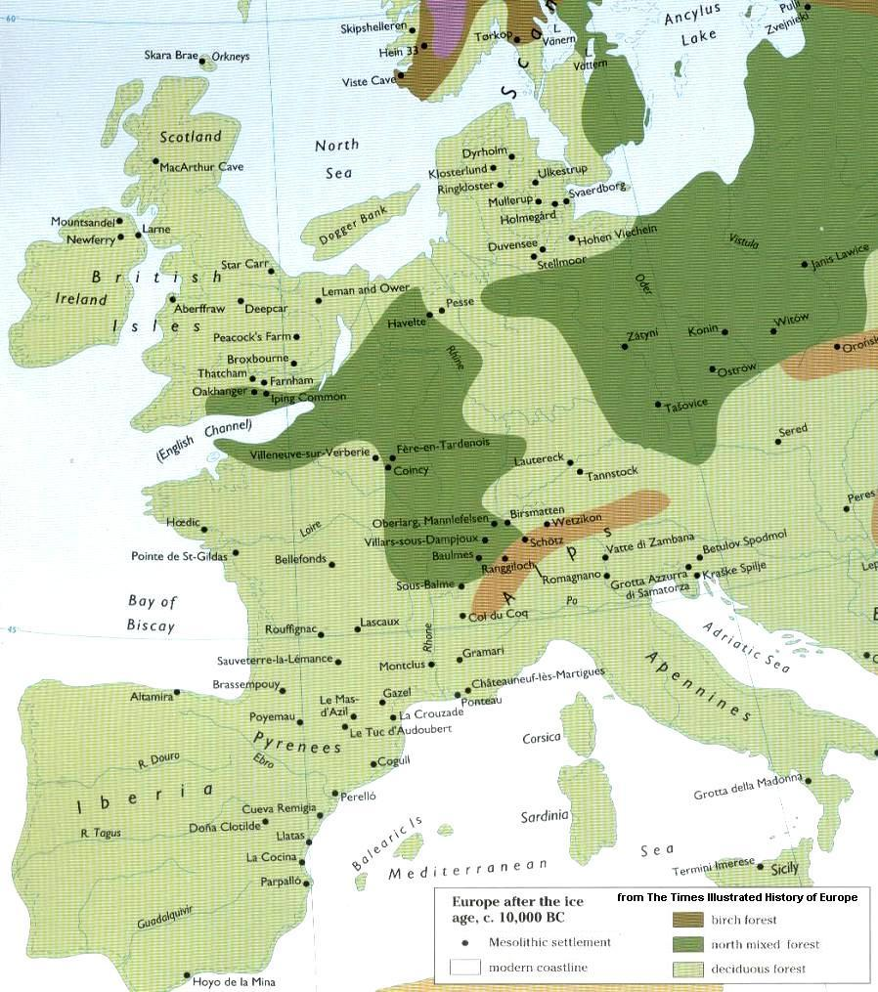
Extent of ancient forest in Southern Britain

Slide 12
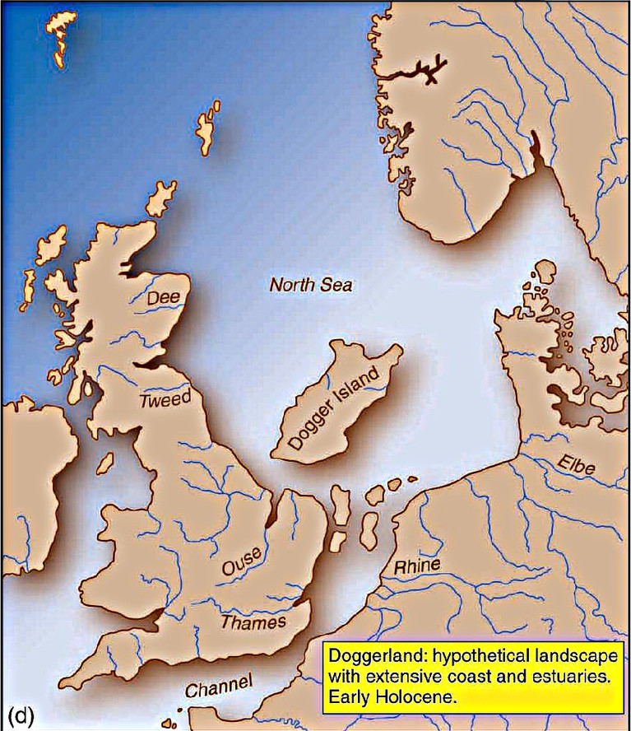
A land slide off the Norwegian coast produced a massive tsunami that washed away the land joining Britain to continental Europe.

Slide 13
A small number of people (1100 – 1200) became trapped on this island – and they were Britain’s first settlers, Britain’s first communities.

Slide 14
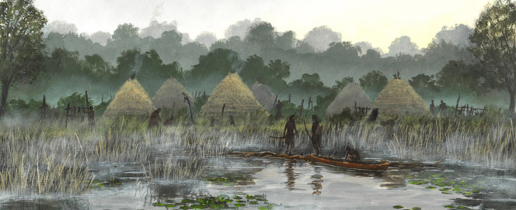
Thatcham - Continuous Settlement for the last 9700 years

Slide 15
Britain's oldest settlement is Amesbury not Thatcham, say scientists
A Wiltshire town has been confirmed as the longest continuous settlement in the United Kingdom.
Amesbury area has been continually occupied for 10,820 years.
The news was confirmed following an archaeological dig which also unearthed evidence of frogs' legs being eaten in Britain 8,000 years before France.

Slide 16
Settlements -
One on the Kennet and One on the Avon.
These early settlers had to stay in groups in order to survive.

Slide 17
The surroundings were hostile. Humans were just as much food for animals as animals are food for humans

Slide 18
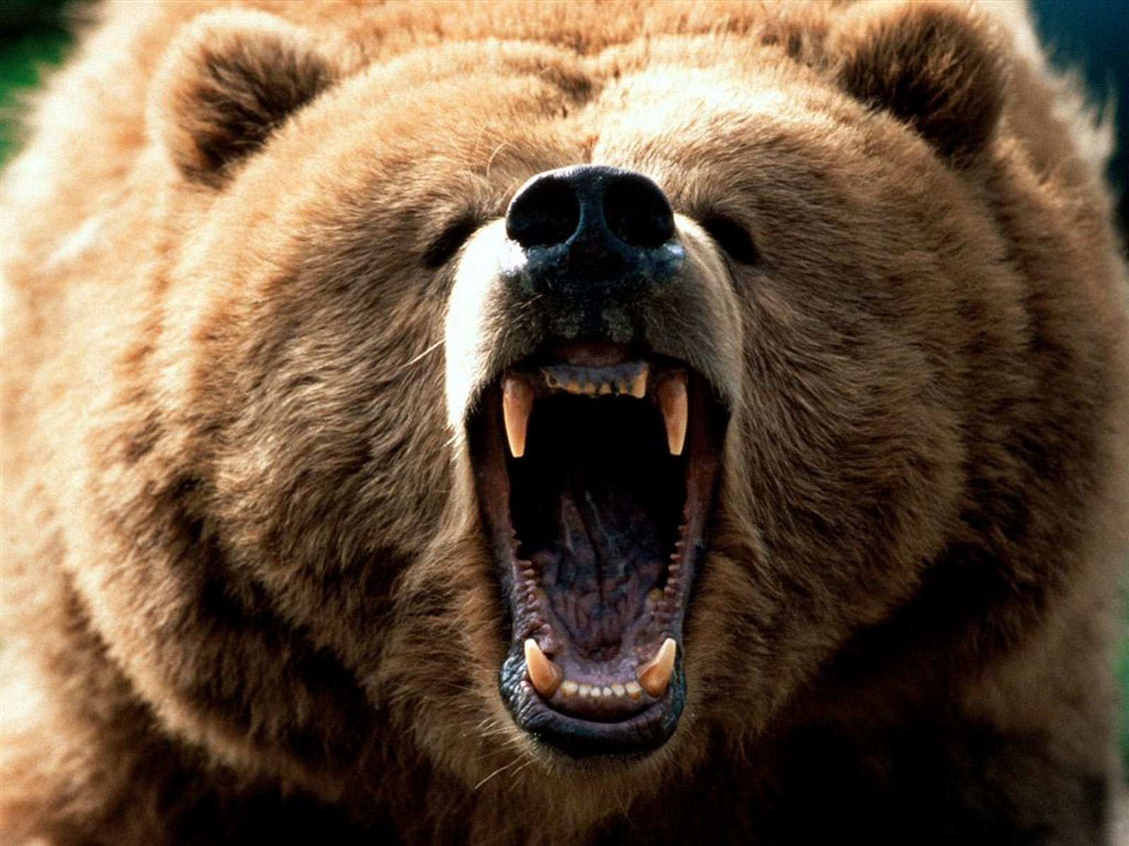
Eurasian Brown Bear

Slide 19
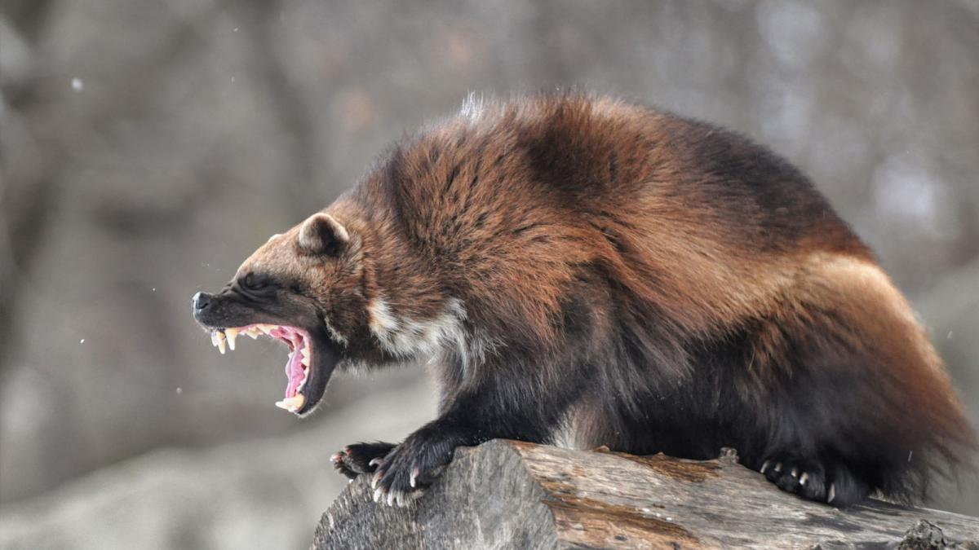
Wolverine

Slide 20
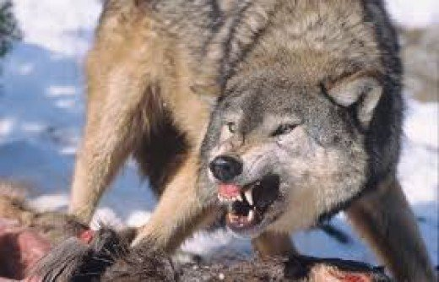
Grey Wolf

Slide 21
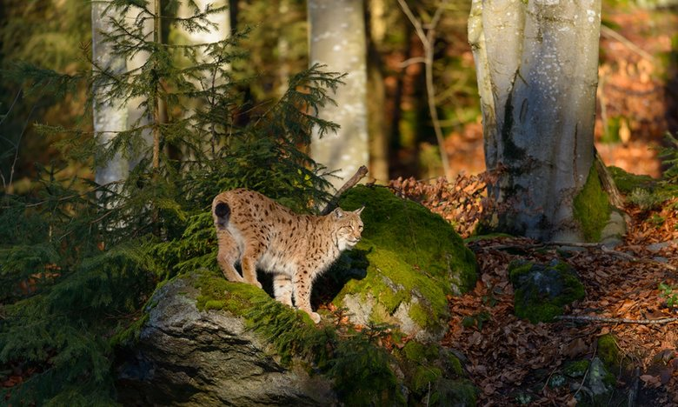
Eurasian Lynx

Slide 22
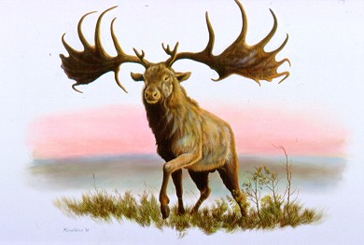
Irish Elk

Slide 23
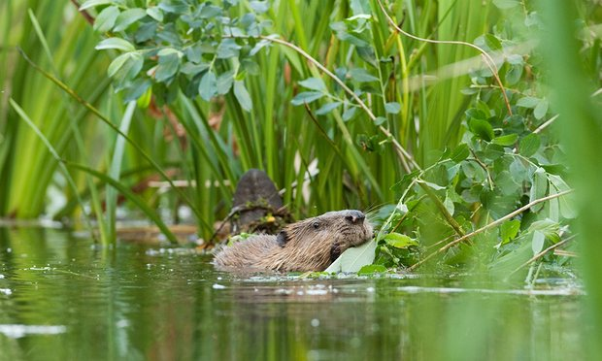
Eurasian Beaver – landscape transformers. Blocking the upper reaches of rivers with dams to create boggy wetlands.

Slide 24
Amesbury to Thatcham via Inkpen
Amesbury (on Avon) and Thatcham (on Kennet) - Connected by water and a hill top ridge.

Slide 25
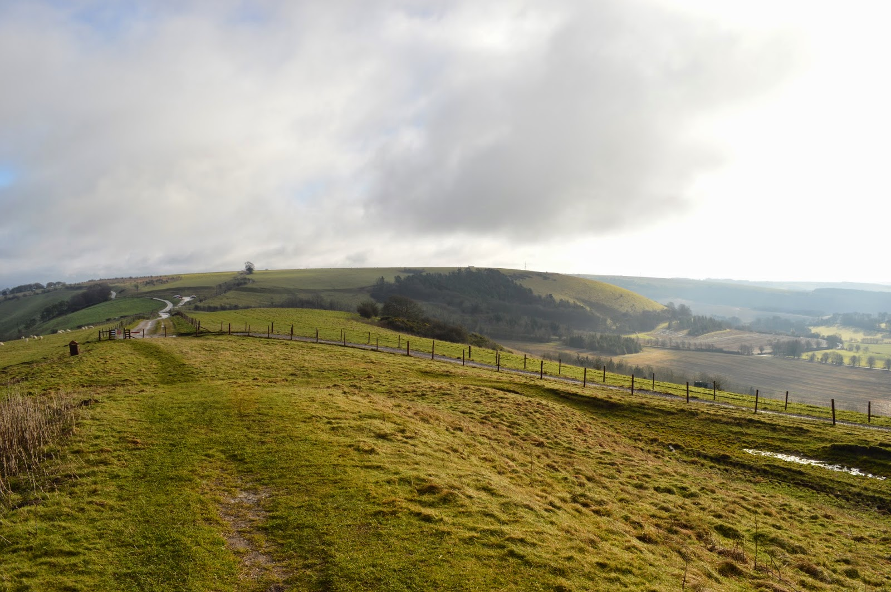
Inkpen, a strategic point on the hill-top motorway.

Slide 26
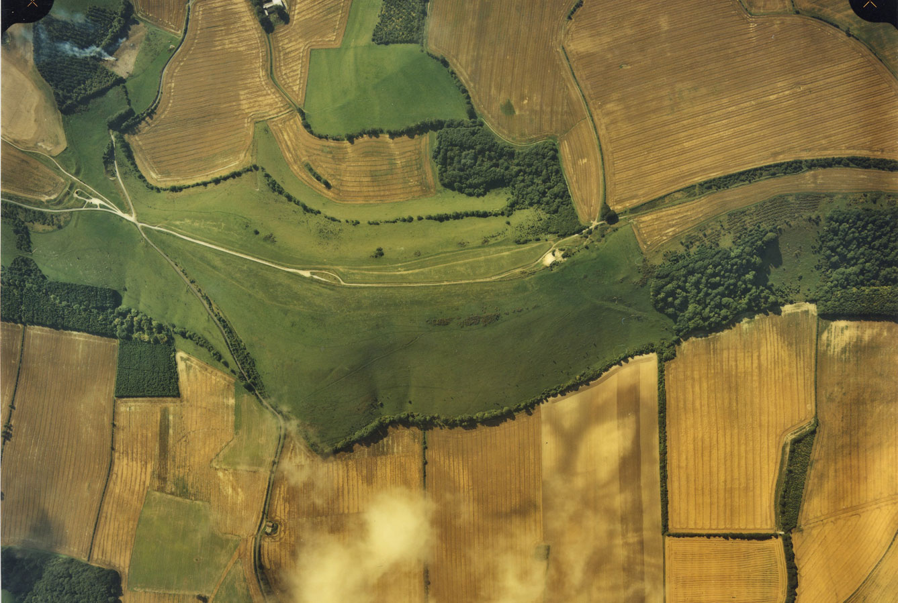
Motel Inkpen

Slide 27
Inkpen Hill is a secure & sustainable location:
Water close by,
Wood for fuel,
Wood & local Clay for pots,
Flint for tools,
Animals, berries and nuts for food,
Animal skins for clothing.

Slide 28
Descending from the hill-top, aiming for Thatcham via where the Crown and Garter is now, and on to Folly Road.

Slide 29
Descending from the hill-top, aiming for Thatcham via where the Crown and Garter is now, and on to Folly Road.

Slide 30
Folly Road – water sources in the direction of Thatcham

Slide 31
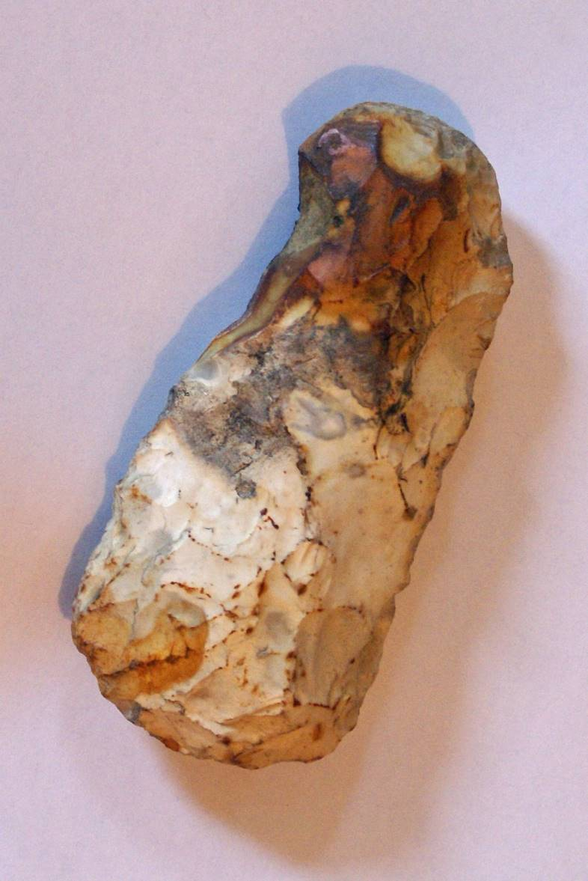
Oldest human artefacts found in Inkpen are Mesolithic and dated at between 50,000 to 5000 BC.
Artefacts include flint cutters and scrapers.
Items found between what is now the Crown & Garter and Folly Road (all to the East of Inkpen)

Slide 32
Mesolithic Scraper tool

Slide 33
Inkpen Long Barrow c 3500 BC Early Neolithic - a structure of permanence

Slide 35
Inkpen Long Barrow (followed by round barrows)

Slide 36
Neolithic and Bronze Age artefacts found between Inkpen Long Barrow and the end of Craven Road, leading to the brook at the end of Craven Road, an important source of water.

Slide 37
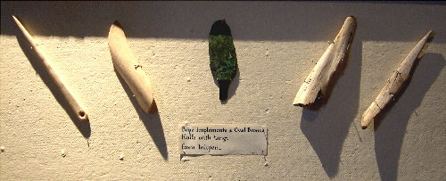
Bronze Age Inkpen (2500 – 800 BC)

Slide 38
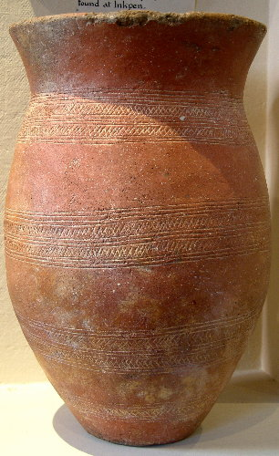
Inkpen Beaker People Pots

Slide 39
Middle Rhine Beakers

Slide 40
Beaker People Crafts

Slide 41
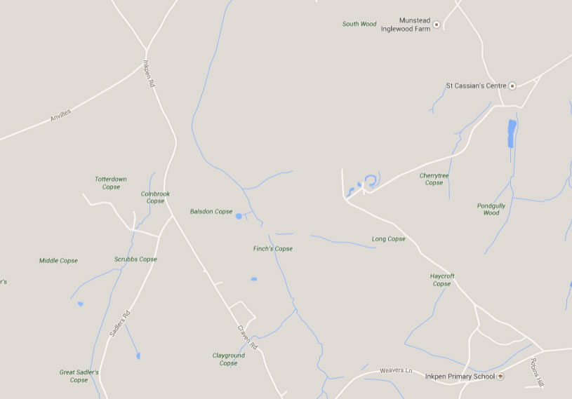
Craven Road – water sources in the direction of Avebury

Slide 42
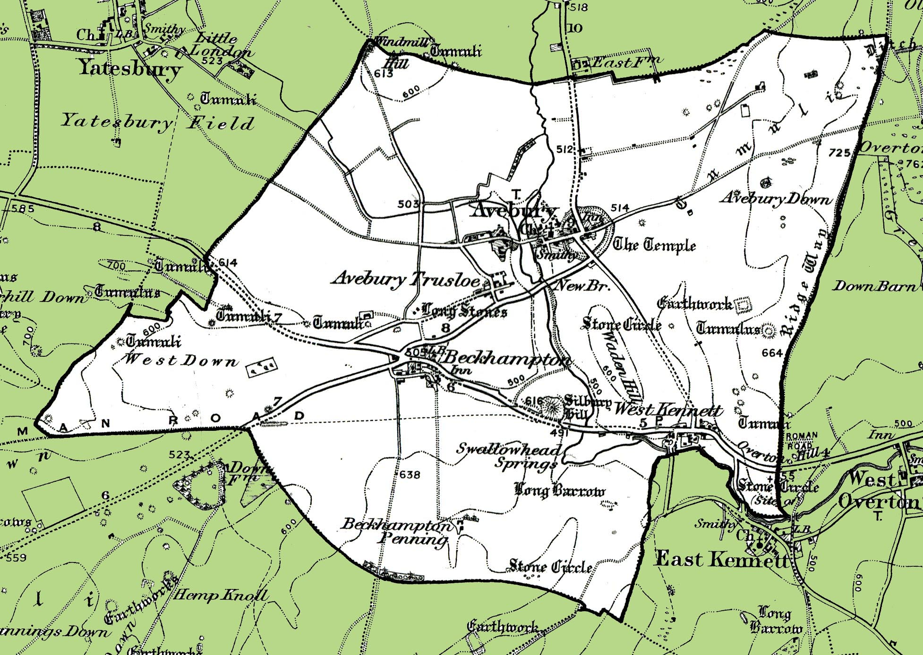

Slide 43
West Kennet Long Barrow - Built in around 3650 BC

Slide 44
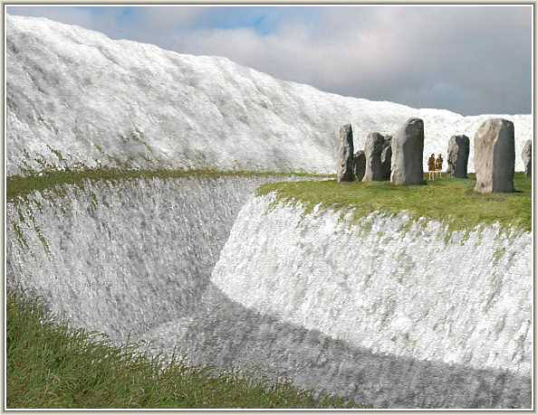
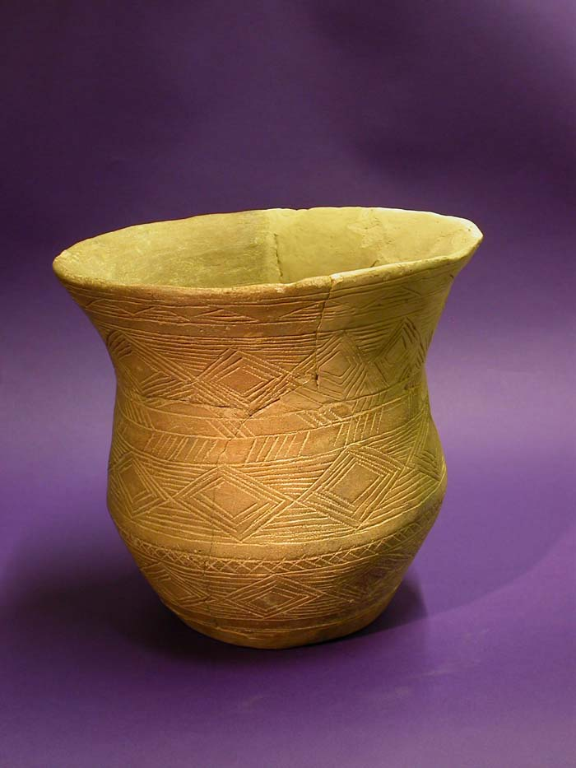
Avebury Ring c 2850-2200 BC Connected to Thatcham by water and hill top ridge

Slide 45
Silbury Hill – completed ~ 2400BC approx. location of the source of the R. Kennet

Slide 46
River, Spring, Monument
Kennet, Swallowhead, Avebury
Avon, Blick Mead, Stonehenge

Slide 47
Navigating without maps requires a knowledge of landmarks and directions, high points and rivers.

Slide 48
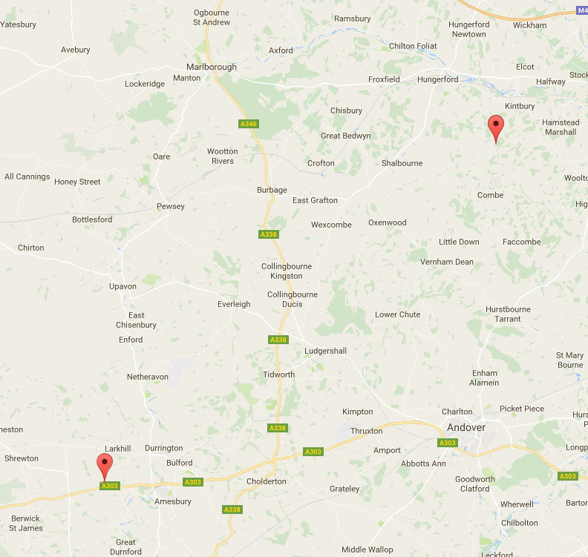
Blick Mead /Stonehenge, Avebury, and Walbury Hill

Slide 49
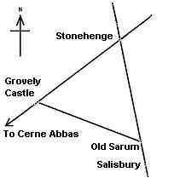
Sir Norman Lockyer, the Astronomer Royal, noticed that the Stonehenge-Grovely castle alignment extends to the North-East beyond St Peters mound, Inkpen beacon, and the Neolithic 'Winterbourne camp'. To the South-West the line continues past Grovely Castle, Castle ditches and the 'Cerne-Abbas' giant to Puncknowle beacon on the South coast.

Slide 50
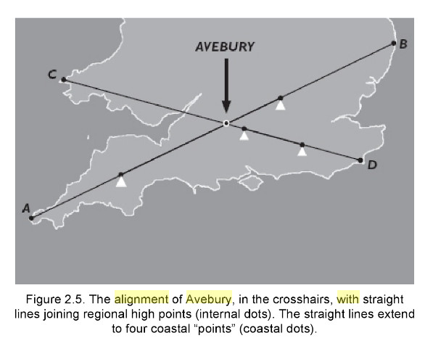

Slide 51
Iron Age
(800 BC – 43 AD)

Slide 52
Walbury - Iron age Hill Fort. 82 acres. Built ~725BC – in use for ~1700 years

Slide 54
Iron Age tools

Slide 55
Iron Age cooking jug

Slide 56
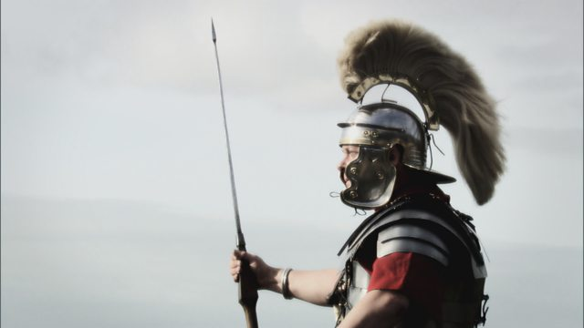
The Romans
(43 – 410 AD)

Slide 57
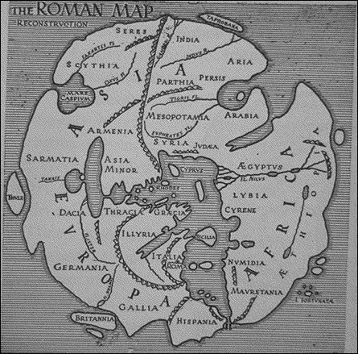
Map c AD 20
Not surpassed for almost 1400 years.

Slide 58
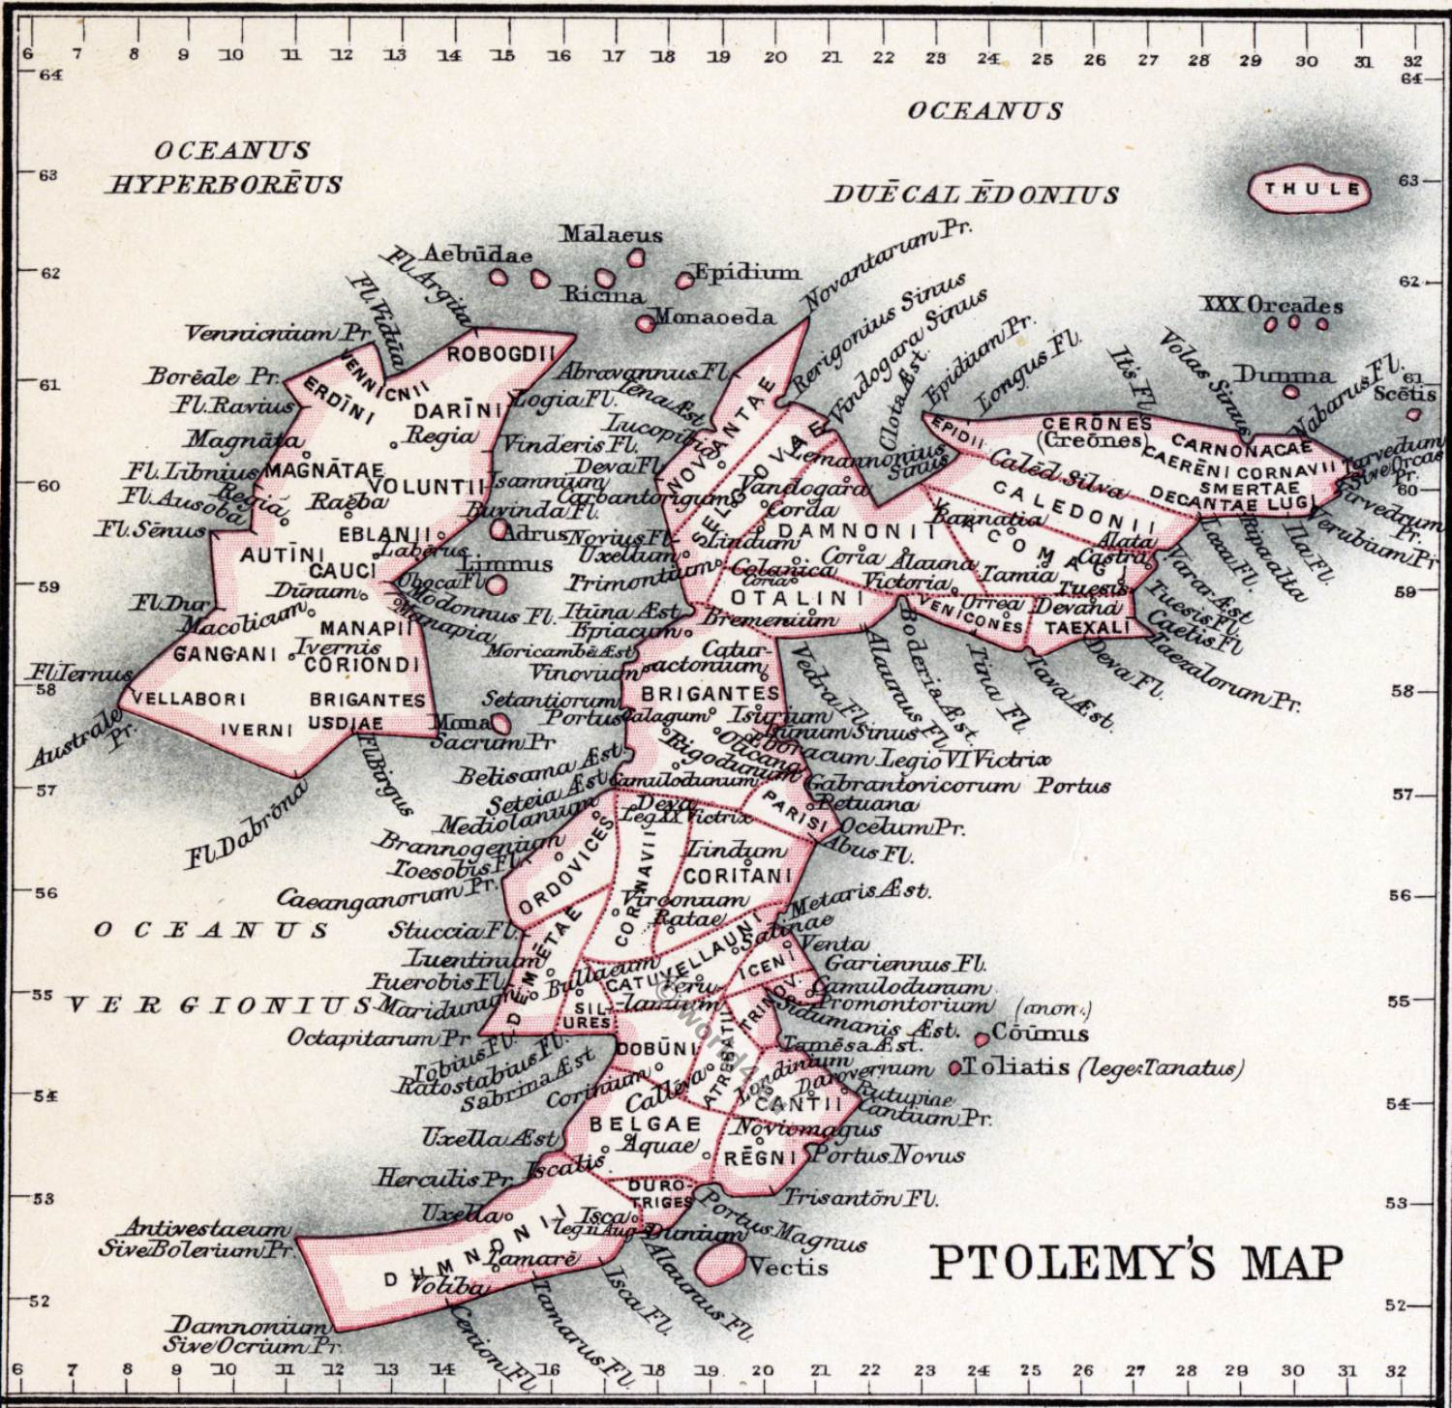
Ptolemy Map
c 150 AD

Slide 59
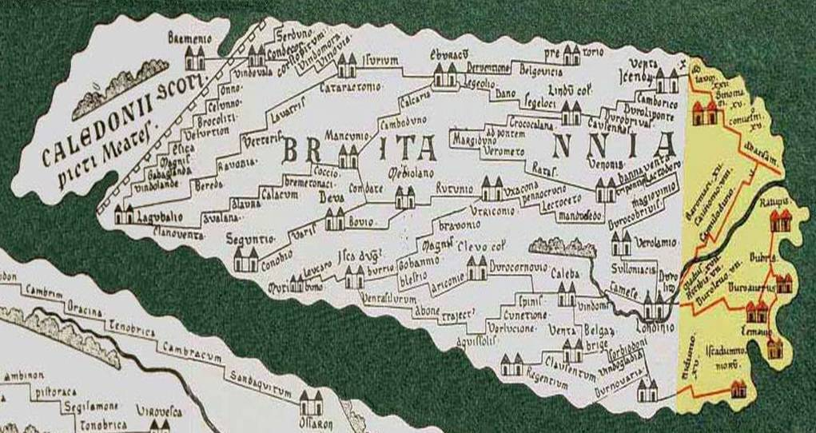
Roman Marching Map

Slide 60
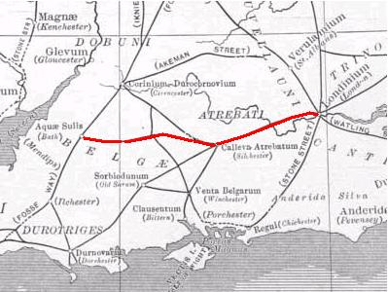
Roman Berkshire
Roman Berkshire was as varied as today’s, populated by towns, villages, hamlets, isolated farms both big and small, small industrial sites, religious areas, all linked by a network of major and minor roads, paths and rivers. Enbourne and the River Kennet were important parts of this network.

Slide 61
Roman Road from Silchester (Calleva) (nr Tadley) to Bath (Aquae Sulis) and on to Avonmouth, via Enbourne, Kintbury, Denford and Silbury Hill.

Slide 62
Kintbury River Fort
Just west of the village, an interesting 4th century Roman bathhouse has been discovered. Roman bathing was a lengthy process taking the bather through several sauna rooms of differing temperatures. The Kintbury building consisted of a large hypocaust heated tepidarium or warm room with two smaller annexes: an unheated frigidarium (cold room) which may have held a swimming pool-like tank for plunging and the typical apsidal caldarium or hot room. An attached villa complex may lie undiscovered nearby.
The name comes from Saxon Kennet-Byrig meaning ‘Fort on the River Kennet’. “Kennet” of Celtic origin.

Slide 63
Anglo-Saxon

Slide 64
Angle, member of a Germanic people, which, together with the Jutes, Saxons, and probably the Frisians, invaded the island of Britain in the 5th century ce. The Angles gave their name to England, as well as to the word Englisc, used even by Saxon writers to denote their vernacular tongue.

Slide 65
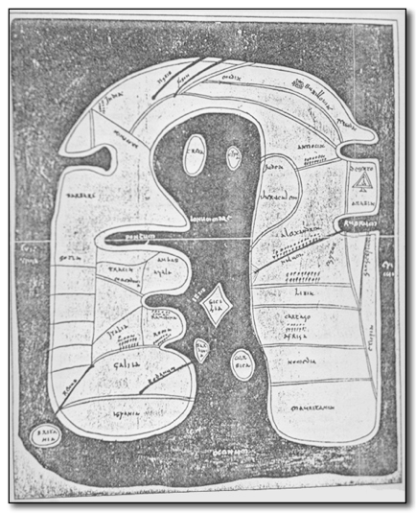
Merovingian map
c 730AD

Slide 66
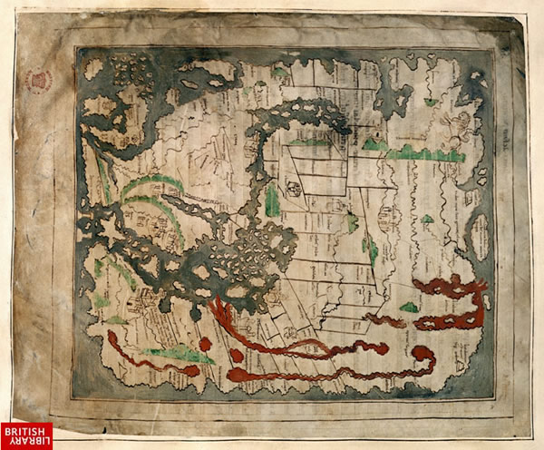
Anglo-Saxon Mappa Mundi
1025 to 1050

Slide 67
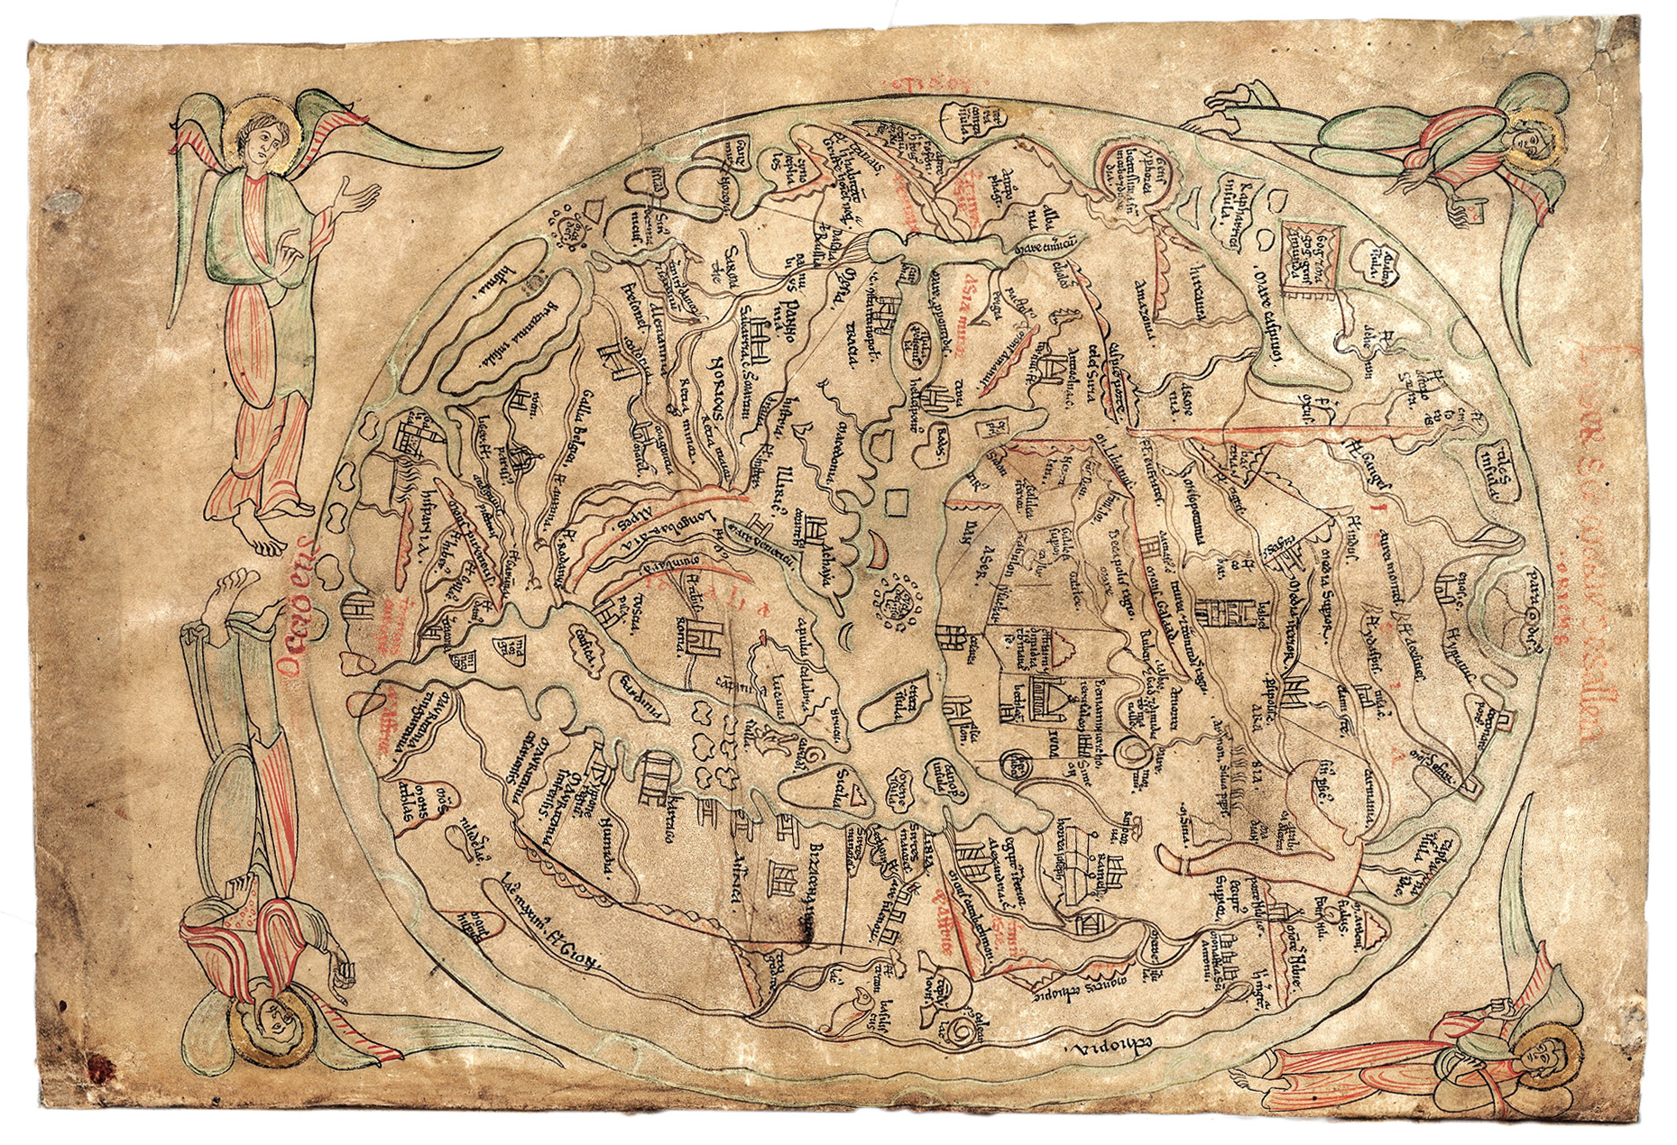
The Sawley map
1190-1210

Slide 68
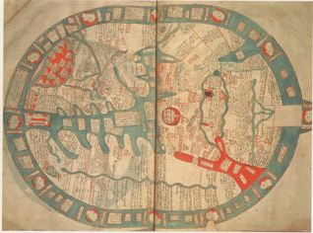
The Vercelli Map
c 1219

Slide 69
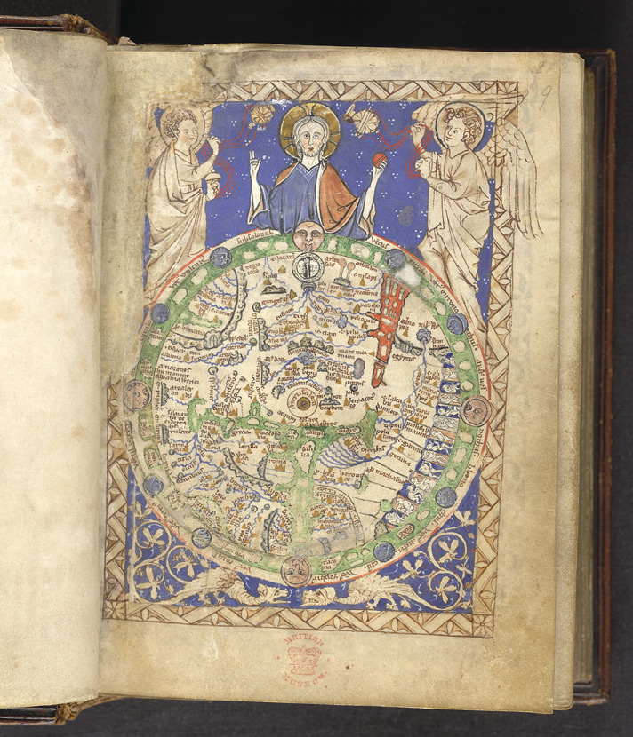
The Psalter map
c 1260

Slide 70
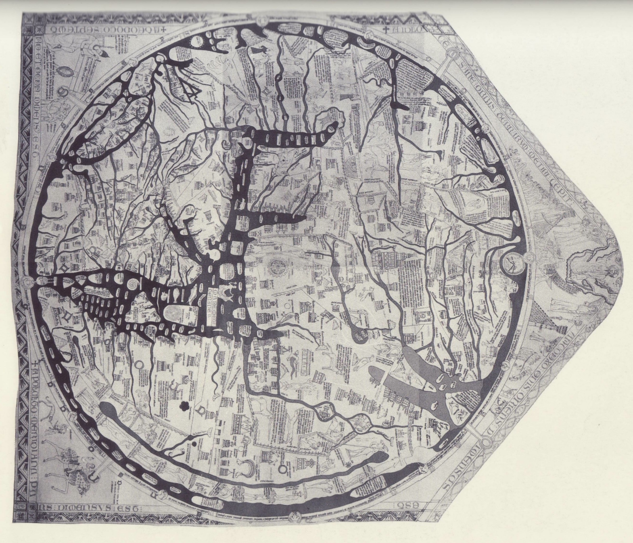
The Hereford Map
c1300

Slide 71
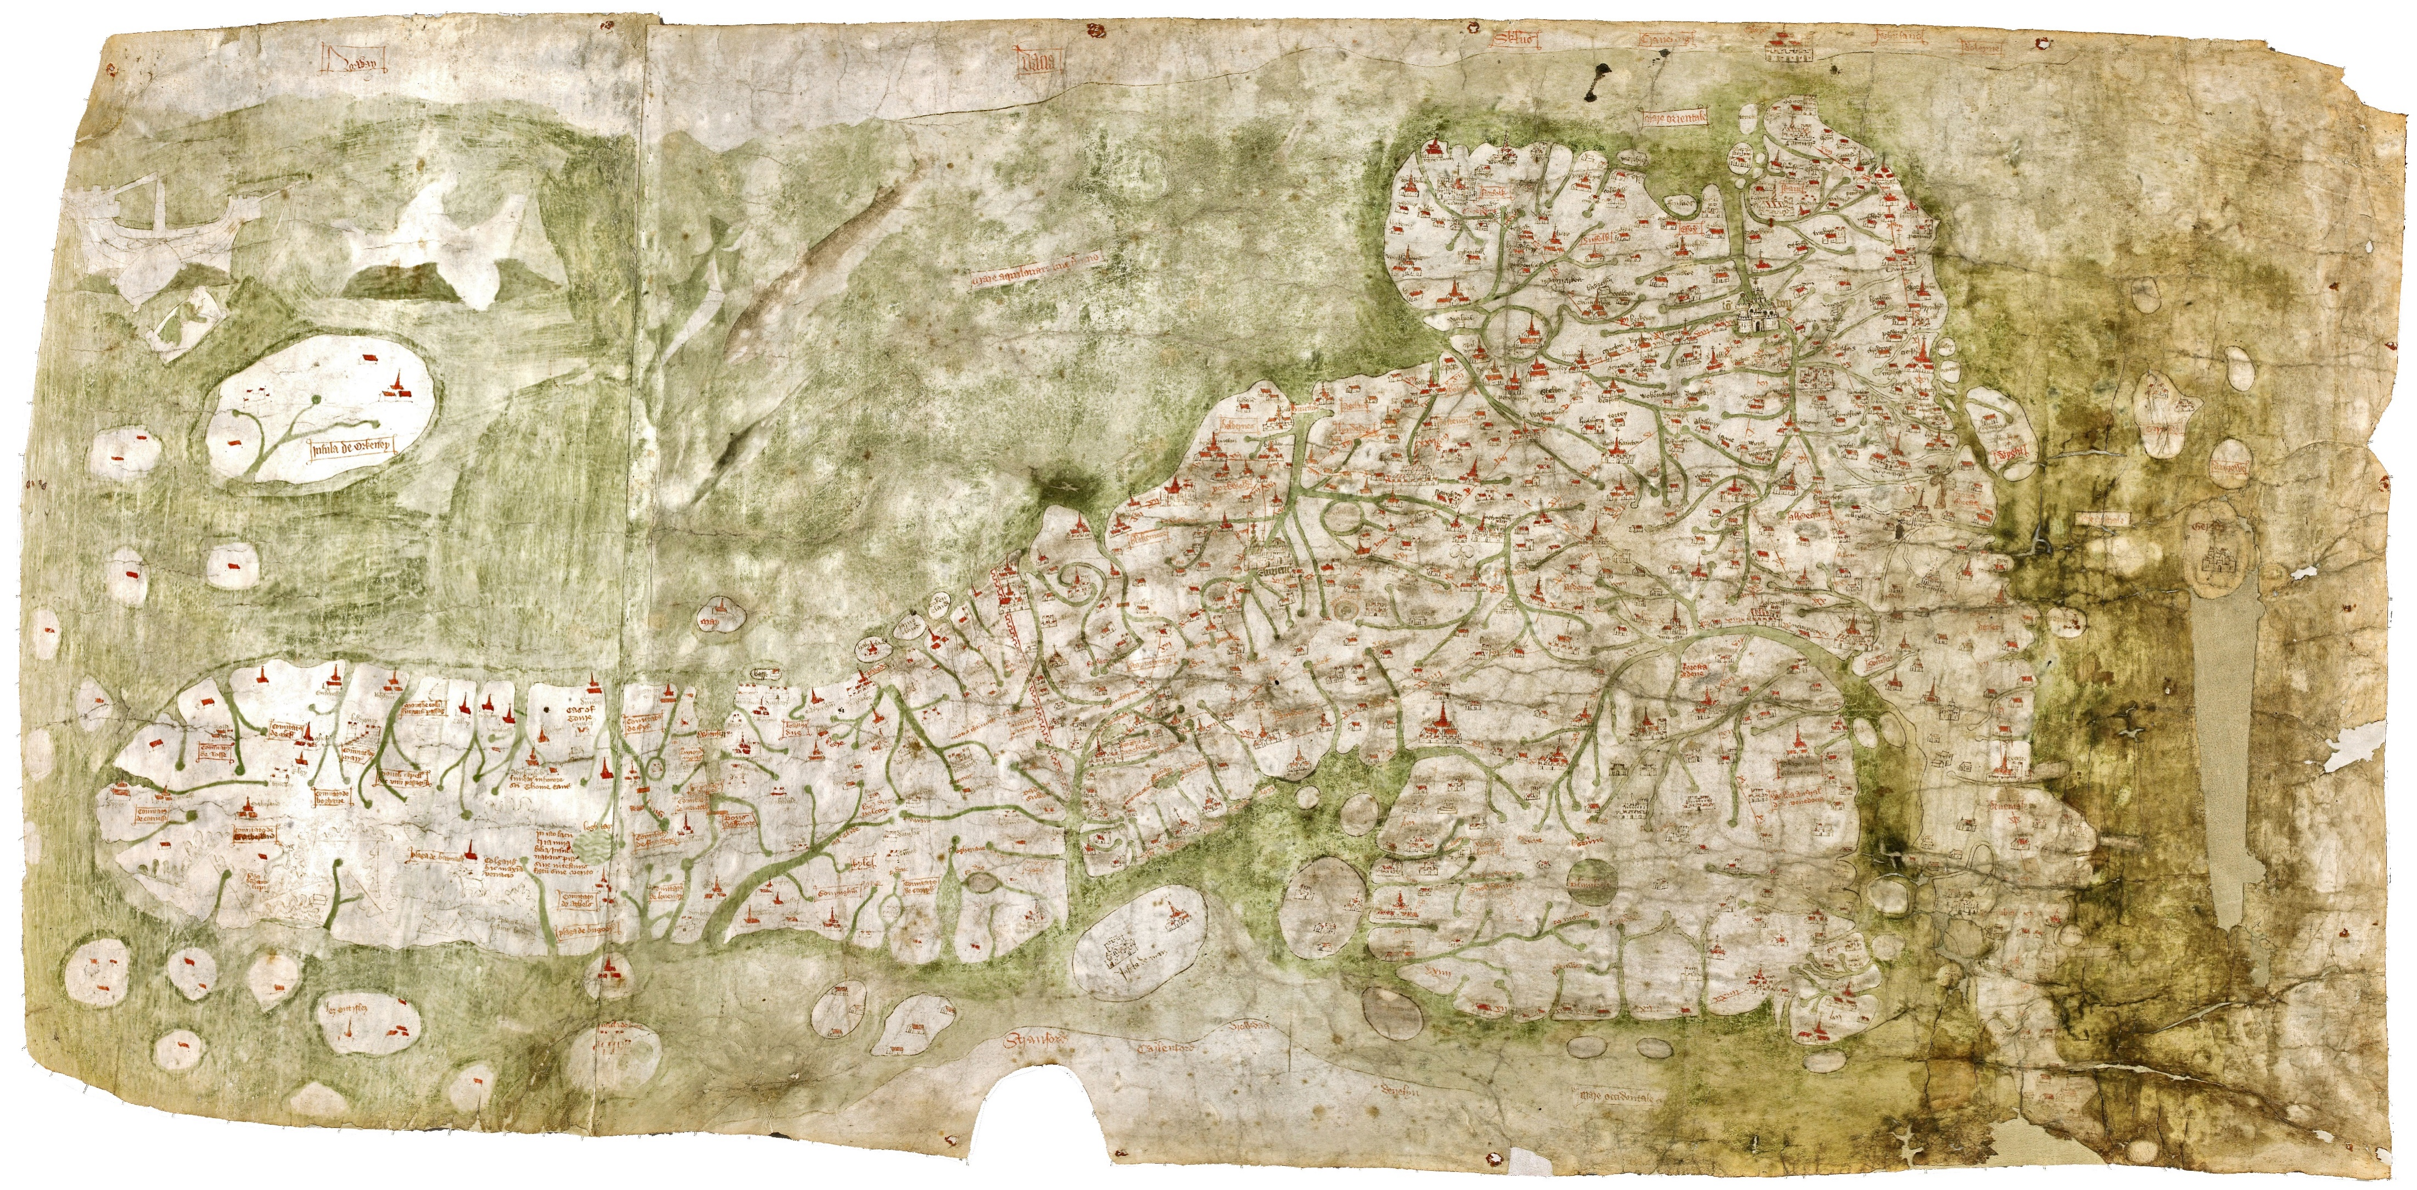
The Gough Map
1370 - 1430

Slide 72
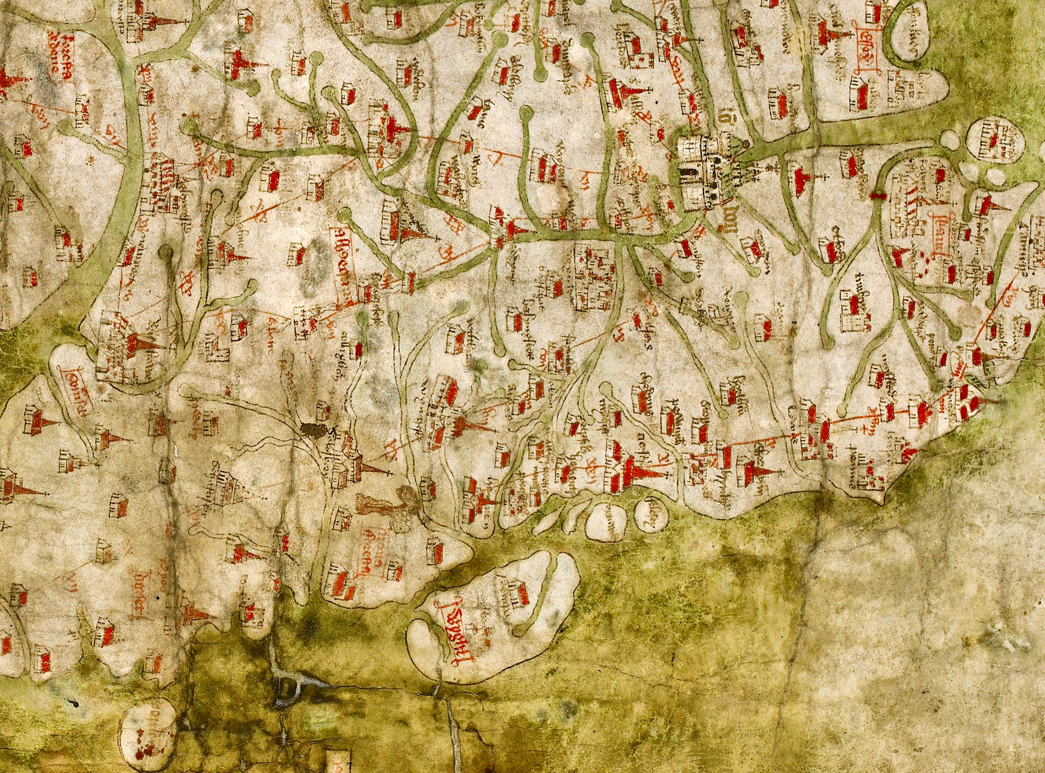

Slide 73
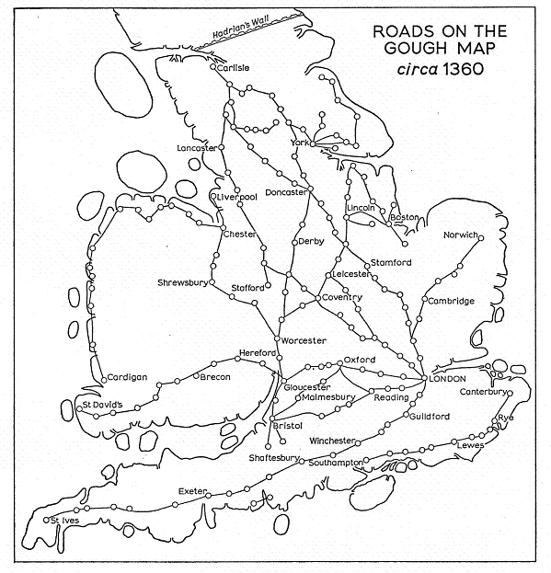

Slide 74
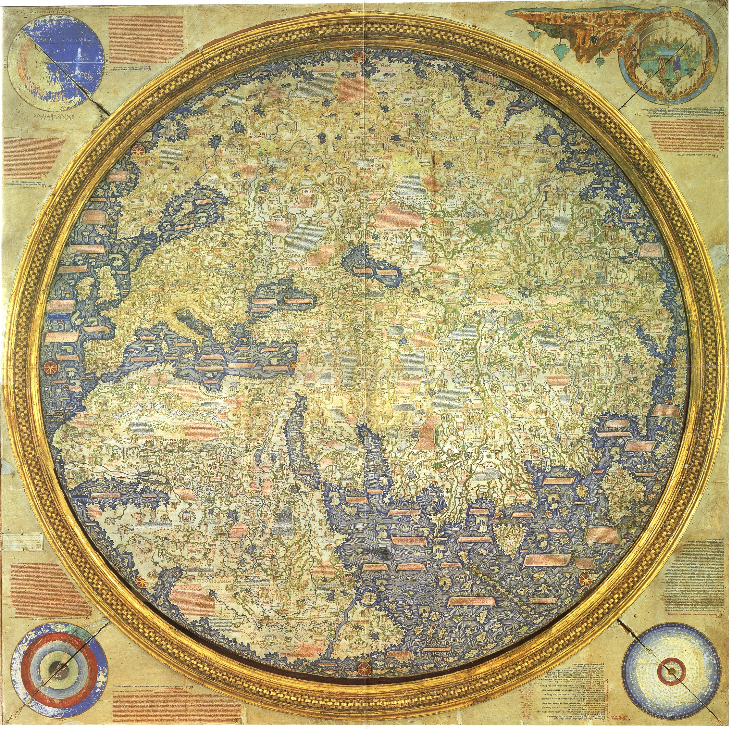
The Fra Mauro map
1459–60

Slide 75
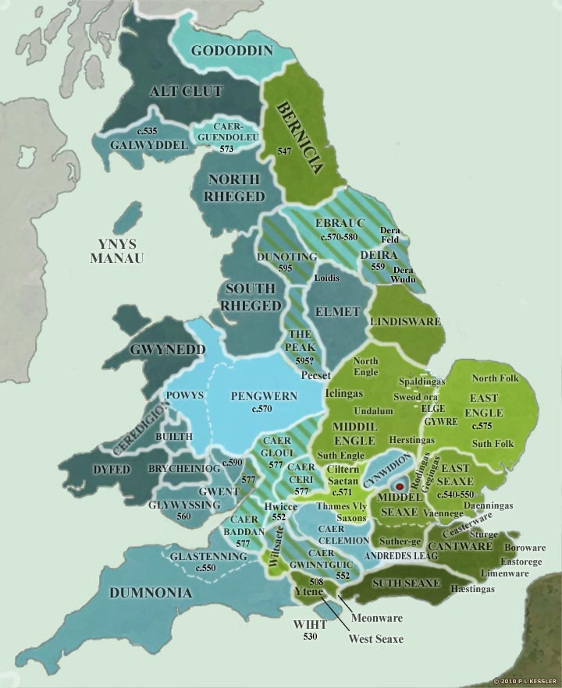
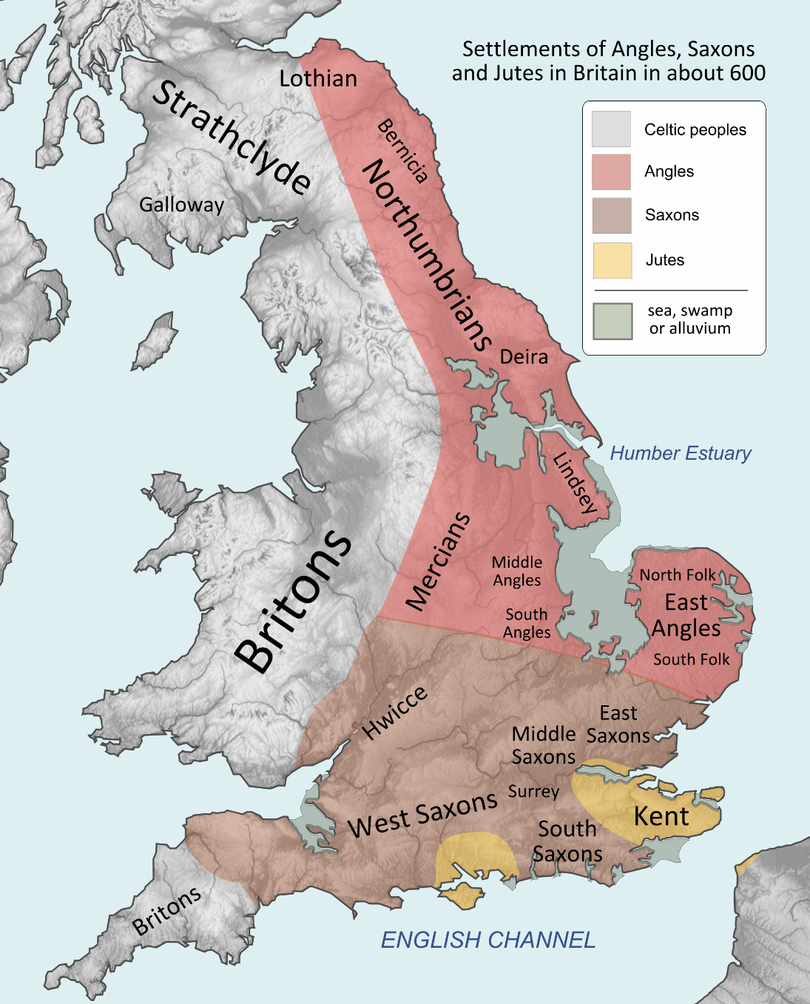

Slide 77
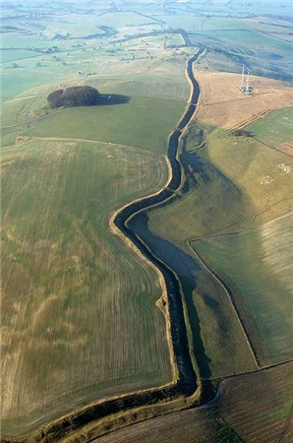
Wansdyke - follows the old Roman Road

Slide 78
Wansdyke ditch

Slide 79
Wansdyke – the garden fence for Wessex

Slide 80
SCEATTAS FOUND AT THE IRON-AGE HILL FORT OF WALBURY CAMP, BERKSHIRE
Another possibility is that the loss of the coins might be connected with some brief phase of reuse of the hill fort for military purposes in the eighth century. There is a good deal of scattered evidence for the reuse of various hill forts in the time of Offa,4 and Walbury is an obvious stronghold in the area contested between Wessex and Mercia at the date to which the coins belong. Stenton wrote that in 735, the traditional date of St. Frideswide's death [and very close to the date of both the recent sceatta finds],
…the land on each side of the Thames at Oxford seems to have been under the direct rule of Ethelbald . . . During the next 100 years every powerful West Saxon king asserted a claim to this territory, but the Mercian kings more than held their ground until their dynasty came to an end, and it was not until the middle of the ninth century that the debateable land was finally divided between them, Berkshire and northern Wiltshire becoming West Saxon, and the plain of central Oxfordshire remaining Mercian.

Slide 81
Sceattas

Slide 82
821 AD – Wessex (West Seaxe) Becomes Supreme Kingdom

Slide 83
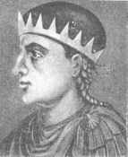
Battle of Ellandum
Ecgbert III, King of Wessex & England from 802 to 839
Born in Aachen

Slide 84
King Æthelred I, King of Wessex from 865-871

Slide 85
Winchester – Capital of England
9th to 12th Century
Although born at Wantage in Berkshire, Winchester’s most famous son is Alfred ‘The Great’. Alfred (Aelfred) became ruler of the west Saxons after he and his brother defeated the Danish Vikings at the Battle of Ashdown. In 871 at the tender age of 21, Alfred was crowned King of Wessex and established Winchester as his capital.

Slide 86
931 AD
Interestingly, there is a place-name reference, in a charter of King Athelstan from 931 AD, to a site on the Wiltshire-Hampshire border by Inkpen Beacon, just east of the ancient Wansdyke. It is called Beow, and nearby is a pool called Grendel's Mere.
The Grendel is a gigantic being usually depicted as a monster. Grendel is one of the three main antagonists of the Anglo-Saxon epic poem Beowulf.
After Grendel is killed and Grendel's mother attacks Heorot in revenge, Beowulf ventures into her lake-based home. When Grendel's mother senses his presence, she immediately attacks Beowulf and drags him into her home. They then engage in fierce combat. Grendel's mother nearly defeats Beowulf until he sees a sword in the "mere." He uses the sword to kill Grendel's mother and to behead the corpse of Grendel.

Slide 87
One night a dreadful creature known as a Grendel came to the Hall of King Hrothgar and ate one of his sleeping warriors. Although invulnerable to weapons, Grendel was seized by a visiting warrior by the name of Beowulf. The grim and greedy, brutally cruel Grendal was held in a powerful grip, from which it could only break away by losing an arm. Mortally wounded, the water monster fled to its home, deep in a nearby lake, and bled to death.

Slide 88
Wulfgar of Inkpen

Slide 89
The gift of Inkpen to Wulfgar by Athelstan was seen as a very prestigious gift, indicating Inkpen’s importance to the Saxons.

Slide 90
Wulfgar’s Will - helped lay the foundations for the crusades.
This will was in the reign of AEthelstan 924-939. Wulfgar wishes "the land at Inche penne" to be divided on his death, with three quarters going to his wife AEffe, the other quarter going to "the servants of God" at his holy place, Kintbury (spelt Cynetanbyrig in the 10th century). Wulfgar adds to "the land at inche penne" the words, "which I had from Wulfric, who had it from Wulfrere who first owned it". Wulfric was Wulfgar's father and Wulfrere, his grandfather.
Following AEffe's death, her share was also to go to the holy place at Kintbury, "for the souls of Wulfgar, Wulfric and Wulfrere".

Slide 91
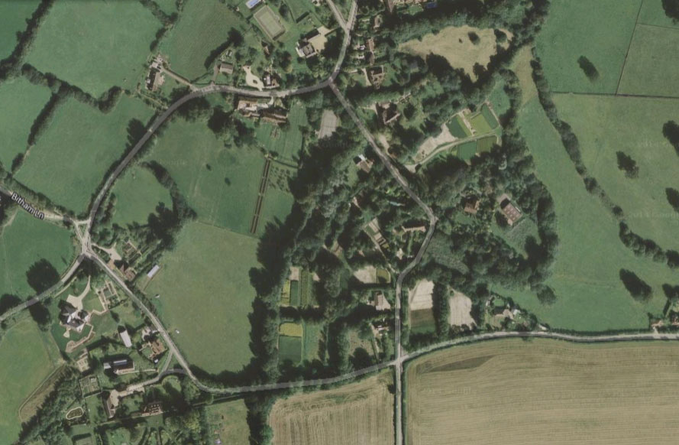

Slide 92
Savernake
Savernake is a surviving remnant of one of Wiltshire's ancient 'Royal Forests' much beloved by Norman kings. The earliest mention of the forest is recorded as far back as 934 AD, when King Athelstan refers to 'the crofts alongside the woodland called Safernoc'. The forest was certainly a remnant of the primeval forest belt, which had been partially cleared by the Romans and Saxons. In 1066 with the Norman invasion, and Savernake became the Royal property of William the Conqueror.

Slide 94
Normans (Normands)

Slide 95
Domesday Record – Place: Inkpen
Hundred: Kintbury
County: Berkshire
Total population: 45 households (very large).
Total tax assessed: 5 exemption units (quite large).
Taxable units: Taxable value 5 exemption units. Taxed on 2.5.
Value: Value to lord in 1066 £14. Value to lord in 1086 £12. Value to lord c. 1070 £12.
Households: 10 villagers. 15 smallholders. 20 slaves.
Ploughland: 4 lord's plough teams. 7 men's plough teams.
Other resources: Meadow 16 acres. 1 mill, value 0.62.
Lord in 1066: free men, two.
Overlord in 1066: King Edward.
Lord in 1086: William son of Ansculf.
Tenant-in-chief in 1086: William son of Ansculf.

Slide 96
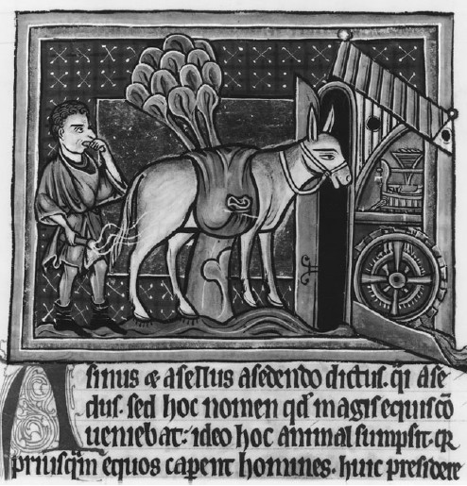

Slide 97
Village Centre In 1176, the manor at Inkpen was known as WESTCOURT

Slide 99
Domesday Book, 1086
Description
Place name: | Inkpen, Berkshire
Folio: | 63v Great Domesday Book
Domesday place name: | Hingepene/Ingepene
People mentioned: | Aelfgifu; Aelfric; Aelfric, free man; Alsige of Faringdon; Alvred; Alweald the chamberlain; Alweard; Alweard the goldsmith; Alwig; Alwig Ceuresbert; Alwine; Alwine son of Cypping; Aubrey the queen's chamberlain; Beorhtric; Berner, nephew of R. de Peronne; Cola; Ealdgifu, free woman; Ealdgyth; Earl Harold; Edith; Edward; Eskil; Father of Alweard the goldsmith; Fulchard; Godebold; Hearding; King Edward as lord; King William as donor; Nigel; Odo of Winchester; Odo, Bishop of Bayeux; Ordmaer; Queen Edith; Queen Matilda; Ralph de Feugeres; Robert fitzRolf; Saewine, free man; Stephen fitzErhard; Tovi; Wigar; Wulfwynn

Slide 100
1190 - Segment from Domesday Book
Detail of a charter of Gervaise Payne to the nuns of Nuneaton, late 12th century. The property in question in this private charter above is described only as molendinum meum de Ingepenna cum prato et crofto, my mill at Inkpen with its meadows and crofts. The parties to the agreement were expected to know which ones.

Slide 101
22 GGF
Possibly Humphrey de Inkpen, who paid a mark for unjust disseising in Berkshire in 1176, was owner of the manor at Inkpen afterwards known as WESTCOURT. Gervase the son of Nicholas de Inkpen was holding land here in 1234, and he was succeeded by his son Nicholas a few years later. Nicholas was living in 1250, when he witnessed the grants to the abbey of Titchfield by Peter Sukemund and Geoffrey Mansell, but he appears to have died soon afterwards, and was succeeded by Richard de Inkpen. Richard was succeeded by his son Sir Roger, who was holding this manor in 1263 and 1273, and settled certain lands here in 1281 on himself and his wife Emeline. He was Sheriff of Cornwall in 1285 and 1286, and at the beginning of the 14th century his possessions were put in exigent until he had accounted for homicides, harbouring of felons and divers other trespasses, but they were restored to him in 1302. He died in 1306, and this manor passed to his widow Emeline.

Slide 102
1303 Pardon, at the request Aymer de Valencia, the king's kinsman, to A Roger de Ingepenne for homicides, robbenes, larcenies, felonies, receiving of felons, ransoms of the same, and all trespasses ; both for the time that he was sheriff of Cornwall and for other times in that county, whereof he was indicted before John de Berewyk and his fellows last in eyre in that county.
On 23 March 1304 there was a meeting between John Blund, then mayor of London, …….….. and Roger de Enkepenne, then mayor of the city of Winchester, and his fellow citizen John de Kyrkeby on behalf of themselves and the community of their city, to negotiate a settlement of disputes that have arisen between them concerning various customs taken at London from Winchester citizens by London bailiffs.

Slide 103
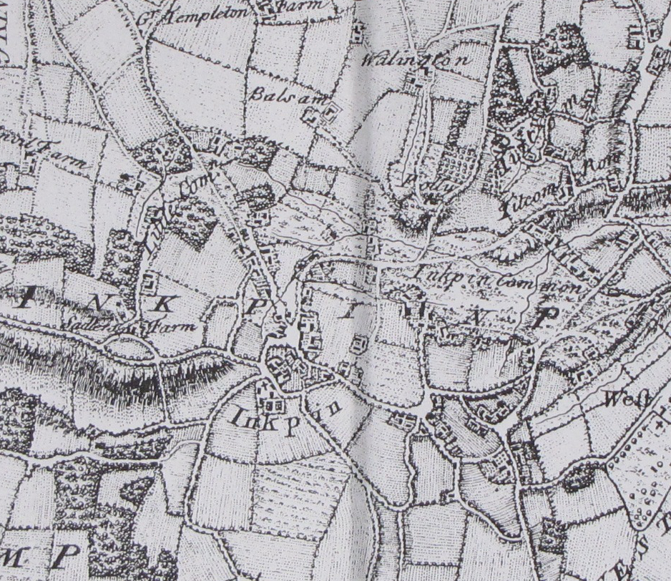

Slide 105
John de Inkepenne
Feb .18. 1354
Edward3 vol10 page0058 - CALENDAR OF PATENT ROLLS.
MEMBRANE 22d. Westminster,
Commission to William de Shareshull, John de Stouford, John de Inkepenne and John Elys to make inquisitions on the oath of good men of New Lemyngton and other parts of the county of Southampton touching an information that John le Wolf of Lemyngton, Luke de Gernesy and others of that county daily buy much wool in those parts and take the same to the nearest port and thence by ship to foreign parts, without the wool being taken to any staple according to the ordinance of the staple, and without payment of the custom and subsidy due to the king, to find of how much custom and subsidy the king has been defrauded in this way, and the names of those buyers and takers of such wool, and to arrest all those found guilty in the premises and imprison them until further order, and to cause such wool to be taken into the king's hands as forfeit.

Slide 106
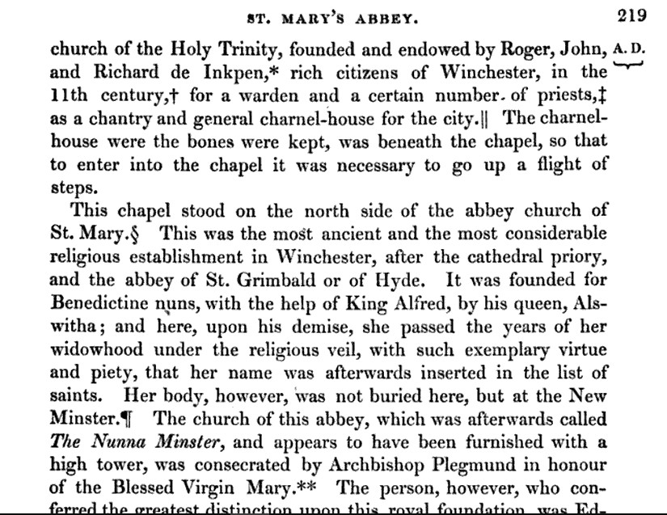

Slide 107
A papal sanction was obtained for Roger de Inkepen, a wealthy and beneficent citizen of Winchester, to found and endow a chapel in the cemetery of Nunnaminster, to be served by two priests, the patronage of which was to belong to him and his heirs. This chapel was dedicated to the Holy Trinity; one of the priests was termed the warden and the other the chaplain; they lived together and had a common table; they were ordered to say daily mattins and evensong in the chapel in addition to the masses.

Slide 109
Inglewood, Godingeflod, Godyngeflod, Goud Ingeflod, Ingeflod Belet, Ingelflod Belet [in Kintbury]
Ingeflod 1147, 14 Sepembre (Angleterre)
Roger donne à l'ordre du Temple sa terre "d'Ingeflod".
1147, et 1148, 14 septembre
Gilbert, comte de Pembroke, confirme la donation d'Ingeflod.

Slide 110
Ingepenne | 935 AD |  | Yngelpenne | 1235
Hingepene | 1086 |  | Ynkepenne | 1241
Ingepenna | 1167 |  | Ingelpenne | 1241
Ingepenn | 1167 |  | Hingepenna | 1242
Ingepenne | 1167 |  | Ingepepenn | 1242
Yngepenn | 1167 |  | Ingelpenn | 1252
Yngepenne | 1167 |  | Enkepenne | 1282
Ynkepenee | 1230 |  | Inckepene | 1292

Slide 112
Winchester’s fortunes however, began to decline during the late 12th and 13th centuries as power and prestige gradually shifted to the new capital in London, including the relocation of the royal mint.

Slide 113
The Crusades

Slide 114
HASLEWICK
HASLEWICK was the eastern portion of the parish and lay around the Upper Green, formerly known as Haslewick Green. Here may have been situated the 2½ hides of land which belonged to Inkpen, held by Ralph de Felgeres in 1086, but nothing has been found to prove that these lands in Haslewick were held by the descendants of Ralph, and in 1309 certain lands there were held of the abbey of Titchfield, presumably as part of the manor of Eastcourt, while the remainder was held of the Knights Templars. Haslewick was held of the Crown and the Abbot of Titchfield in 1357, though the Hospitallers were holding the overlordship of a small parcel of land here in 1382, for which they received 14d. yearly, the rest of Haslewick being held of the king.

Slide 115
Templeton
Roger de Beaumont, Count of Meulan (Roger son of Humphrey), granted 3 hides at Inglewood in this parish to the Knights Templars. This land, afterwards known as the manor of TEMPLETON or Templeyngeflod, formed part of the honour of Leicester and reverted on the dissolution of the order in 1311 to the overlord, though Robert Hungerford and his wife Geva were holding it for life in 1327. These lands were subsequently granted to the Knights Hospitallers, who continued to hold them until the Dissolution, when they passed to the king.

Slide 116
Effigy of Richard de Inkpen
Why do the figures on the crusader´s tombs have crossed legs?
“Sometimes the figure on the tomb of a knight has his legs crossed at the ankles,
this meant that the knight went one crusade. If the legs are crossed at the knees,
he went twice; if at the thighs he went three times. ”

Slide 117
Tomb End Panel

Slide 118
Inkpen is renowned for its wild crocus field, said to have been blooming annually since the time of the Crusades, and to have been associated with the Knights Templar. (part of Haslewick ?)

Slide 119
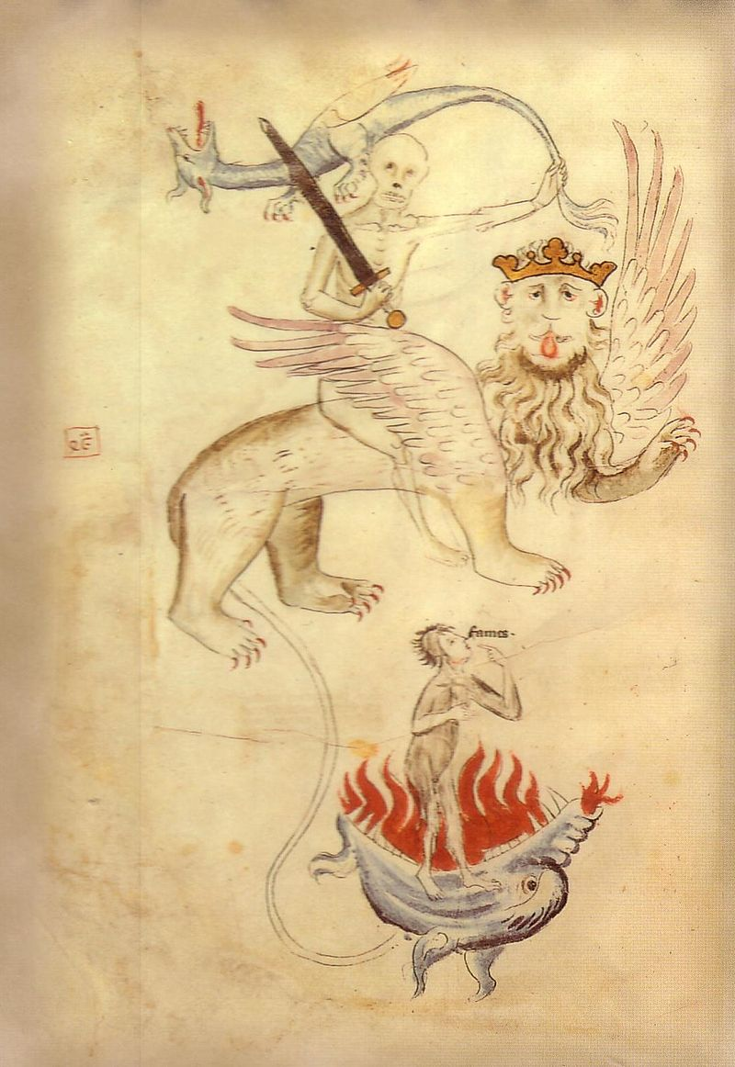
The Great Famine
The Great Famine may have been precipitated by a volcanic event, perhaps that of Mount Tarawera, New Zealand, which lasted about five years.

Slide 121
Black Death 1348 and workers revolt

Slide 122
Ring a ring o’roses
A pocket full of posies
A Tishoo! A Tishoo!
We all fall down.

Slide 123
The Black Death
The Black Death reached England by June 1348. Combined with poor harvests and outbreaks of sheep disease, proved to be a calamitous reverse for the prosperity of Berkshire. Sheep numbers on the Inkpen pastures were reduced by 75 percent. As for the plague, it wiped out entire communities and contributed to the emptying of at least forty Berkshire villages of their inhabitants.

Slide 125
The increase in rural wages as a result of labour shortages following the Black Death, and the letting of land on longer and more secure leases, seems to have brought a wave of rural house building in more substantial materials than had been possible before the plague. The earliest surviving peasant houses are at Froxfield (1360) and North Warnborough (1384). Thereafter surviving peasant houses become increasingly common throughout the 15th century, a pattern repeated in other areas of southern England. A new wealth among survivors, not least from inheritance, seems to have enabled for the first time the creation of houses sufficiently solid to stand the test of time.

Slide 127
Berkshire made a fairly speedy recovery from the ravages of the Black Death and in time, its numerous farms, large and small, acquired a new basis of economic prosperity in the corn they produced as a staple crop. By the 16th century, Berkshire was a major supplier of corn to London and other centres, and also contributed greatly to the rich wool and cloth trades which comprised three-quarters of England's exports to Europe and made many fine fortunes.

Slide 128
The black death rumbled on for nearly another
300 years

Slide 129
Inside Inkpen

Slide 130
1547 Agnes Field inkpen brk archd berks will 10008 Will of agnes ffilde of inkpen In the name of god amen. The iii day of june the yere off our lord god M IIIII & XLVII. I annes felde late wyfe off thomas felde off the pariche off inkepen & in the dioc' off saru' howle off mynde & good off rememberance mayde thys my last wyll & testament in thys man' her' aft' folowyng. Fyrst i beqethe my sowle to almyghte god owr lade sanet mar' and to all the howle compene of hevyn & my bode to be burred in the chyrche yarde off inkpen. Item i bequethe to the hed aut' ther viiid. Item to the mother chyrche off sar' iid also i bequeth to the rowde leyght to the sepulker leyght & to the herse leyght iid a pece. Item i bequethe to evr' godchylde iid also i gyffe & bequethe my howle mess' with appurtenance called hult and ii other mess'ys owne called serrens(?) liyng in inkpen grene and the other in hasylwyke aganys a …..

Slide 131
Parish Church Goods, Inkpen A D 1552

Slide 132
Combe Gibbet erected in 1676 to hang George Bromham and Dorothy Newman
The true facts however appear to be that there lived at Combe a labourer named George Bromham, a married man, and a woman Dorothy Newman, who had apparently formed an illicit association, and to further their plans decided to remove the man's wife Martha out of the way.
"They waylaid Mrs. Bromham and her son Robert close to where the gibbet now stands and beat them to death with staves."
"From extracts from the Western Circuit Gaol Book" . . . they were convicted at the Assizes "which began on 23rd February 1676 of the murder of Robert, son of George Bromham and of Martha, wife of said George Bromham, each with a "staffe", and were ordered to be hanged "in chaynes near the place of the murder".

Slide 133
1683 henry hunt inkpen brk PCC will 6668 Will of henry robinson alias hunt of inkpen victualler To my dau mary bartlett £5 and to mary her dau £5 and henry her son £5. To mary robinson als hunt my grandchild £10 and to william her brother £4….. My wife to have all the household goods in the room called the parlour for her life. The residue to my wife who is sole executrix. Mark of the testator. Dated 2 mar 1680.

Slide 134
Inkpen House, (also known as The Old Rectory, Inkpen), Newbury, England
This site has a late-17th or early-18th century formal garden covering about 1.5 hectares.
The present house was built between 1690 and 1710, possibly by Dr Colwell Brickenden, who appears to have been the creator of the formal garden at Inkpen. The garden was probably replanted in the 19th century and was restored in the 20th century.

Slide 135
Industrial Revolution
in and around Inkpen

Slide 136
Jethro Tull
1674 – 21 February 1741,
died at Prosperous Farm

Slide 142
By the time King George III came to the throne in 1760 and, later, re-established Windsor Castle's importance as the chief royal residence, the commercial emphasis in Berkshire had changed.
Berkshire trade of all kinds received a boost from the canal-building 'mania' which saw a canal linking Newbury and Kintbury by 1810; by 1818, this canal carried over 200 boats, including seventy barges loaded with up to 60 tons of goods.

Slide 144
On 17 April 1794 the Kennet and Avon Canal Act received the Royal Assent and construction began. The Newbury to Hungerford section was completed in 1798, and was extended to Great Bedwyn in 1799. The section from Bath to Foxhangers was finished in 1804, and Devizes Locks were completed in 1810.
The rate of carriage per ton from London to Bath was £2 9s 6d, which compared well with carriage by road, at £6 3s to £7 per ton
The horse which moved 1 ton on land could pull 30 tons or more in a floating barge.
The opening of the Great Western Railway in 1841 removed much of the canal's traffic, even though the canal company lowered tariffs. In 1852 the railway company took over the canal's operation, levying high tolls at every toll point and reducing the amount spent on maintenance.
In 1877 the canal recorded a deficit of £1,920 and never subsequently made any profit

Slide 146
Bad harvests, the scarcity of corn, the depressing of wages, unemployment and bankruptcies made much of the 19th century a turbulent time in Berkshire.
Mechanisation and the Enclosures Acts deprived many agricultural workers of their living. November 22 1830 saw the"Kintbury Riots“. 500 rioters, known as the Kintbury Mob, pillaged Inkpen, Hamstead Marshall and West Woodhay armed with hammers and bludgeons. One protester, William Winterbourne, was subsequently executed while forty-five others were transported to Australia.

Slide 147
Kintbury Riots.

Slide 150
Transport changed very quickly in the period 1700-1900 as a result of an increased need for better methods of moving goods, new technologies and large scale investment in the countries infra-structure (communications network).
The changes came in several stages. First Roads were improved, then Canals were built and finally the Railway was developed. Each change had an impact upon life in the country, each shortened travel times over longer distances and each enabled industrialists to seek new markets in previously out of reach areas of the country. Likewise they enabled more raw materials and goods to be shipped to and from factories, providing further impetus to the industrial age.

Slide 151
By 1870, the use of canals for trade was virtually wiped out by the railways.

Slide 154
In the early years of the railway era, contemporaries were awestruck by speeding through the landscape at 25 miles per hours, two or three times the pace of the swiftest horse drawn coach. Writing of his first train journey in 1830, the Reverend Edward Stanley recalled the elation he and his companions felt.
No words can convey an adequate notion of the magnificence ( I cannot use a smaller word ) of our progress. At first it was comparatively slow; but soon we felt that we were GOING, and then it was that every person to whom the conveyance was new, must have been sensible that the adaptation of locomotive power was establishing a fresh era in the state of society.…
The most intense curiosity and excitement prevailed... and ... enormous masses of densely packed people lined the road, shouting and waving hats and handkerchiefs as we flew by them. What with the sight and sound of these cheering multitudes and the tremendous velocity with which we were borne past them, my spirits rose to true champagne height.

Slide 155
1835 - Isambard Kingdom Brunel was employed to build the London - Bristol line, with Daniel Gooch as the engineer. It was the start of the Great Western Railway (G.W.R. - God's Wonderful Railway), which was absolutely flat for 85 miles.
1838 - The opening of the London - Bath - Bristol line.
1838 | 5½ million rail passengers
1845 | 30 million rail passengers
1855 | 111 million rail passengers

Slide 156
Newbury c 1850

Slide 158
School
A charity school was built and run by the Johnson family in 1842, but it closed when they left the village in 1859. The Wesleyan Methodist chapel added a schoolroom to its buildings in 1893, but this too closed, and it is now a private house. Another school set up by the rector in 1850 became a Board school after 1870. Today’s Inkpen Primary School still occupies this 1850 building.

Slide 159
In 1870-72, John Marius Wilson's Imperial Gazetteer of England and Wales described Inkpen like this:
INKPEN, a village and a parish in Hungerford district, Berks. The village stands among hills,
near the river Auborn and the boundaries with Wilts and. Hants, 3¼ miles SW of Kintbury r. station,
and 3¼ SE by S of Hungerford; and has a post office under Hungerford. The parish comprises
2, 850 acres. Real property, £3, 524. Pop., 748. Houses, 164. The property is much subdivided.
The manor., with much of the land. belongs to the Earl of Craven. Kirby House is the seat of
John Butler, Esq. Inkpen Beacon is a chalk down, the loftiest in England; has an altitude of
1, 011 feet above sea level; and commands a very extensive and fine view.
The living is a rectory in the diocese of Oxford. Value, £520. Patron, John Butler, Esq.
The church is ancient but good; consists of nave and chancel, with low square tower; and contains
monuments of the Butlers. There are chapels for Wesleyans and Primitive Methodists,
a national school, and charities £25.

Slide 160
Population of Inkpen
1801 The parish comprises 2886 acres. Pop. 590
1831 The parish comprises 2886 acres. Pop. 729
1848 The parish comprises 2759 acres. Pop. 743
1861 The parish comprises 2886 acres. Pop. 748
1870-72, John Marius Wilson's Imperial Gazetteer of England and Wales. The parish comprises 2, 850 acres. Pop. 748. Houses, 164.
2014 population circa 800, Houses 379

Slide 161
Reuben Annett talks about his role as the local pig-killer

Slide 162
Inkpen Trades
There used to be three blacksmith's shops, four public houses, several smallholdings, with milk delivered or collected daily, and several small shops selling groceries. There were six or eight potteries in the village; the clayworkers were known locally as “yellowlegs”. The sawmills flourished until 1970. Basket-making, rope-making, silk and wool weaving were also carried out in Inkpen.

Slide 164
May 1944

Slide 165
Farming in wartime Inkpen
At the outbreak of World War II, Julia White was a 39 year old single woman living in the New Forest. She bought the run-down Manor Farm at Inkpen in west Berkshire for £3000, and ran it herself with her two little dogs as resident ratters and rabbiters.
Julia's unusually detailed farm diaries and memoirs of her time at the farm have now been given to Berkshire Record Office. Records of her daily work at Manor Farm show how she transformed it from a run-down place without mains water, electricity or sanitation, to a successful farm which won a prize at the Newbury Agricultural Show in 1952. One temporary labourer who also lodged at the farmhouse turned out to be a professional burglar on the run from prison. He disappeared just before being unmasked, and the local police gave Julia a secret password to use on the phone to alert the authorities if he turned up again. German PoWs also helped out on the farm.

Slide 166
So what does all this say about our future, Inkpen’s future ?

Slide 167
Climate, Rivers, Tracks, Roads, Canals and railways have all changed Inkpen.

Slide 168
What is Inkpen Now ? Sunday Times

Slide 169
The Industrial revolution isn’t just history – it’s still going on.
Population movements to towns continues.
Industry continues to change, as does the work and skills required by it.

Slide 170
To survive in business today, we have to understand the approaching challenges and be relevant to them, and that is what we have to do as a community in order to survive, in order to preserve our identity.

Slide 171
For a community to survive, it has to be relevant, and able to interact and trade with other communities. Inkpen has done this for thousands of years.
Inkpen was a focus of connections in the past and it needs to remain a focus to survive in the future.

Slide 172
Inkpen is becoming globally connected
Superfast Broadband comes to Inkpen:
Phase I …..Sept 2015
Phase II ….Sept 2017

Slide 173
Superfast broadband is changing businesses and peoples’ lives.
Superfast broadband can improve work-life balance and enables home working.

Slide 174
But what about practical skills, hand crafts ?

Slide 176
The Ice age hasn’t finished. Will global warming end it ?
And, what might it mean for us ?

Slide 177
Global climate change has already had observable effects on the environment.
... Effects that scientists had predicted in the past would result from global climate change are now occurring: loss of sea ice, accelerated sea level rise and longer, more intense heat waves.
It means pressure on land and pressure on food.

Slide 178
The UN State of Food & Agriculture 2016 report said
"business as usual" would leave millions at risk from hunger.
Last year, nations adopted a UN goal of ending hunger by 2030.
"The climate is changing, so agriculture must change too. …Agriculture is contributing itself to about one fifth of the global emissions of carbon dioxide and other greenhouse gases," Mr Voss, who headed the team that produced the FAO State of Food & Agriculture 2016 report, added.
"If we continue along the present pathways then we will not be able to [deliver] food security around the world and we will not be able to stabilise the climate."
Oct 18th 2016

Slide 181
Climate change projections for 24 different countries, found that farmers in the UK, Germany and Canada could all benefit from global warming.
In these temperate climates, the increase in temperature will not kill plants but can make it easier to grow crops like wheat.
The UK could benefit the most with an estimated 96 per cent of agricultural land becoming more suitable for crops by 2100.
However Australia, Spain and South Africa will all see their crop production fall as the plants die in the hotter climate. More than 90 per cent of the land in these countries will become less suitable for agriculture.

Slide 182
Climate change to bring opportunities and problems for UK.
Farming, forestry and tourism to benefit from warmer summers.
Shorter sea routes caused by the melting of the ice caps benefitting shipping and reducing transportation costs.
Rising temperatures may lead to improved health across the UK, encouraging outdoor activity, boosting vitamin D levels and increasing tourism.
Cost of increase in storms, droughts, floods and other extreme weather conditions could rise 10 fold.
Increased crop yields as warmer weather results in better growth rates.
Fewer deaths due to cold weather.
Mosquito-borne diseases such as malaria may increase and native animal species decline.

Slide 184
For some countries and peoples it will be a fight for survival.

