Slide 1
The Crown and Garter 1800-1939: a genealogical perspective

Slide 2
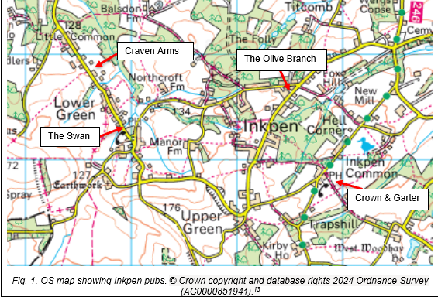

Slide 3
Kelly’s Trade Directory, 1887

Slide 4
1891 census, Great Common

Slide 5
When was it built?

Slide 6
The site of the Crown and Garter today

Slide 7
The site of the Crown and Garter in 1775

Slide 8
The leaseholders of plots 35, 36 and 37 in 1775

Slide 9
Formerly known as The King’s Head?
In 1796 the sale of a dwelling house and outbuildings ‘known by the name of the King’s Head Inn, in Inkpen’ was advertised, with adjoining arable and pastureland. The tenant was John Cannon
A land tax record of 1798 lists Mr Mundy as the proprietor of the King’s Head, Inkpen

Slide 10
The site in 1815

Slide 11
The leaseholders in 1815

Slide 12
Electoral register for Inkpen, 1832

Slide 13
Samuel Watts
In October 1839, Samuel Watts, beer retailer at Inkpen, appeared before magistrates, charged with ‘selling beer at unseasonable hours’ fined £2/9/6d
Two other beer retailers of the same place, Thomas Cully and William Philip Turton, were charged with the same offence
In 1841 Samuel is a publican in Kintbury

Slide 14
The Watts family in Great Common, 1841
Nearby lived Joseph Watts, joiner, 31
James Watts, farmer, 63 and Emma, 4
Richard Watts, sawyer, 59 with his wife and four children

Slide 15
Charlotte Radbourn or Radbone
Baptised Charlotte Hunt in Broad Hinton, Wiltshire in 1798
Married John Raithbourne of Shalbourne in 1818

Slide 16
1830 Swing Riots
On 22 November 1830, hundreds of local men rioted and damaged machinery in Kintbury and Hungerford.
John Radbourne was among those arrested but not committed for trial.
Henry Honey of West Woodhay was summoned to the Special Commission but acquitted.

Slide 17
Charlotte Radbourn and Henry Honey
John Radbourn was buried in Inkpen in 1836
In 1839 Charlotte Radbourn’s son Henry was baptised: no father’s name is given.
Was Henry Honey more than a lodger?

Slide 18
Site of the Crown and Garter in 1842

Slide 20
Charlotte Radbourn and Henry Honey
In 1851 Henry and Charlotte are listed as husband and wife, now living between the Olive Branch, which was occupied by James Finch, and Great Common
Henry Honey is listed as a beer retailer in 1847 and 1854, but we cannot be certain which pub he held the licence for during those years .

Slide 21
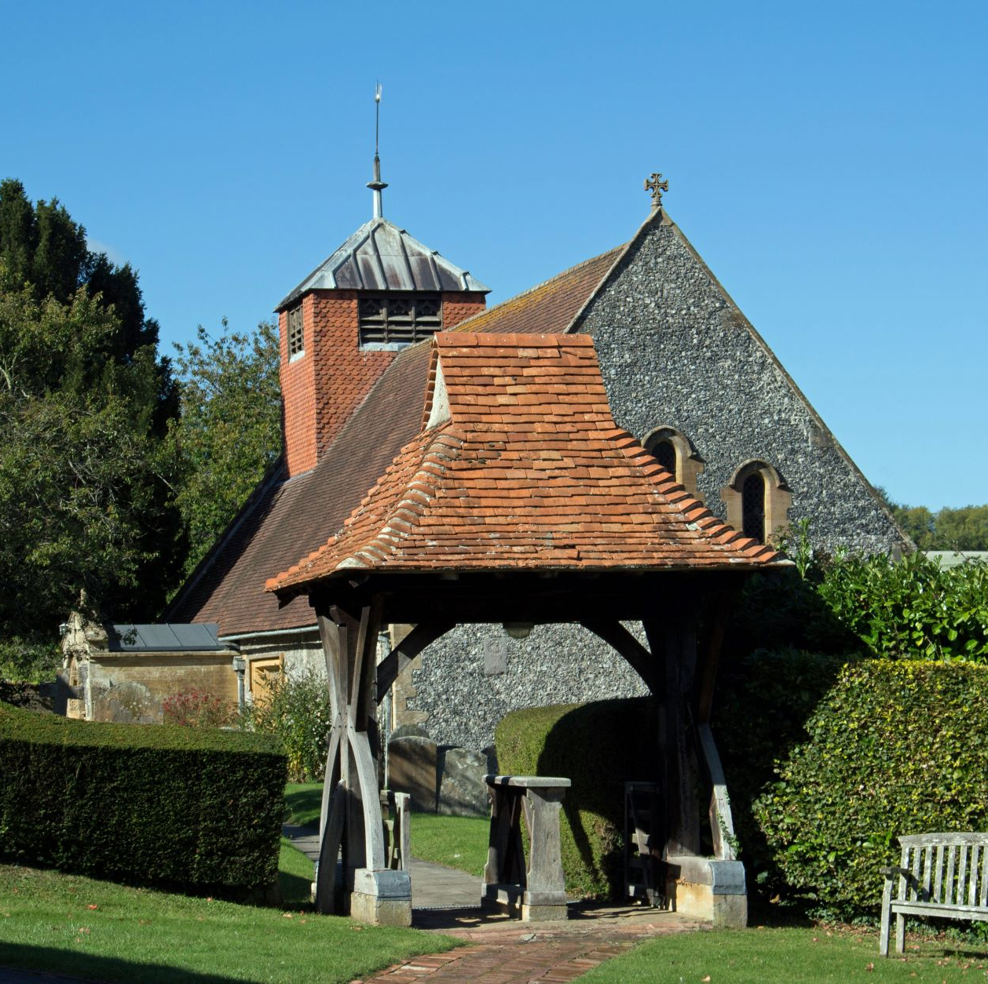
Deaths of Charlotte and Henry
Charlotte Radbourne was buried in Inkpen on 12 February 1869, aged 74.
Henry Honey died at the Blue Boar Inn in Wantage and was buried in Inkpen on 5 May 1869

Slide 22
Benjamin Finch
Born in Newbury c.1838.
1861 census: grocer and beer seller in Great Common.
1871 census: tea dealer in Plympton, Devon.

Slide 23
Isaac Westall
Born c.1817, he worked as a blacksmith in Chisbury and Inkpen.
He was listed as a beer retailer in Inkpen in 1864.
An advertisement in 1866 announced an auction of all his property under a ‘distress for rent’.
In the 1869 directory, Mrs Mary Westall is listed as a beer retailer in Inkpen.
On the death certificate of Isaac’s wife Sarah, her occupation was beerhouse keeper and place of death was Inkpen, but no mention is made of Isaac.

Slide 24
1871 census

Slide 25
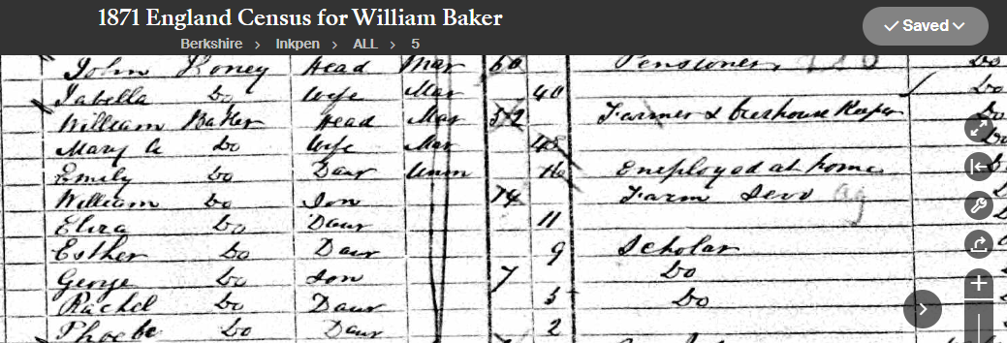
William Baker
Baptised in 1819 at Inkpen.
1841 census: under carter at Inkpen Farm
Married at Kintbury 1842.
1851 census Ag lab in Great Common; 1861 carrier.

Slide 26
Crown and Garter named

Slide 27
George Howard Brand

Slide 28
Charles John Rogers
Longest-serving landlord of the Crown & Garter
Born in Tisbury, Wiltshire 1850.
A bricklayer, he moved to Inkpen c.1881-1882.
Licence transferred to him in 1886.
1911 census: farmer in Ashford Hill.
Buried in Inkpen 1925.

Slide 29
Edward William Rogers
Eldest son of Charles John Rogers.
Born in Devizes, 1878.
Took over the pub in 1911.
Landlord until 1924; also dairy farmer.
1925 farmer at Stockcross.

Slide 30
Walter Lawrence
Born in Kintbury in 1888.
1911 census: coachman in West Woodhay.
1921 census: stud groom in Adstock, Buckinghamshire.
1925-1931: Crown and Garter.
1939 register: Chauffeur in Kintbury.

Slide 31
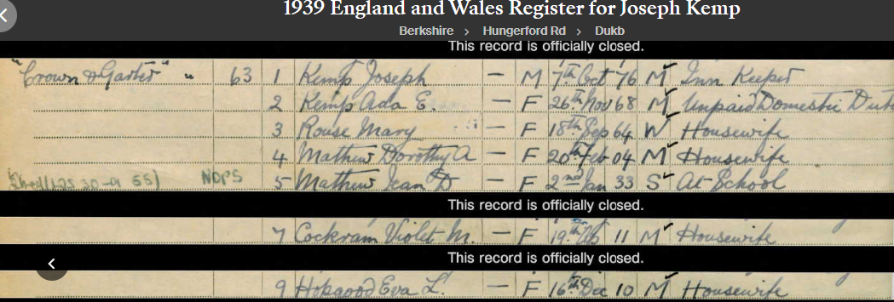
Joseph Kemp
Born in Inkpen in 1876.
1901 census: stableman at Welford.
1911-1921: groom in Rutland.
Died in 1956, three years after leaving the pub.

Slide 32
Landlords of all Inkpen pubs

Slide 33
Images
Images reproduced by kind permission of Royal Berkshire Archives:
Nos. 7, 8, 10, 11, 18, 19.
Images reproduced with permission under creative commons licence:
Nos. 2 & 24 (OS maps)
No. 3 (University of Leicester – Kelly’s Directory 1887)
All others Ancestry.com
Nos. 1 & 5 Patricia Coveney Sears
No. 21 Christopher Sears

