Slide 1
Inkpen History Society

Slide 2
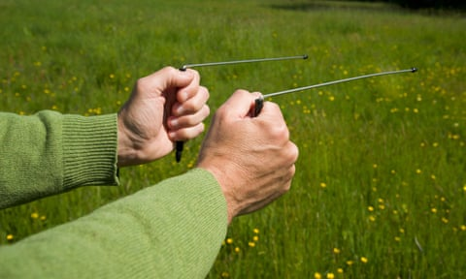
DT
Ten of the 12 water companies in the UK have admitted they are still using the practice of water dowsing despite the lack of scientific evidence for its effectiveness.

Slide 3
Prof K M
We have mapped Walbury Hill in 3-D using LiDAR. Now we want to map Inkpen Hill using the same technique. This will cover the long barrow (with gibbet) and the numerous round barrows. Hopefully we will see features that are otherwise invisible.

Slide 4
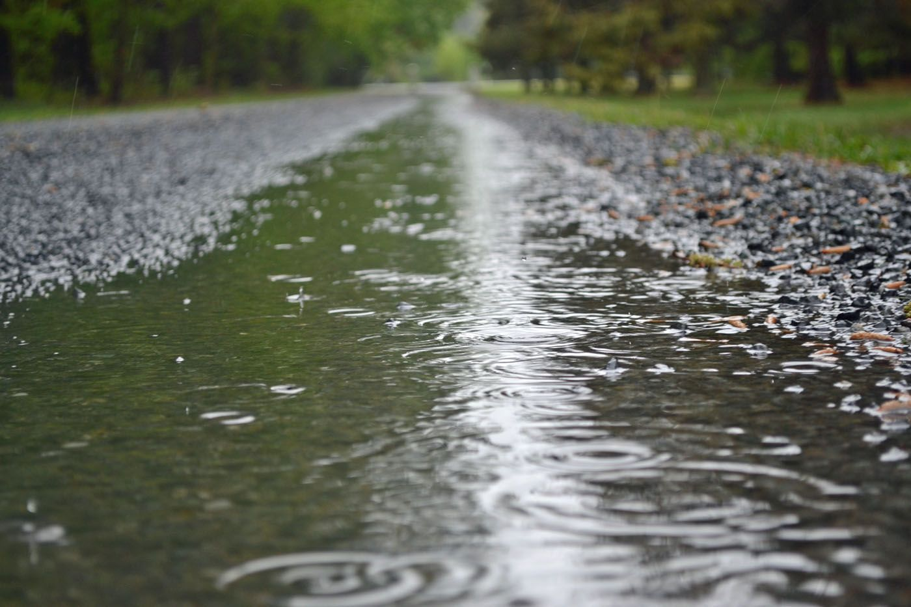
JS
Metal Detecting? Rain stopped play! We’re hoping to restart in the next few weeks.

Slide 5
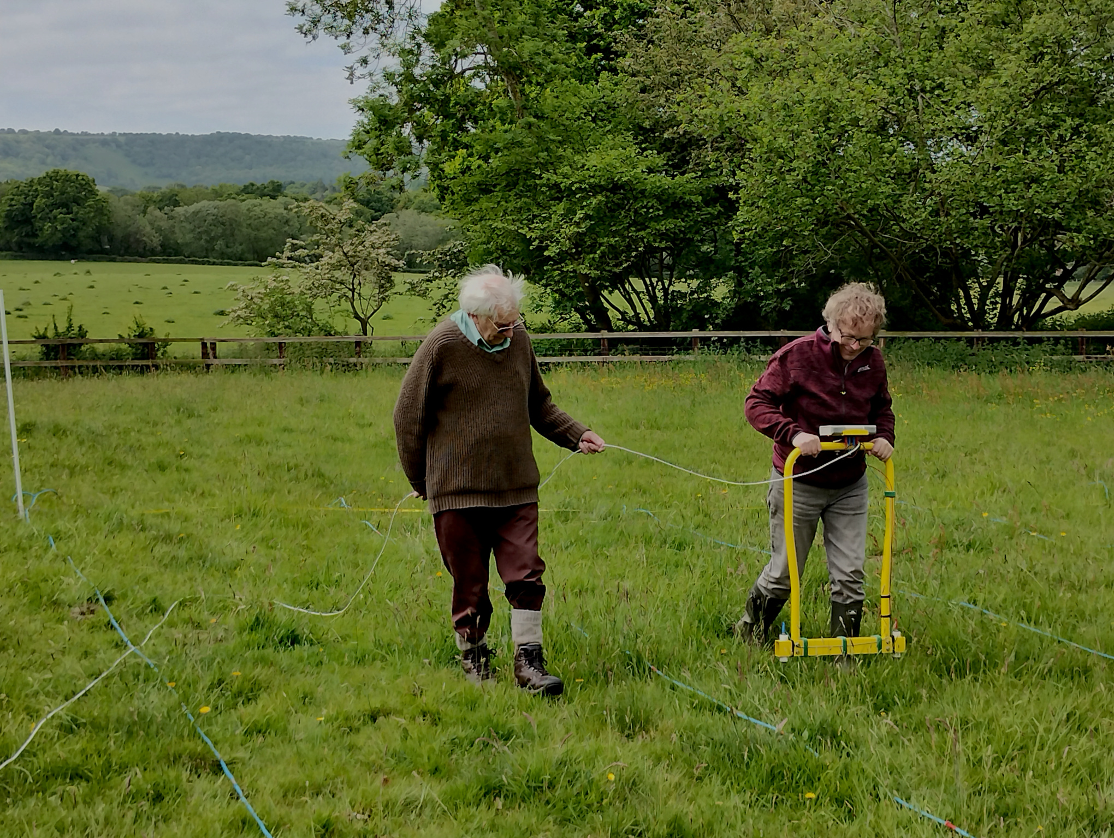
AH
We’ve been trying to get in touch with the Berkshire Archaeological Society but as yet, haven’t had much success. We hope to progress ground based geophysics soon.

Slide 6
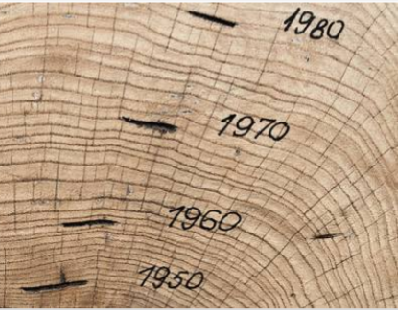
ODL
We have a grant from Inkpen PC to carry out dendrochronology on one house in Inkpen. We are hoping for a grant to be able to do this on two further properties. The work involves Oxford Uni.

Slide 7
SS
Newspaper clips spreadsheet

Slide 8
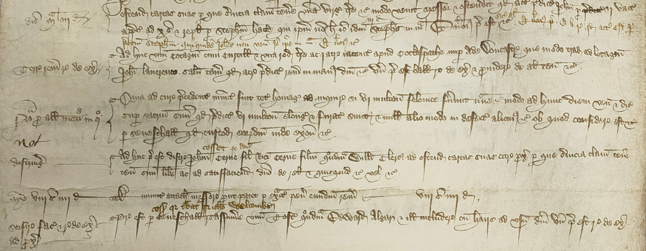
AB
Many early medieval documents of Inkpen are very difficult to decipher. Thankfully we now have access to people who can translate these and cast some insight into what these say about Inkpen in the period shortly after the black death. This is tremendously exciting.

Slide 9
DR

Slide 10
PH

Slide 11
PW
One account of the village from the 1950’s added this month. More audio tracks are to be recorded.

Slide 12
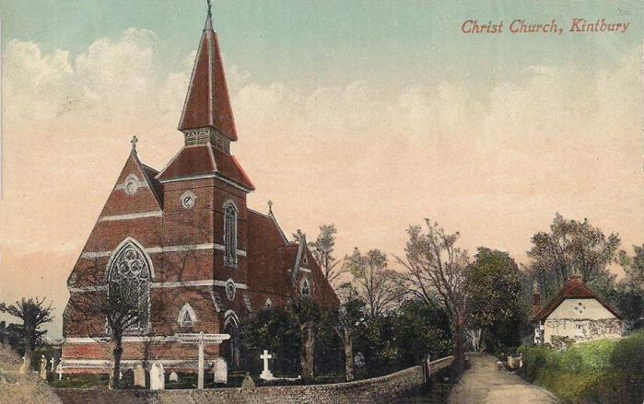
SC
Photos of the Morris Minor garage and the sawmills have surfaced.
We also have pictures of Christchurch Church. What a magnificent building.

Slide 13
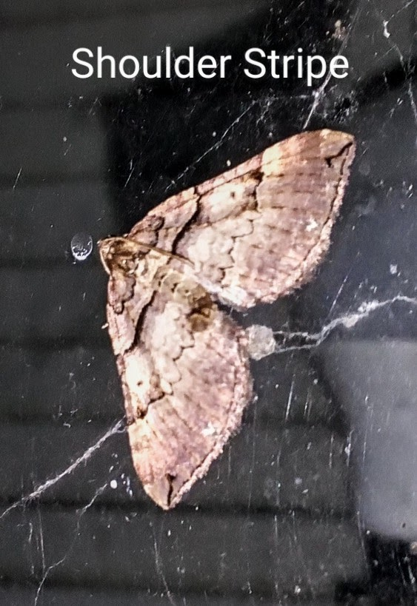
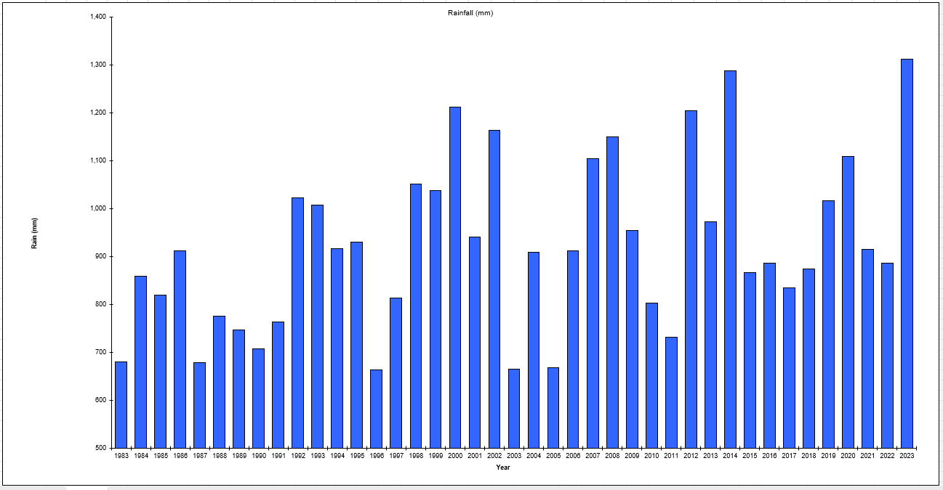
JA/SP

Slide 14
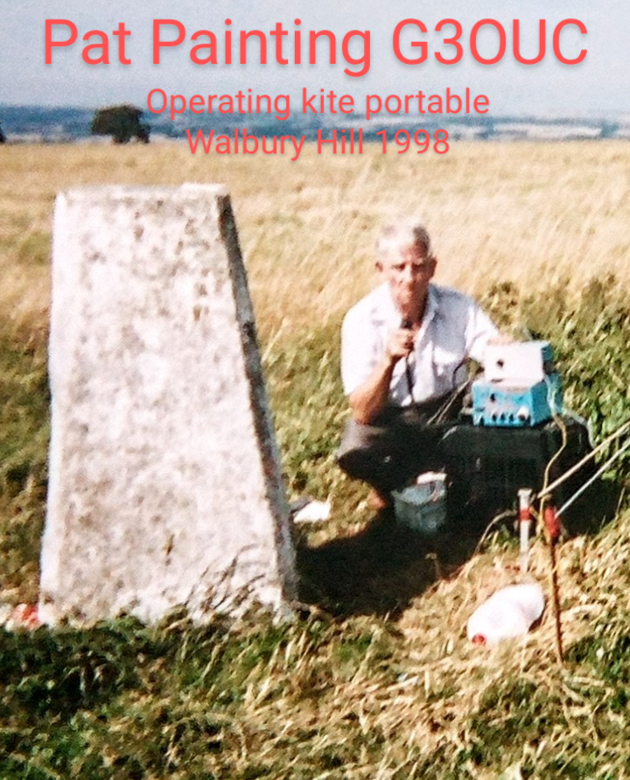
Var

Slide 15
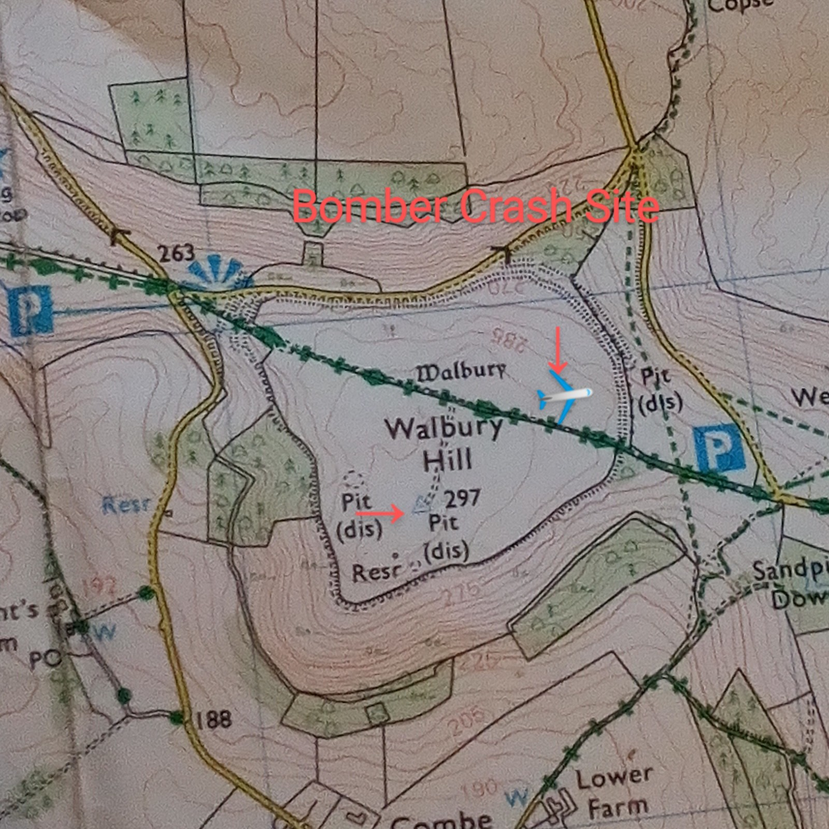
RA

Slide 16
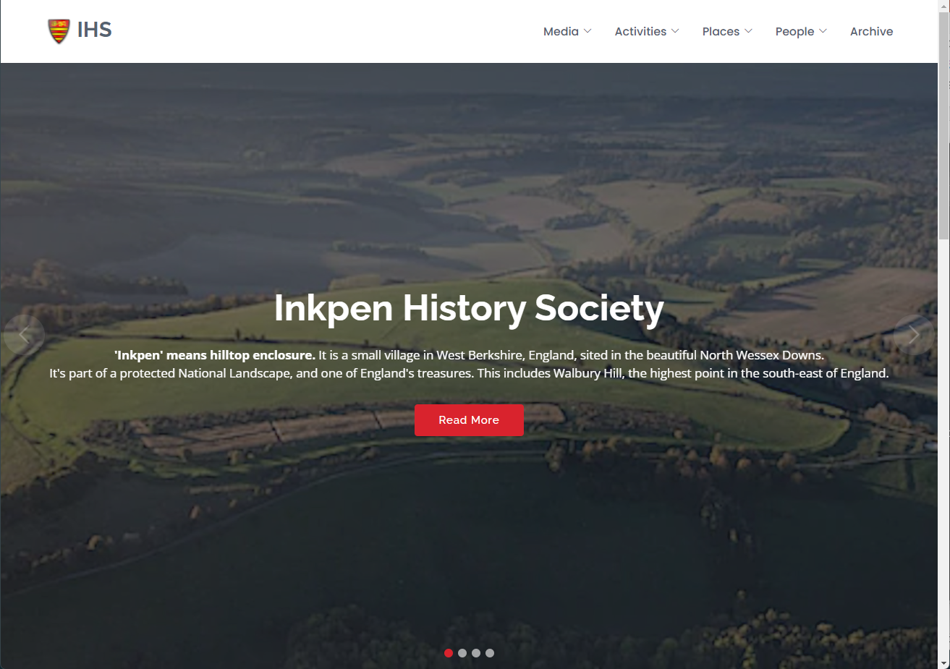
DT

