Slide 2
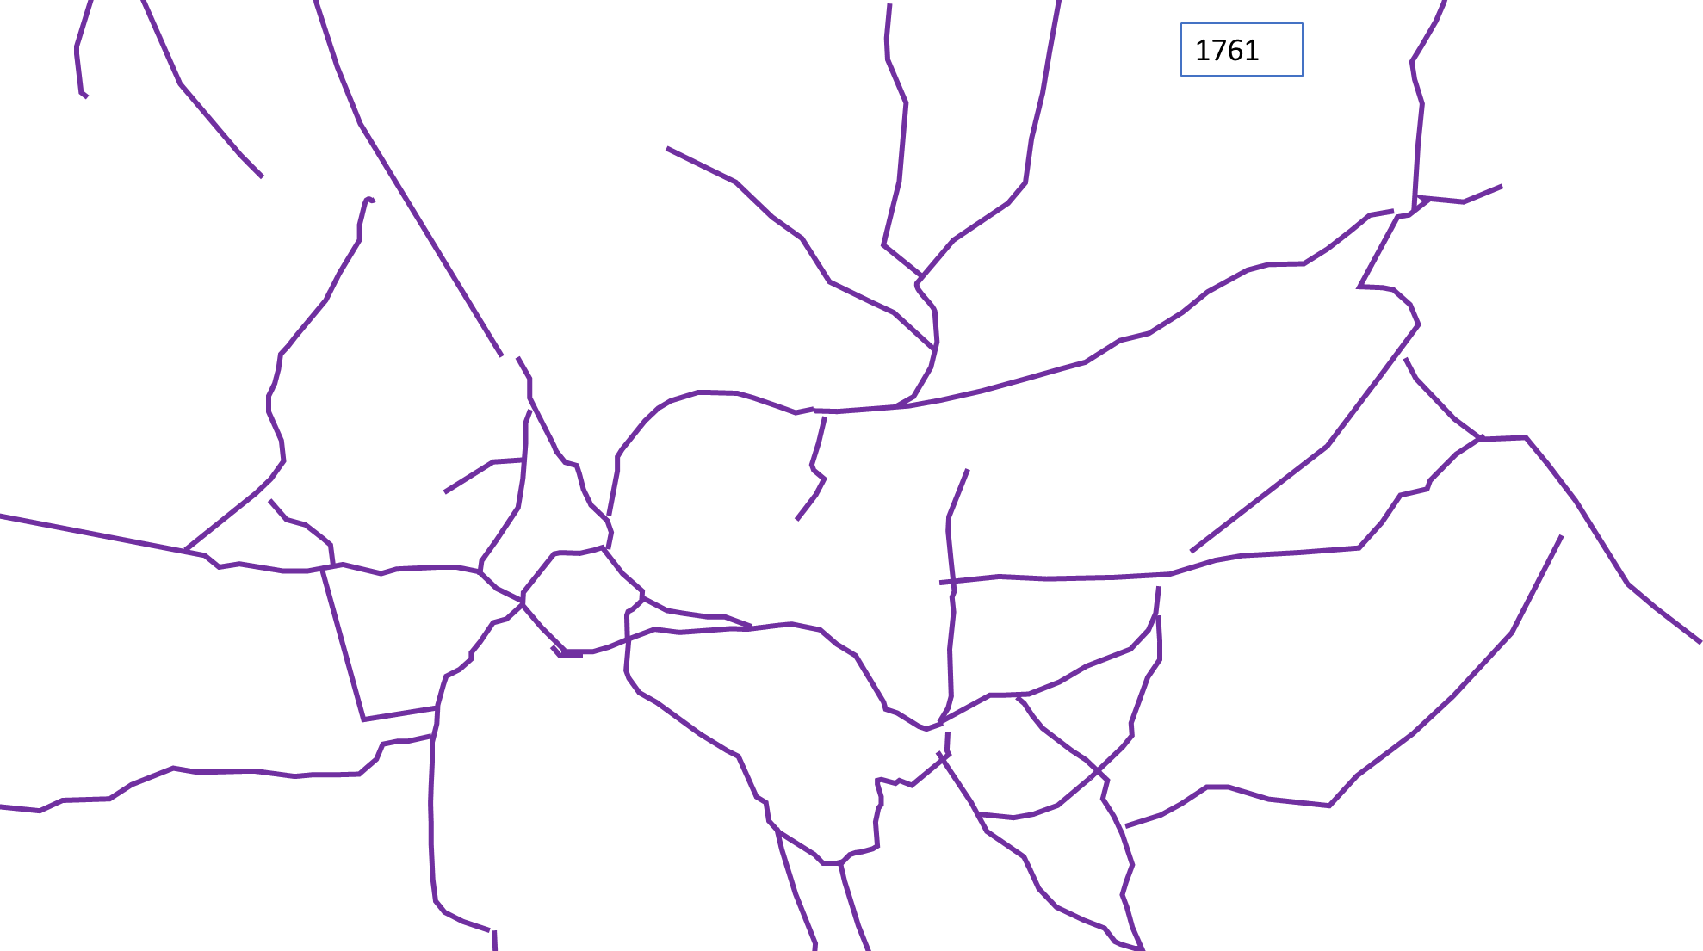
1761 Tracks & structures
Balsdon
Totterdown
Sadlers Farm
LG
Church
UG
Kirby House
Notes:
Based on Rocques Map of 1761. No differentiation of track types. But a lot in common with how it looks today! Gaps between roads e.g. at top end of Craven Road are as shown on Rocques Map. Note northward tracks (toward Kintbury) from existing Folly area (NB Folly marked on this map) and lack of “Triangle” around Folly area. Structures taken from map are more dispersed likely because of the style of cartography – their map footprint is much larger than later versions.

Slide 3
1842 Tracks & structures
Balsdon
Balsdon
Totterdown
Totterdown
NE LIMIT OF 1842 MAPS
Sadlers Farm
Sadlers Farm
LG
Church
Church
UG
Kirby House
Kirby House

Slide 4
1873 Roads, Tracks & Structures
Balsdon
Roads
Totterdown
Tracks
p
s
s
c
Sadlers Farm
LG
Crown & Garter
Church
c
UG
Kirby House

Slide 5
Mid-20th century Roads and tracks/ paths & structures
Balsdon
Roads, good
Totterdown
Roads, poor
Tracks labelled FP
Other Tracks
p
s
s
c
Sadlers Farm
LG
Crown & Garter
Church
c
UG
Kirby House

Slide 6
Present Day Rights of Way & Structures
Balsdon
Roads> 4m wide
Totterdown
Roads< 4m wide
Byways
Bridlepaths
Footpaths
p
s
s
c
LG
Crown & Garter
c
Church
UG
Kirby House

