Slide 1
Inkpen Newspaper Project
1700-1900
Stephen Smallbone

Slide 2
Ideas behind project
To Index news clips containing the word “Inkpen”
Record key words from these clippings
Make them searchable on a locally held database
Improve knowledge and social history for Inkpen
Easy online access without the need for subscriptions
Depending on results possible spin off projects

Slide 3
Which newspapers
Berkshire Chronicle
Reading Chronicle
Reading Mercury
Oxford Journal
Devizes and Wiltshire Gazette
Marlborough Times
Newbury Weekly News and General Advertiser
ETC-ETC

Slide 4
Headings preselected
Death
Assizes
Notification
Sale
To let
Marriage
Legal
Political
May add Wills/probate and jobs to stage 3 results

Slide 5
Number of events recorded Inkpen
Total circa 700
Relevant leads currently circa 400
Most popular category Sale/auction (189)
Notification (84
Assizes (63)
Death (50)
Legal (23)
Marriage (10)
Birth (0)
Transportation (3)

Slide 6
Dates covered
First batch 1700-1850
Second batch 1850-1900
Future batch 1900-1949
I might not go beyond 1949 as there may still be people alive who clearly remember these people
Although it might be fun to try
I hope no one here has skeletons in the closet

Slide 7
What did we find in the first batch
The pub was the epicentre of all village activity
landlords constantly before local courts for selling short Measures
Stealing crops and poaching was treated with very harsh sentencing
Beating your wife or children was not
Abandoning your family to the poorhouse=hard labour
Swing Riots
Canal and railway building
Discussions on abolishing the house of lords and home rule for Eire
Farming, timber, labourer, maltsters and potters

Slide 8
What did we ignore?
The Inkpen temperance band
Gamekeepers lists
Property sales without any names or exact location
Tendering for provisions for local poorhouses
Any duplications of the same story

Slide 9
What names do we find
Enough Rev Butlers to last a few centuries
The Right Honourable or Earl William Lord Craven
The Buckeridge family
The Durnford family
The May family
The Stratton family
The Hayward family

Slide 10
1851-1900 What did we find
Sale/auction (41)
Assizes (26)
Notification (22)
Inquest (13)
Death (9)
To let(6)
Marriage (7)
Fire (5)
Remainder Deportation 1 Voting 2 Legal 3

Slide 11
Names most prevalent
Dodd
Butler (again)
Hayward
Mills
Fulbrook
Bridgeman

Slide 12
Topics encountered
Jobs
Poor roads both ruts and flooding
Short measures
Wills Will Rev Butler.jpg
Man dies waiting for train Die waiting for train.jpg
Lightning does strike twice Warminster_Herald_27_June_1857.jpg
Reporting inaccuracies. Fir tree pub fire.jpg Fire at Olive Branch.jpg

Slide 13
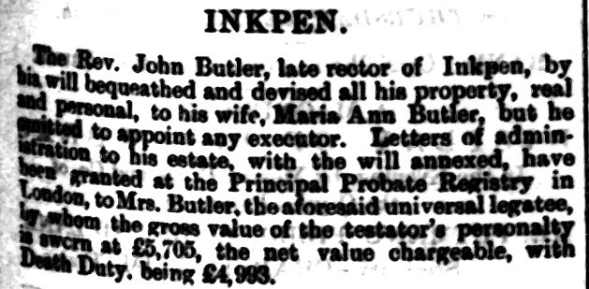

Slide 14
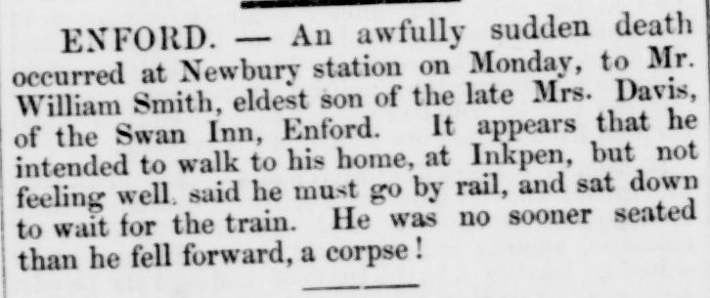

Slide 15
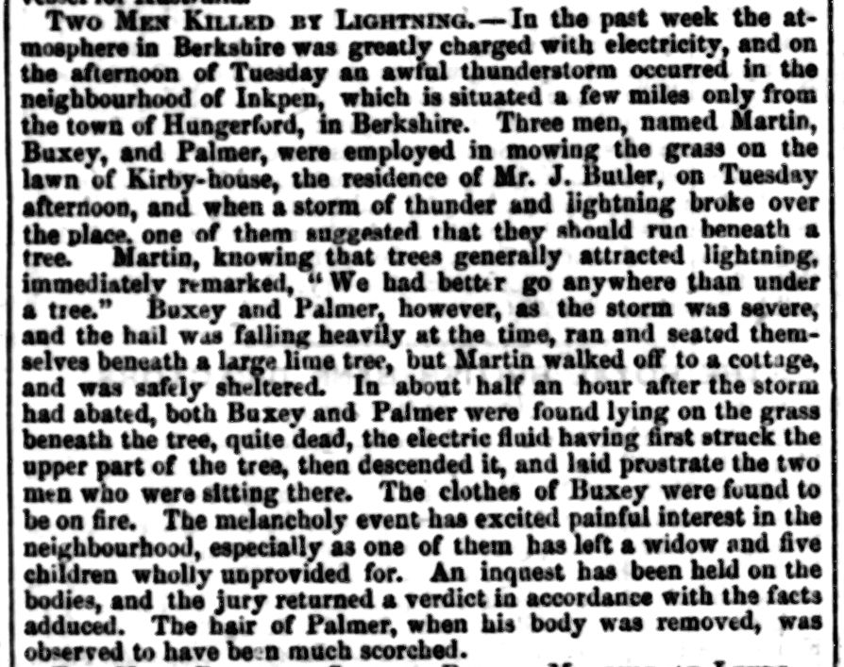

Slide 16
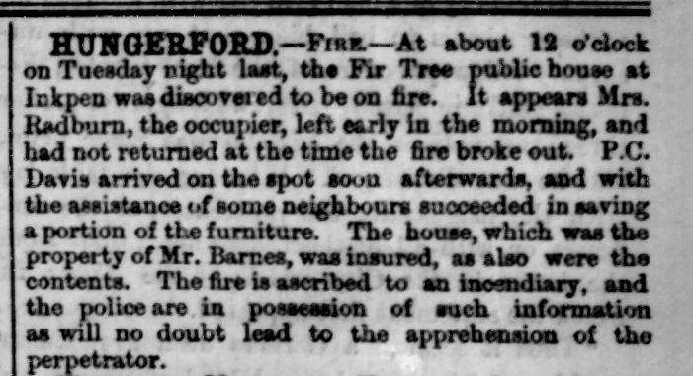

Slide 17
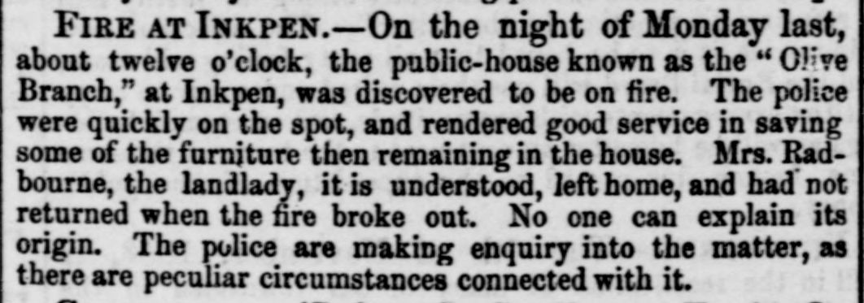

Slide 18
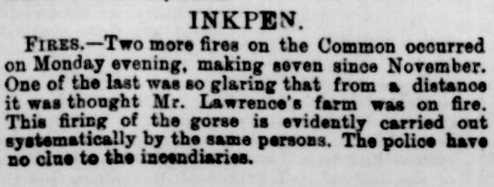

Slide 19
1900-1949
Probably too early to draw conclusion as only 50% complete
More wills and probate
More job positions
Fund raising to support troops in WW1
More business advertise- Jas Edward and Sons Inkpen
More photos accompanying articles
Increase in house and farm rental
Walking, cycling and motorcycle trips to the Gibbet, return via pub!!
Photos appear on high end property sales Kirby House Country_Life_08_January_1938_0012_Clip.jpg

Slide 21
Conclusions
First batch has just gone live on the new history society website
Second batch completed but problems to be solved before upload, being worked on
Third batch still being worked on, about a month’s work to complete
Works on iPad and P.Cs but not yet phones as screens too small, work in progress http://history.inkpenvillage.co.uk/papers.html
Future projects wills and probates- employment- linking property sales to closest census- all ideas most welcome

Slide 22
Images acquired along the way
The Swan circa 1950.jpg
The Swan match box The Swan invite.jpg
The Olive Branch Inkpen.jpg
Olive Branch Pub post closure.jpg
Crown and Garter circa 1908.jpg
Back of Crown and Garter postcard.jpg
Withers Country_Life_10_September_1938.jpg
Swan Coachworks.JPG
A few local postcards
2021Census numbers Inkpen and UK.docx
Surnames 1881 census

Slide 23
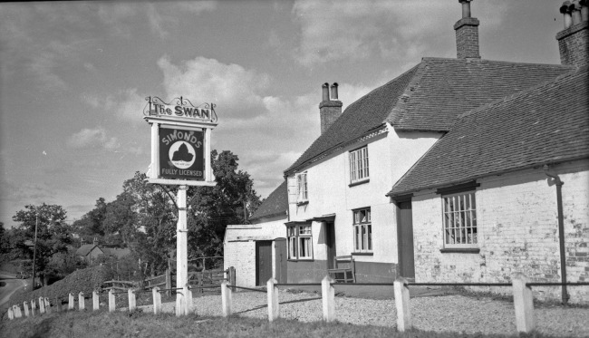

Slide 24
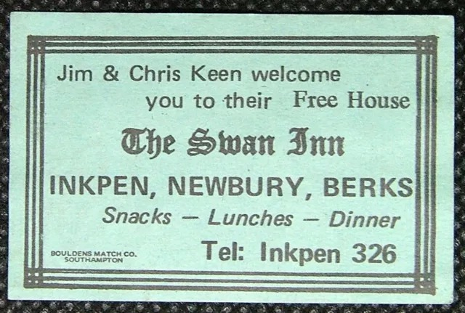

Slide 25
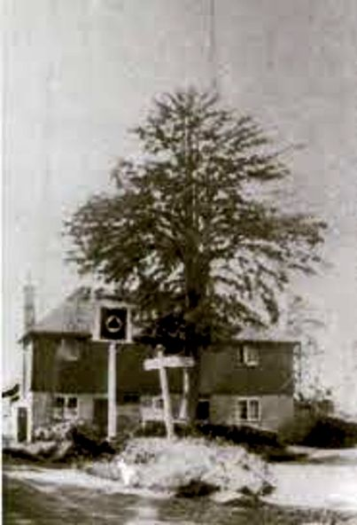

Slide 26
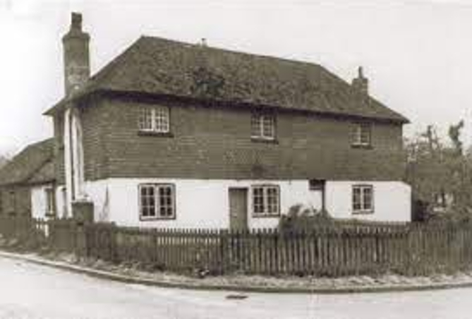

Slide 27
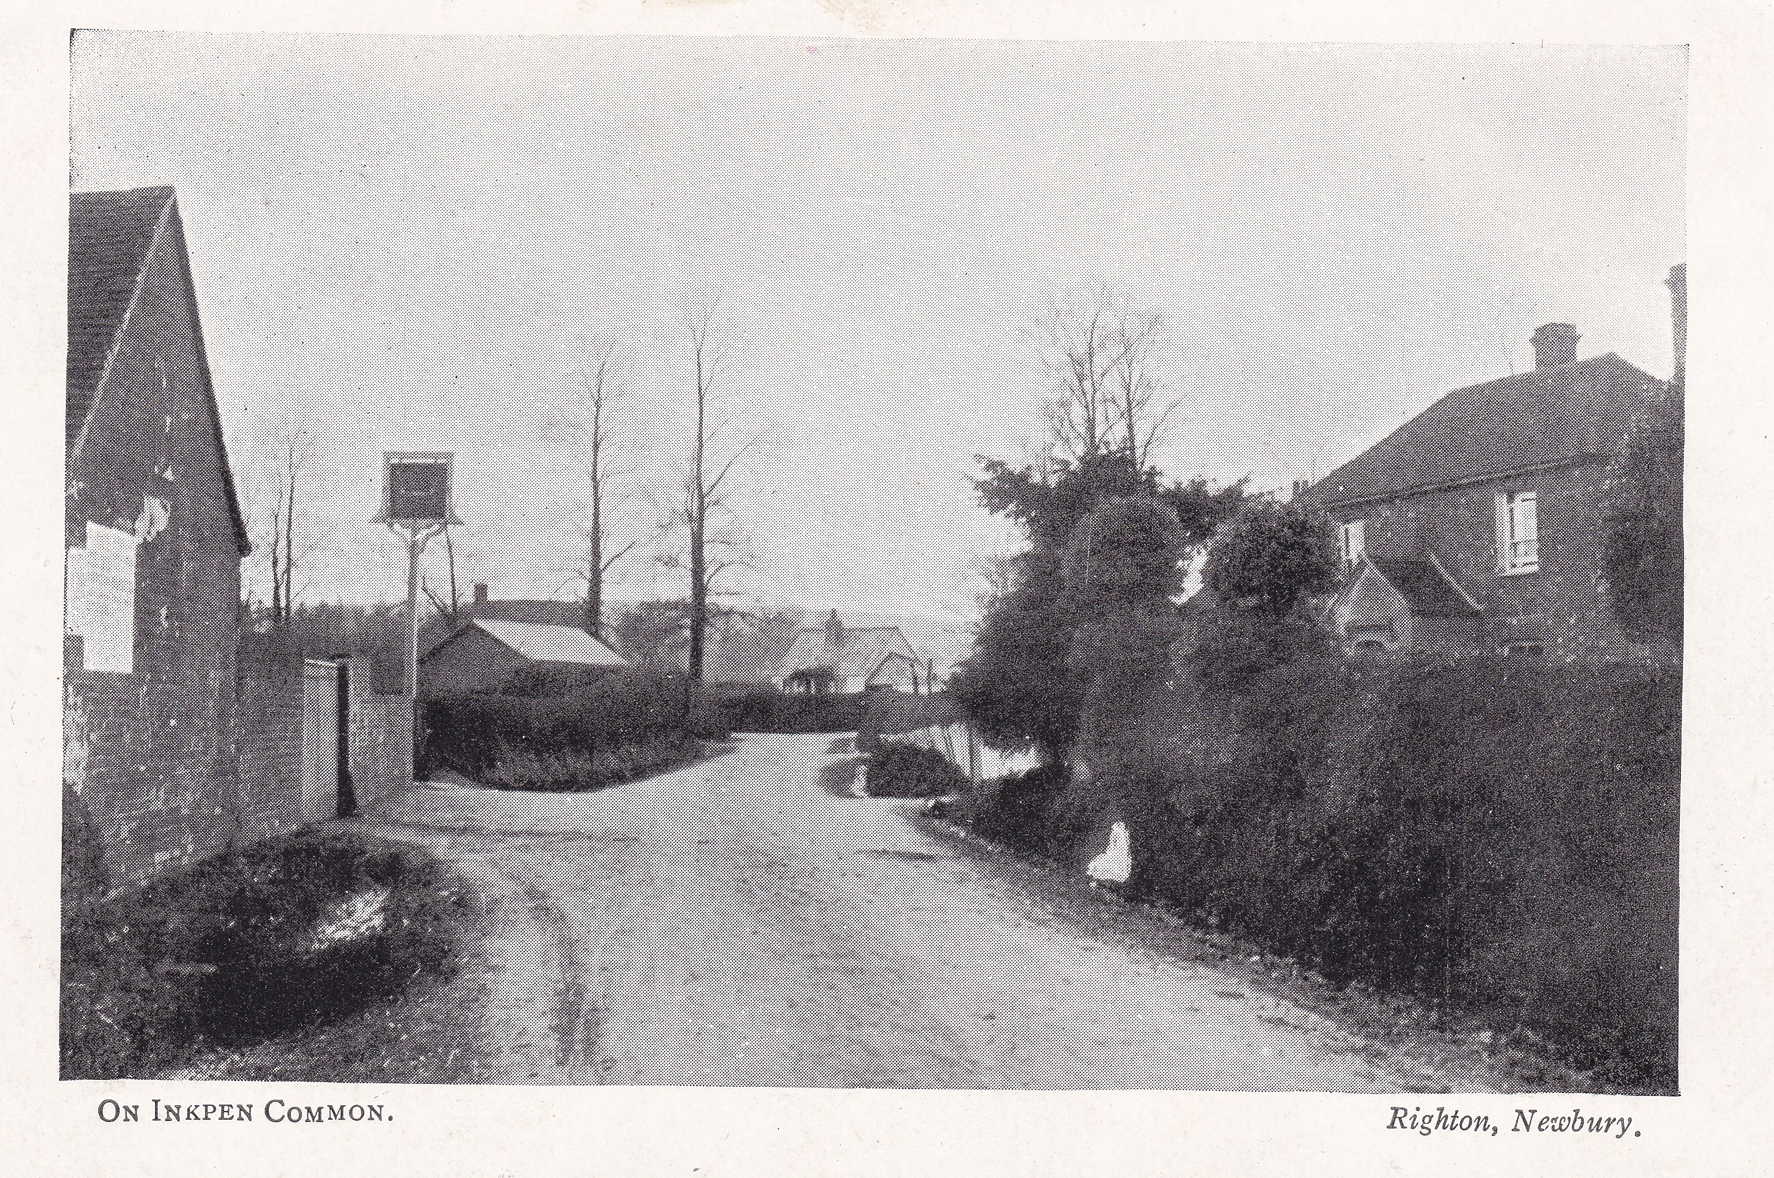

Slide 28
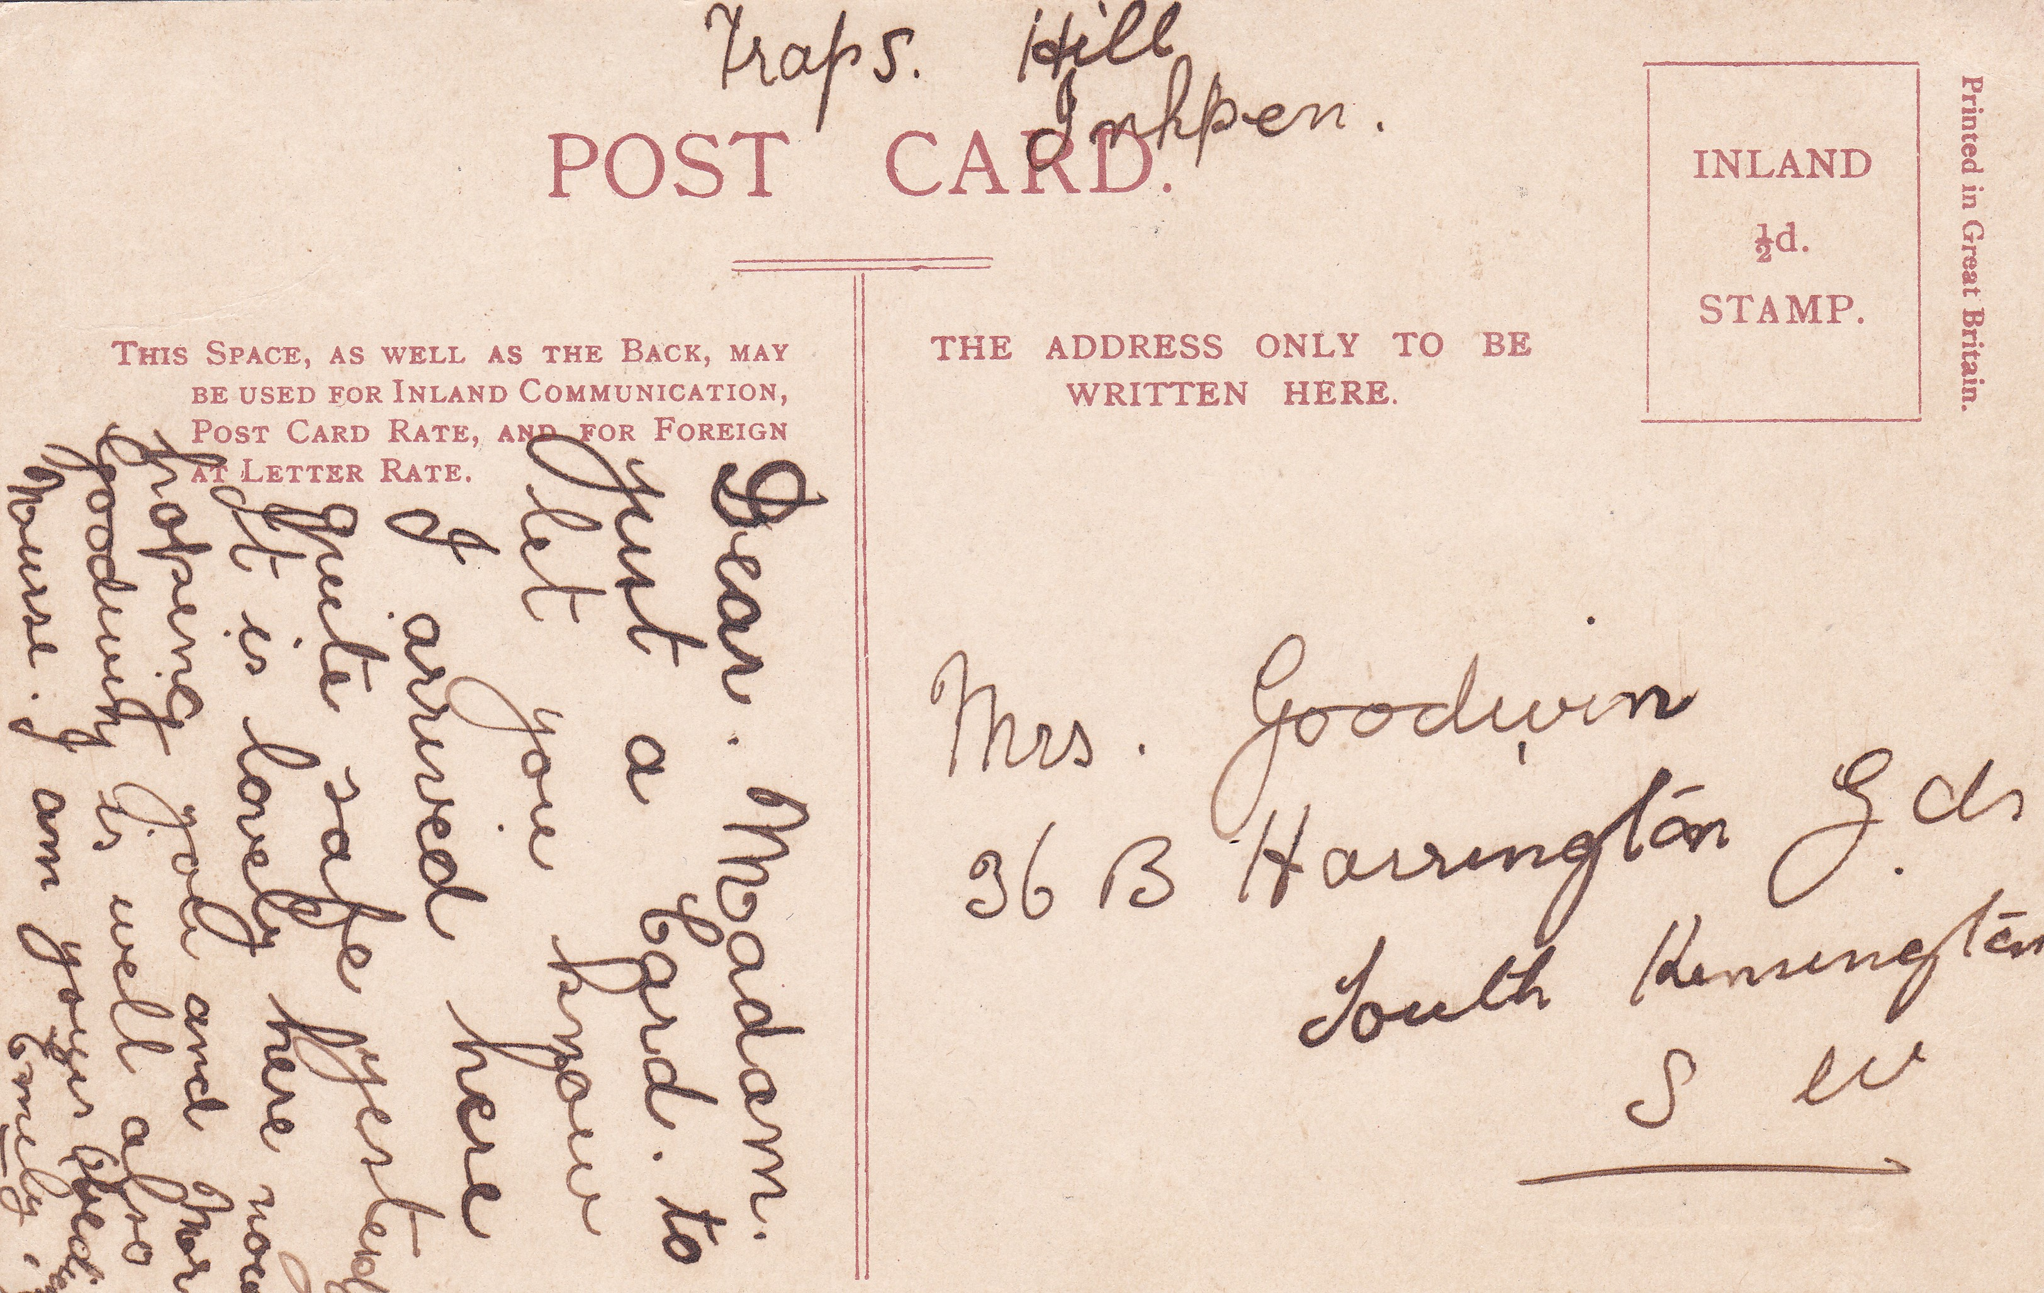

Slide 29
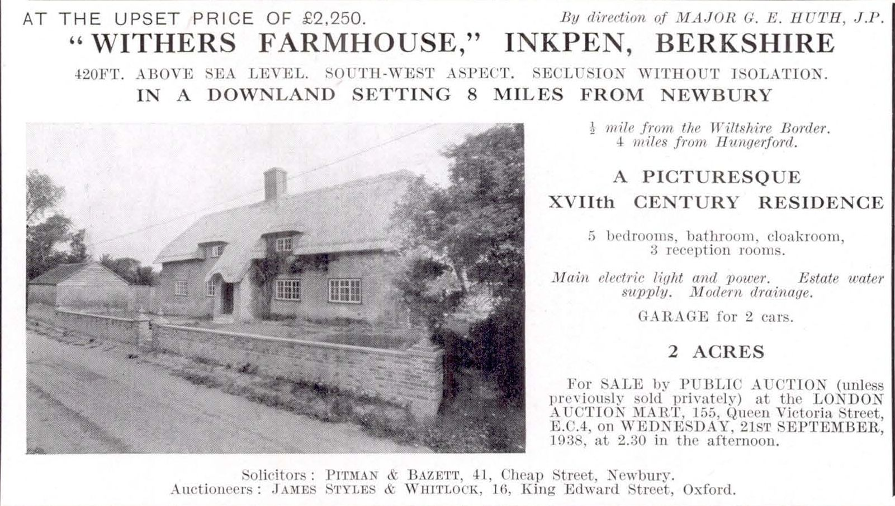

Slide 30
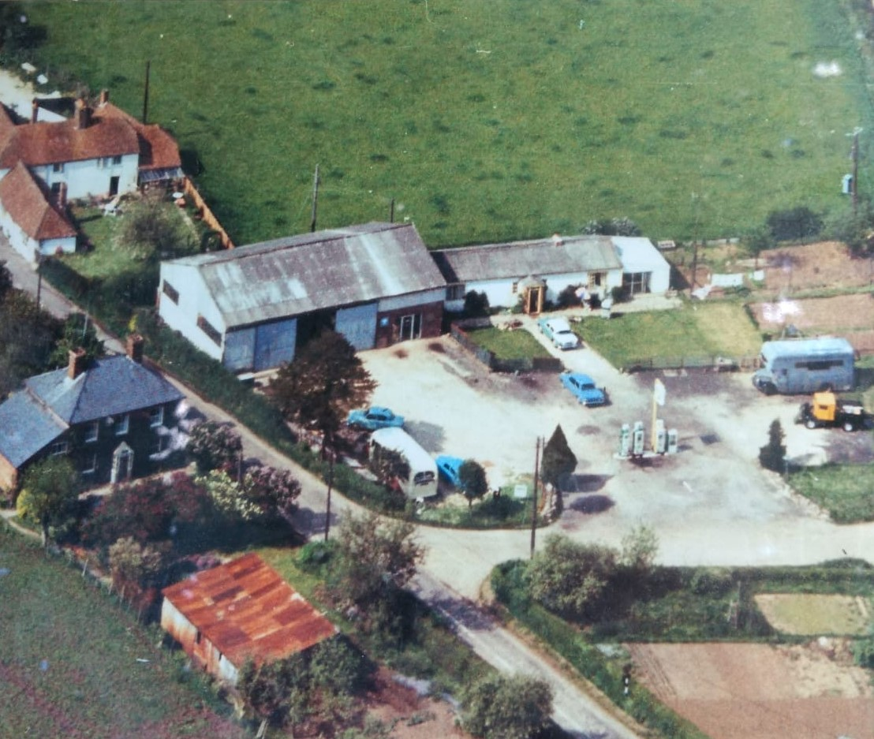

Slide 31
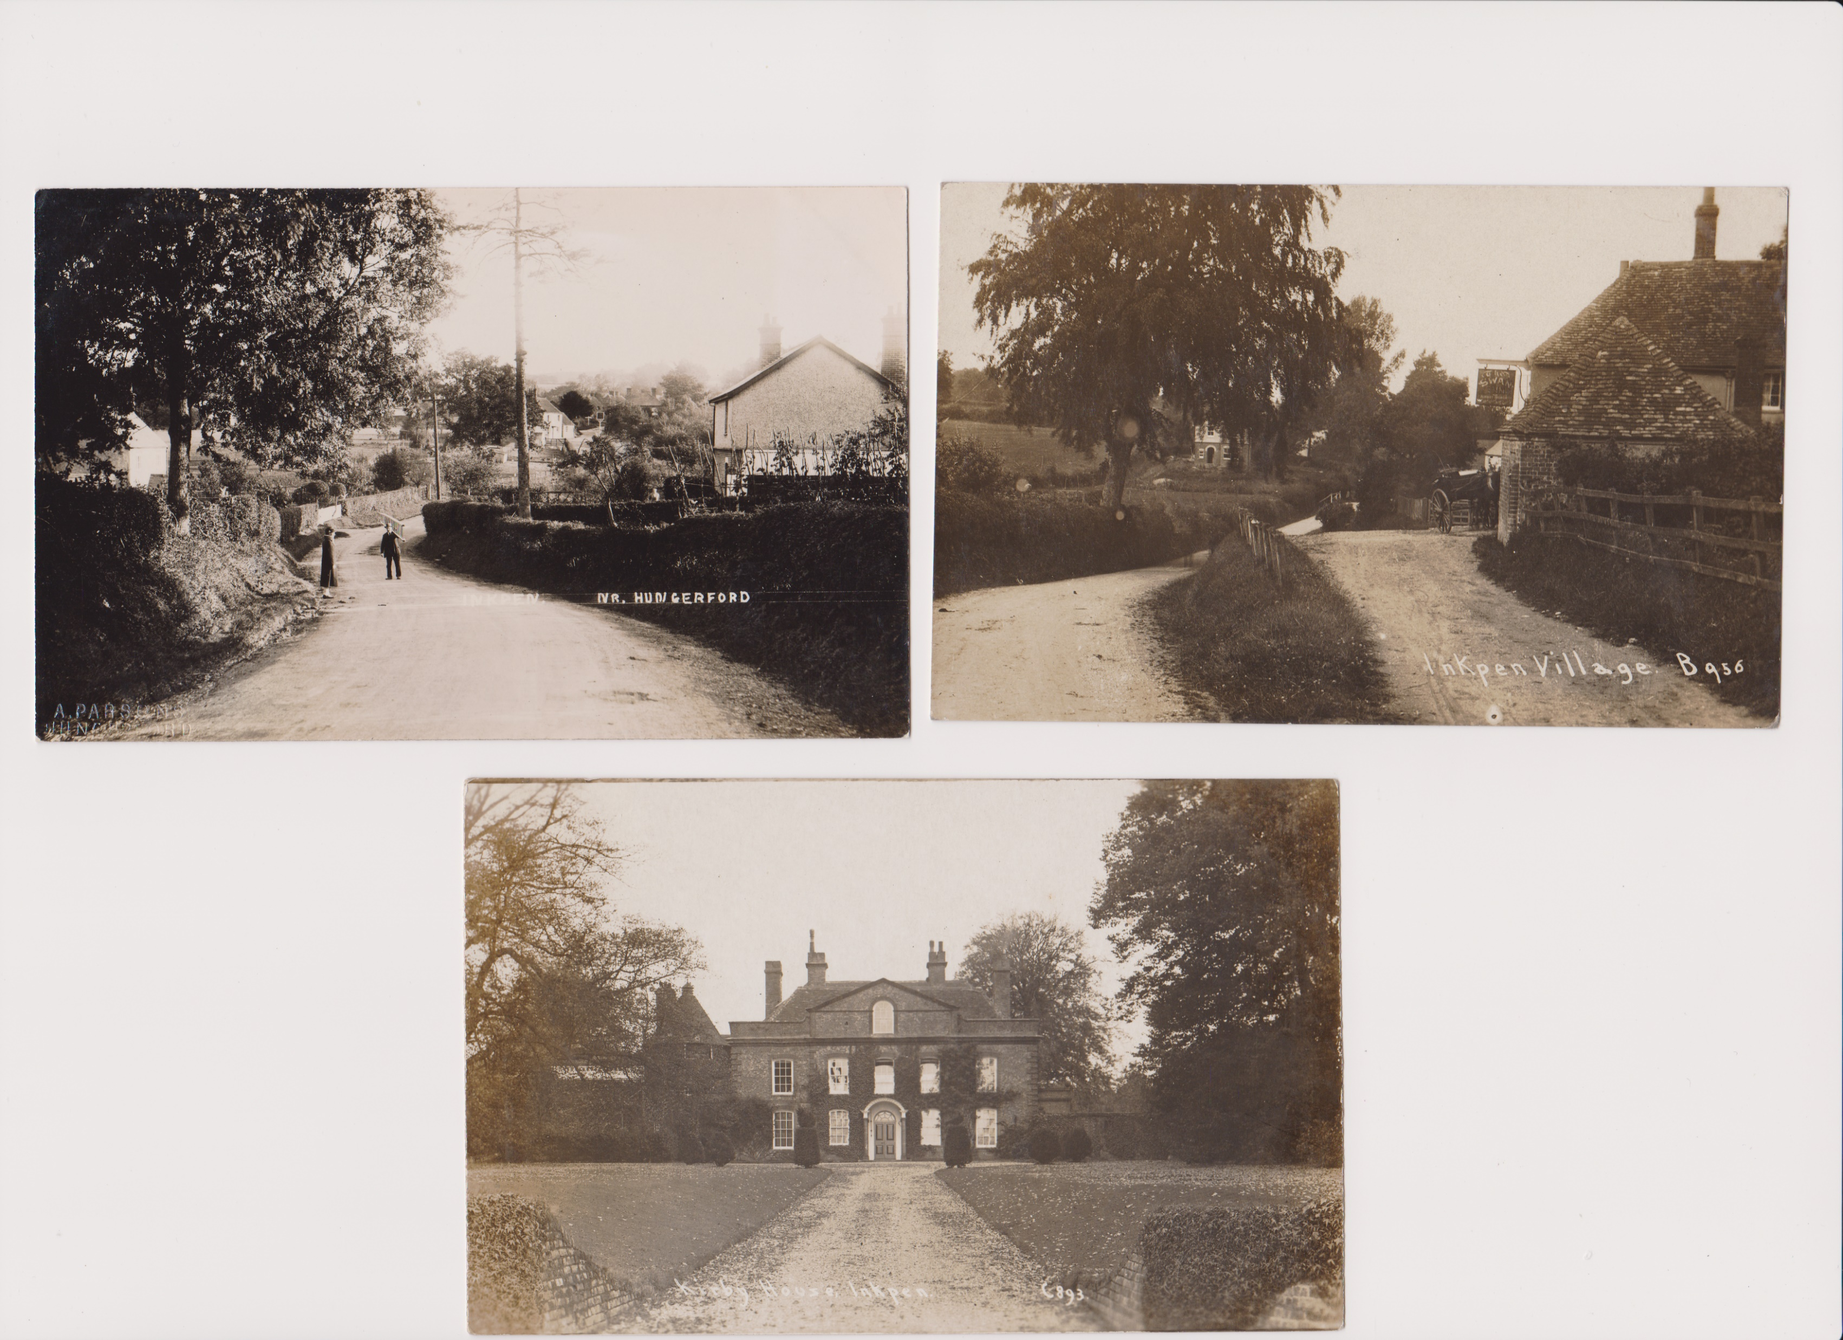

Slide 33
Surname | Total 1881 census
MAY | 61
BAKER | 23
ROLFE | 22
EDWARDS | 18
STACEY | 16
BLACK | 15
FRANKLIN | 13
PALMER | 12
WRIGHT | 12
GILBERT | 12
WATTS | 12
WILLIAMS | 11
ABRAHAM | 11
BAILEY | 11
HOPKINS | 11
BANCE | 11
BATTEN | 10

Slide 34
Final notes
Find My Past newspaper index Can be used free at the Library
Ancestry- can be used FOC at the library
Old photos/postcards wanted
Interesting stories Please we need them all

