Slide 1
Newspaper Clips – 1750 to 1840
With a few extras as shown here

Slide 2
Our Pubs

Slide 3
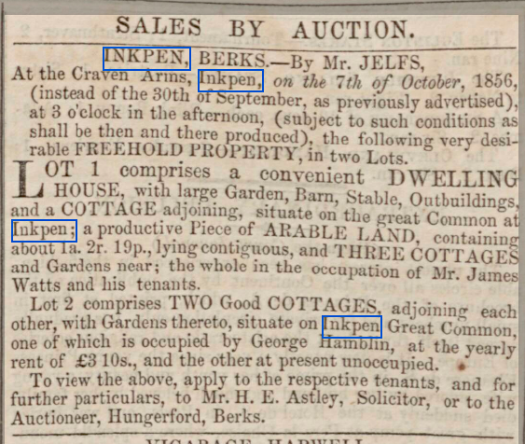
Craven Arms
Estate agents

Slide 4
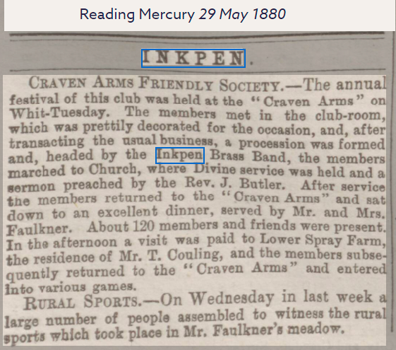
Focus of social activity

Slide 5
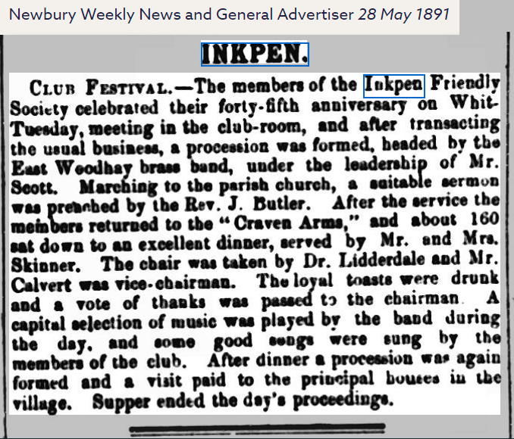
Supported by their favoured brass band

Slide 6
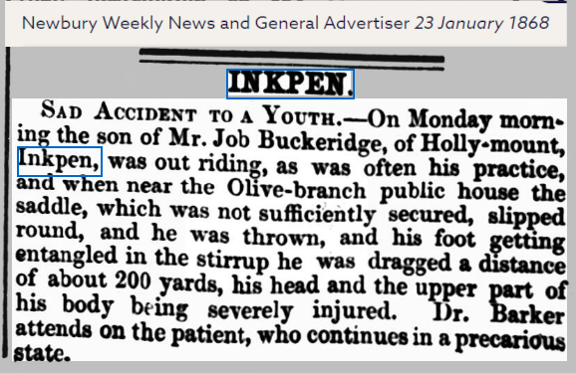
Olive Branch Public House
A place for inquests

Slide 7
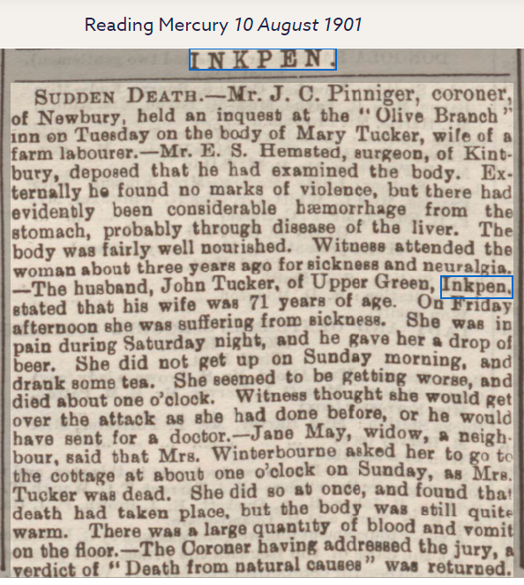
Inquest

Slide 8
Crown & Garter Inquest

Slide 9
1901-10—19 Reading Murcury
Inquest

Slide 10
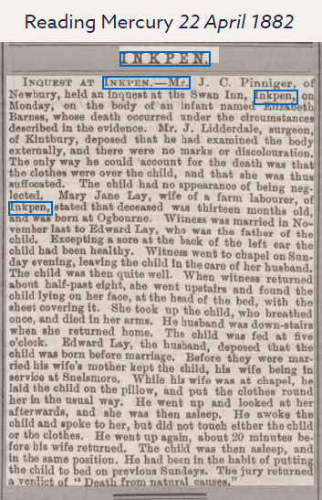
The Swan Inn
Inquest

Slide 11
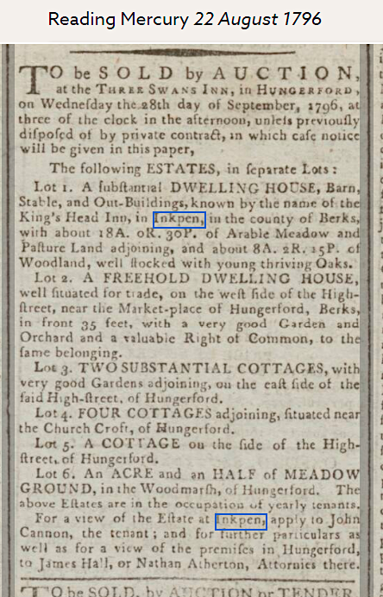
Kings Head Inn, Inkpen ?

Slide 13
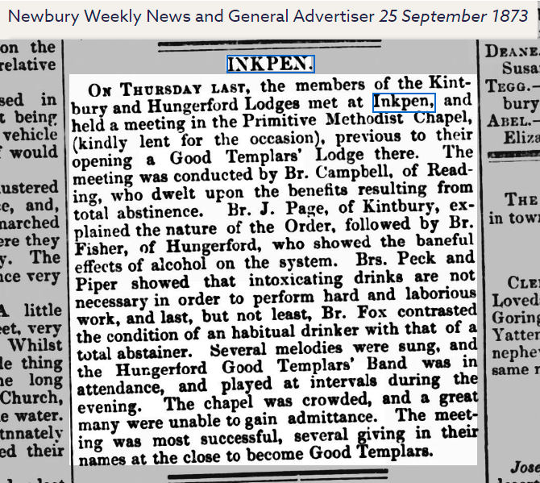
Our Churches
PrimitiveMethodist

Slide 14
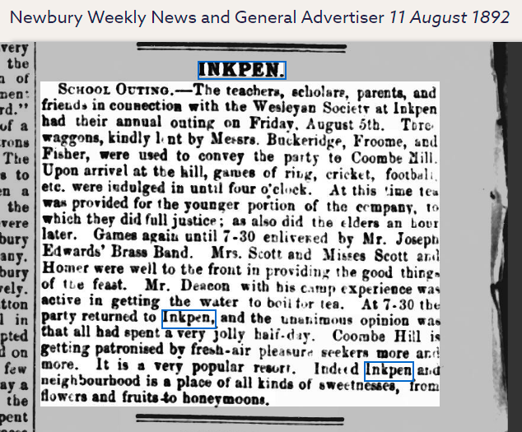
Wesleyan

Slide 15
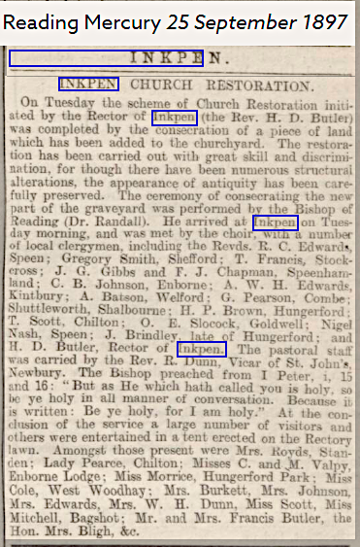
St. Michael’s Restoration

Slide 16
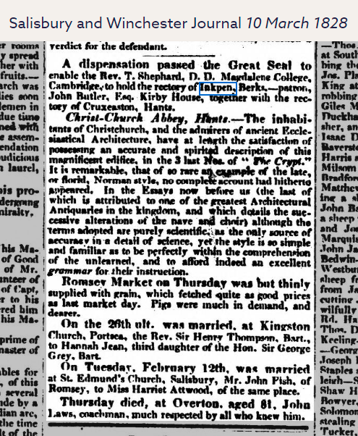
Rector via the Great Seal

Slide 17
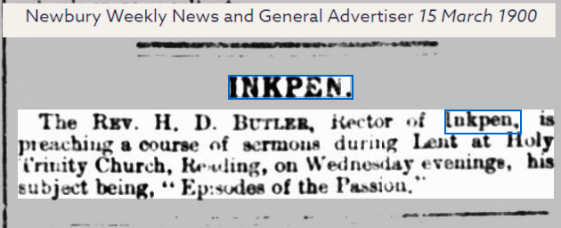
Episodes of Passion

Slide 18
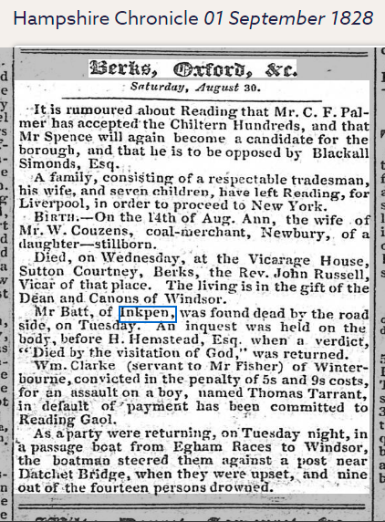
Visitation of God

Slide 19
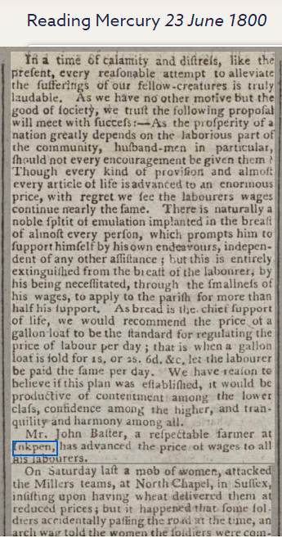
Start of the Poors’ Allotment Trust

Slide 20
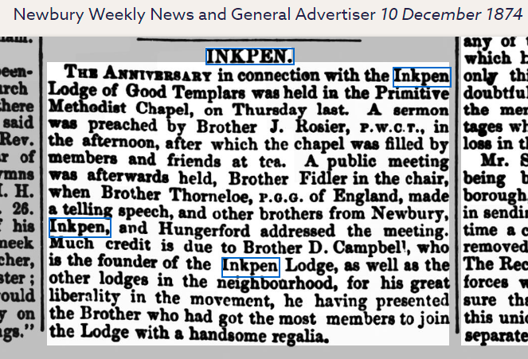
The Templars

Slide 21
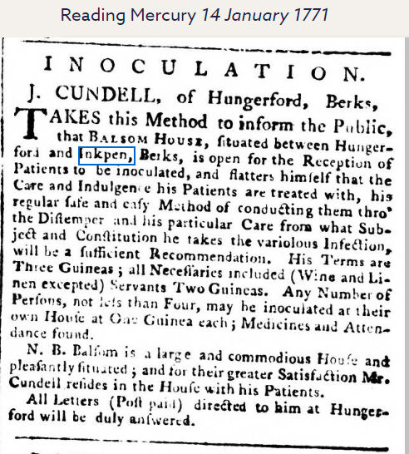
Health Care

Slide 22
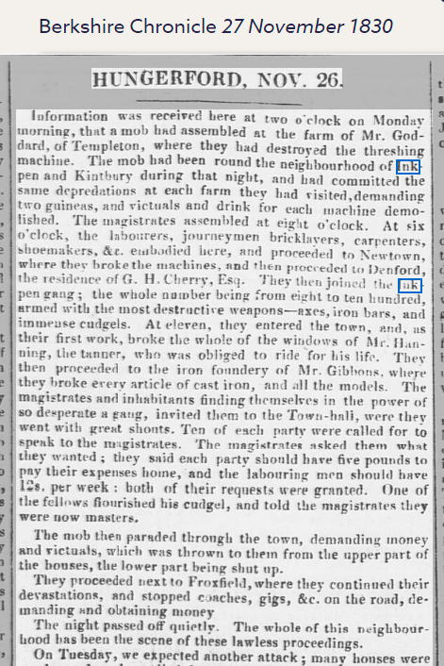
Inkpen and Kintbury Riots

Slide 24
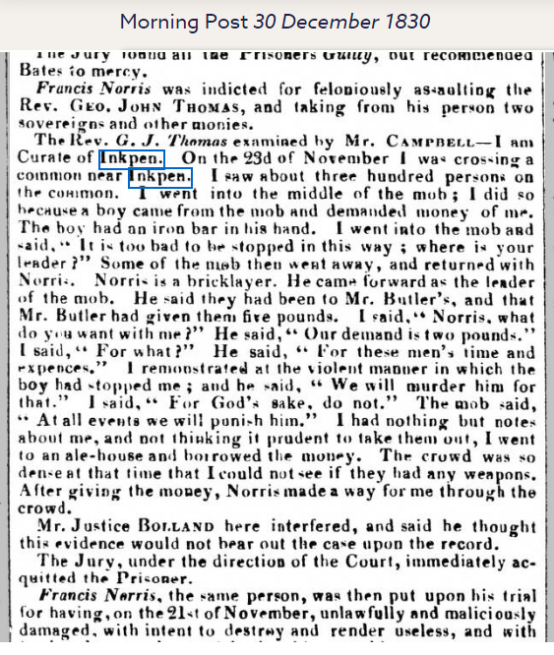

Slide 25
Death or Transportation

Slide 26
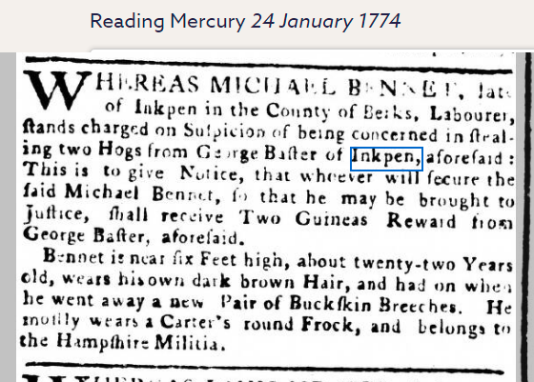
Felony

Slide 27
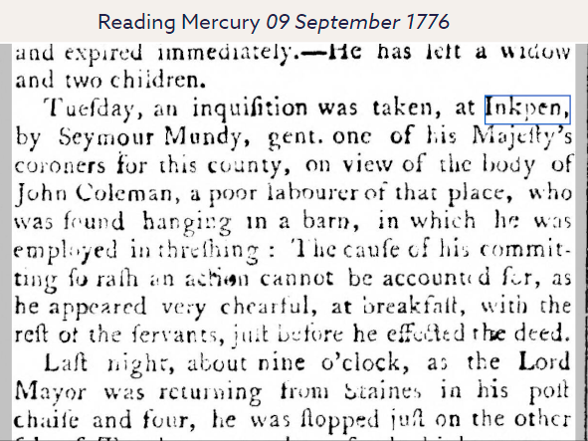

Slide 28
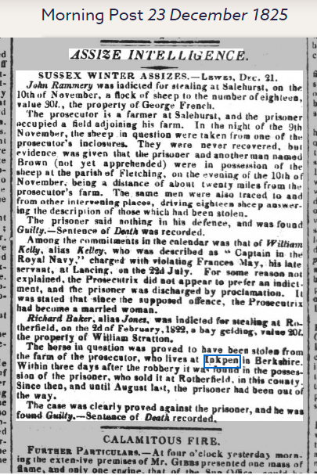

Slide 29
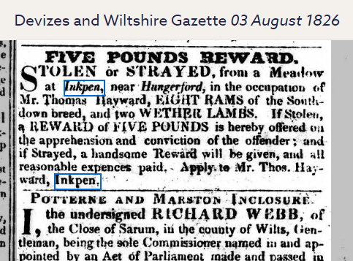

Slide 30
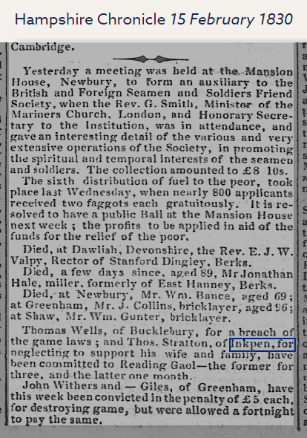

Slide 31
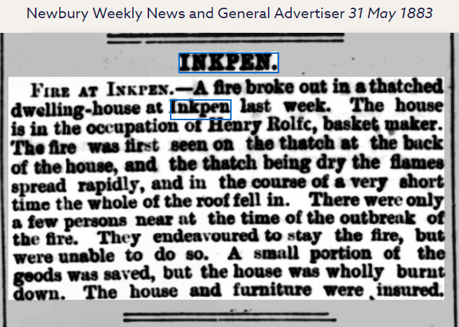
Inkpen Trades

Slide 32
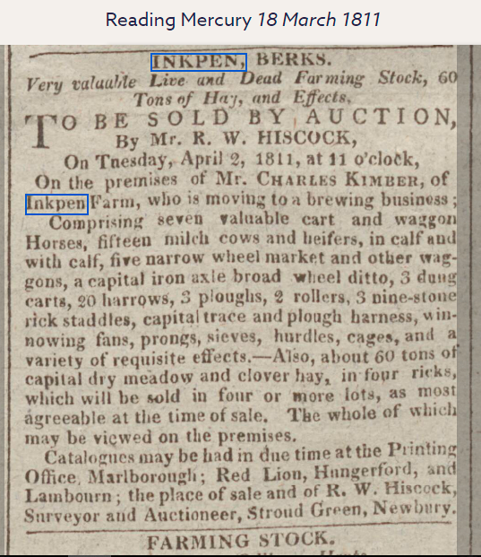

Slide 33
Activities

Slide 34
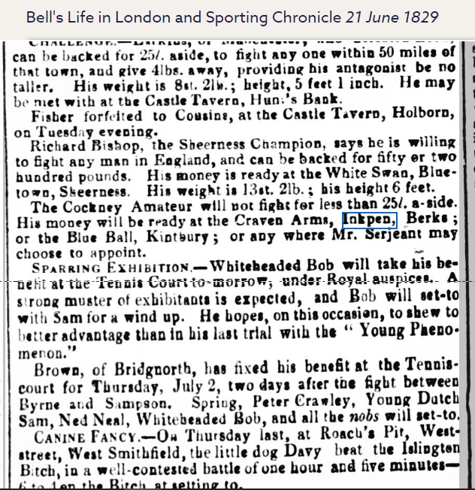

Slide 35
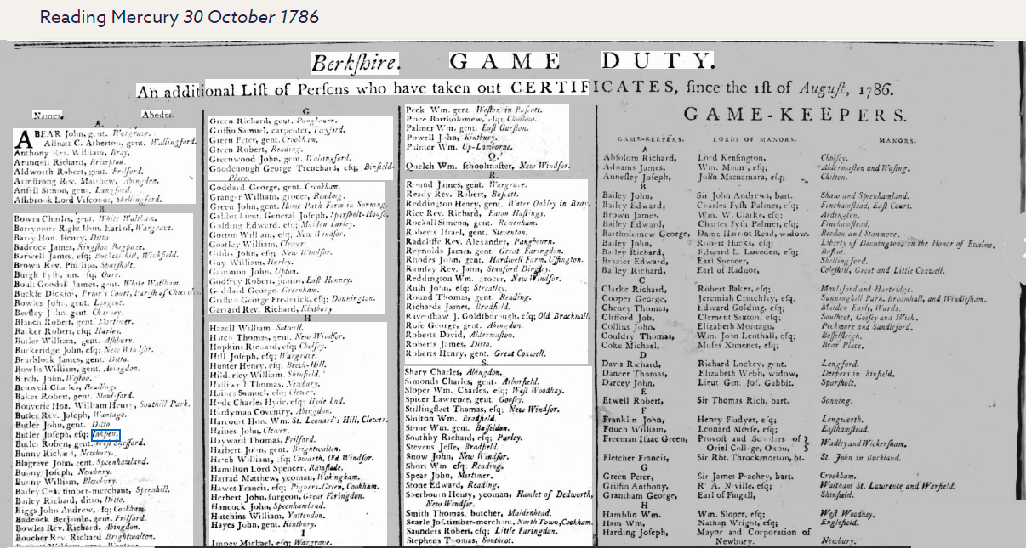

Slide 36
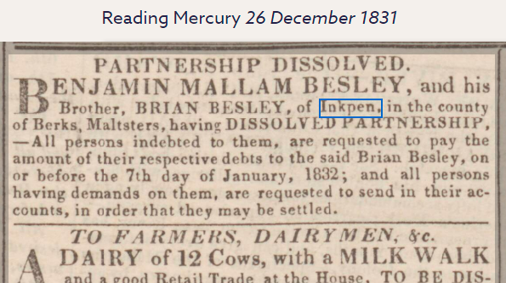

Slide 38
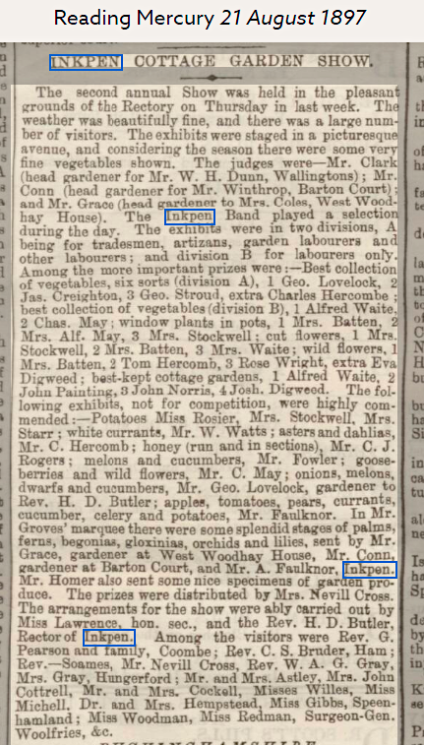

Slide 39
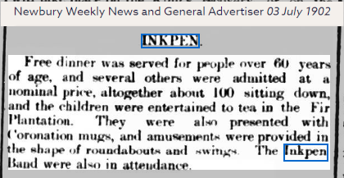

Slide 40
