Slide 2
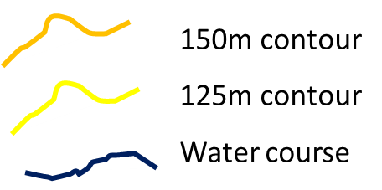
Shape of the land
B
T
P
C
K

Slide 3
Shape of the land
Pre-Domesday Book Finds
B
T
P
C
K
Beaker finds

Slide 4
Shape of the land
Domesday Book ???
B
T
P
C
K
Beaker finds

Slide 5
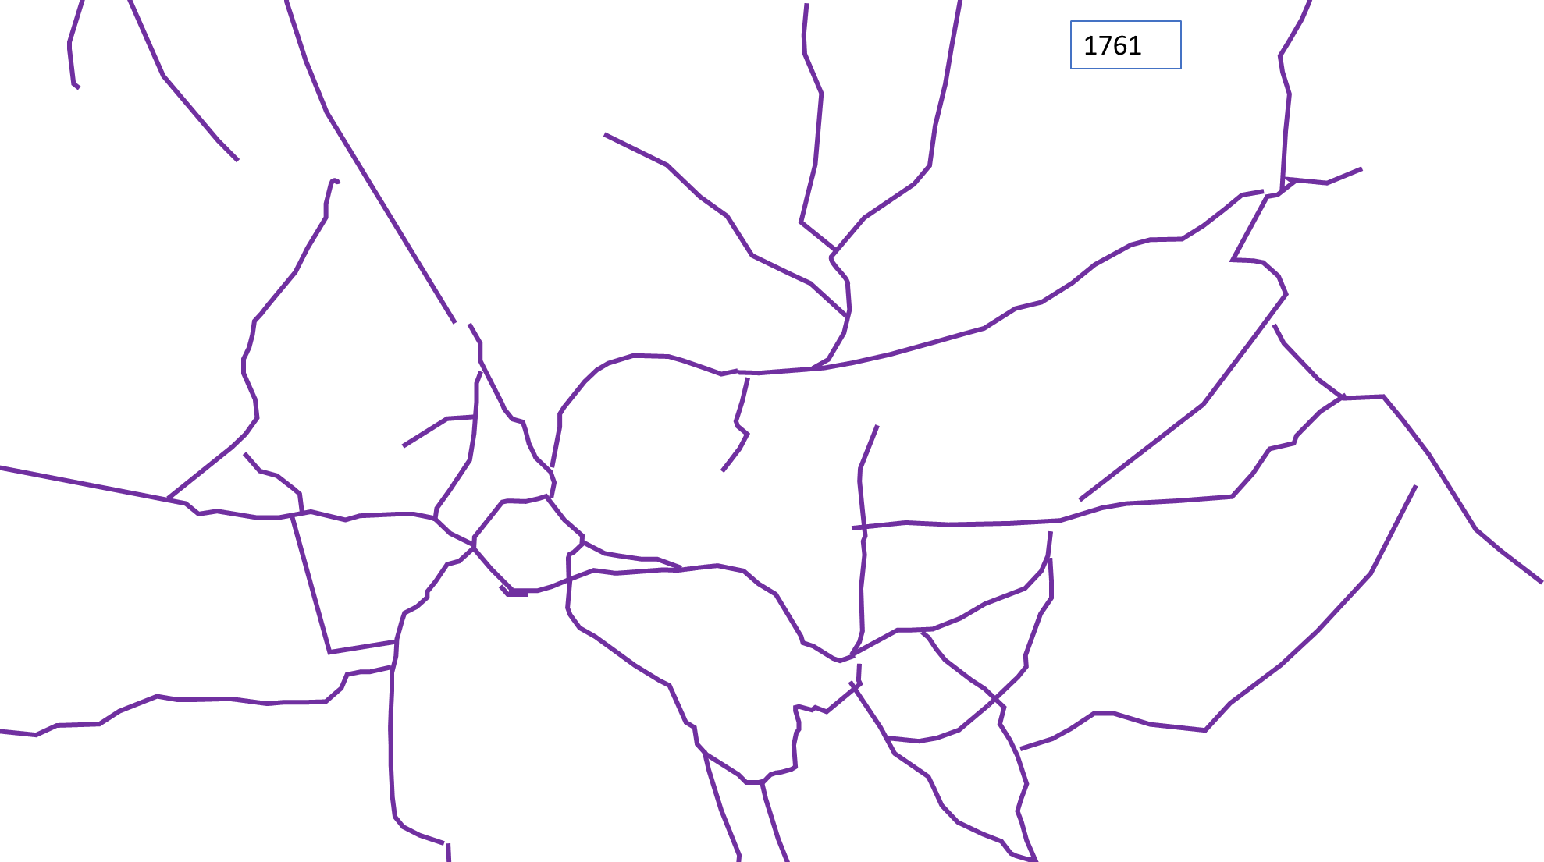
Tracks

Slide 6
1761 Structures

Slide 7
Tracks and
Structures
B
T
P
C
K

Slide 8
1842 Tracks
B
T
NE LIMIT OF 1842 MAPS
P
C
K

Slide 9
1842
Structures (all colours)
B
T
NE LIMIT OF 1842 MAPS
P
C
K

Slide 10
1842
Maps and Structures
B
T
NE LIMIT OF 1842 MAPS
P
C
K

Slide 11
1842 “Roads”
B
T
P
C
K

Slide 12
1842 “Roads” (purple) and “Paths” (green)
B
T
P
C
K

Slide 13
1842 Structures
B
T
p
s
c
c
P
C
K

Slide 14
1842
B
T
p
s
c
c
P
C
K

Slide 15
Early 20th century – need to decide which map

