Slide 1
The last of the Crusades
and,
Who was Roger de Ingepenne?

Slide 2
The ending of the Crusades
Sir Roger de Ingepenne
St Michael’s Church

Slide 3
The Crusades

Slide 4
Military religious orders:
  Knights Templar (founded 1119) – protected pilgrims; became elite warriors and bankers
  Knights Hospitaller (founded c. 1099) – cared for sick; later military order
  Teutonic Knights (founded 1190) – operated in the Baltic region

Slide 5
England at the end of the Crusades (1272–1327)
Edward I (r. 1272–1307)
  “Hammer of the Scots” – conquered Wales, expelled Jews (1290)
  Called the “Model Parliament” (1295)
Edward II (r. 1307–1327)
  First Prince of Wales, but weak ruler
  Lost to Scotland at Bannockburn (1314)
  Deposed by his wife and her ally
  Great famine of early 1310s
Edward III (r. 1327–1377)
  Became king at 14 after father’s fall
  Began the Hundred Years’ War with France

Slide 6
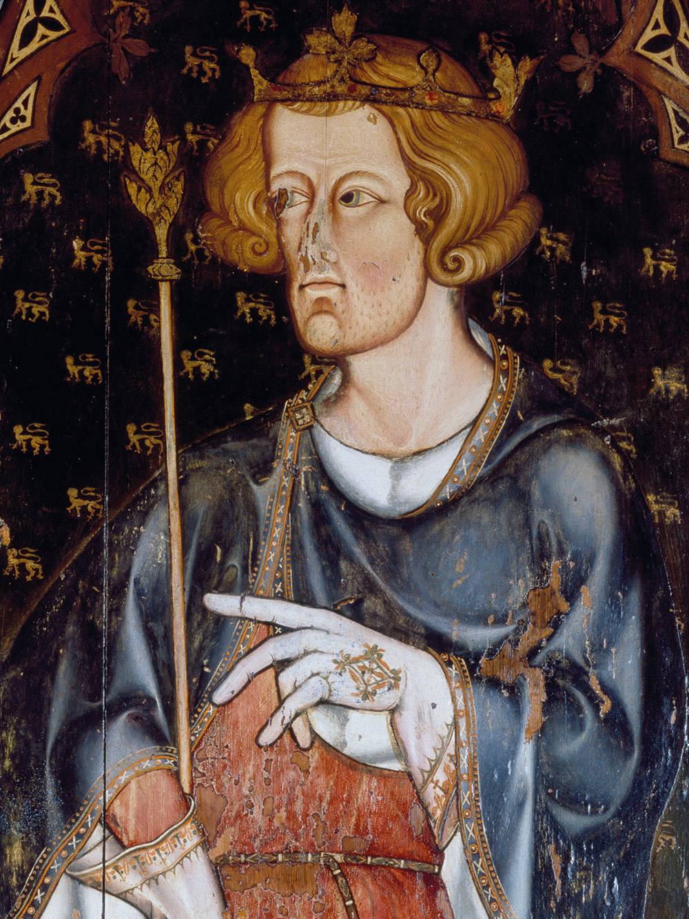
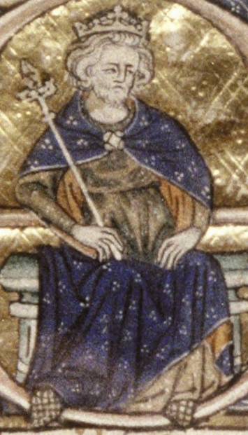
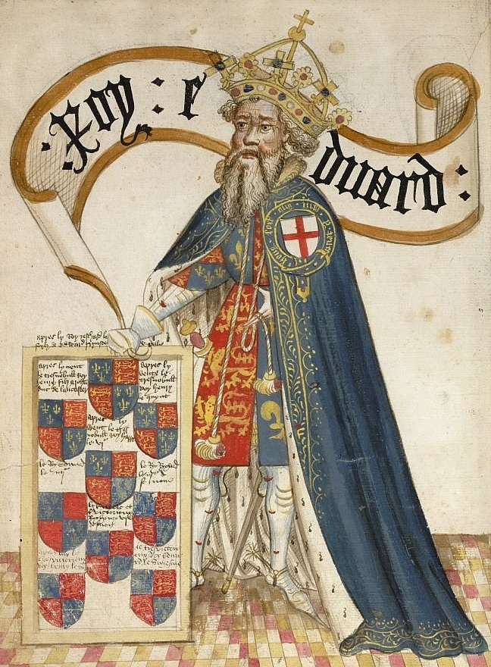

Slide 7
But remember,
The Pope rules in England as in Europe.
We are all Catholic and do just what the Pope tells us to do
(King or pauper).

Slide 8
The Pope tells the Normans to go and capture the Holy Lands and stop waring in Europe.
In 1098 the Templars (Normans) captured the Holy Lands.

Slide 9
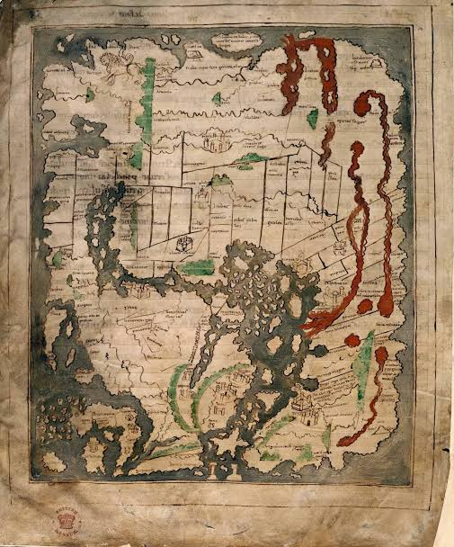
Pre Crusades,
Anglo-Saxon Map centred on Rome.
Dates 1025-50

Slide 10
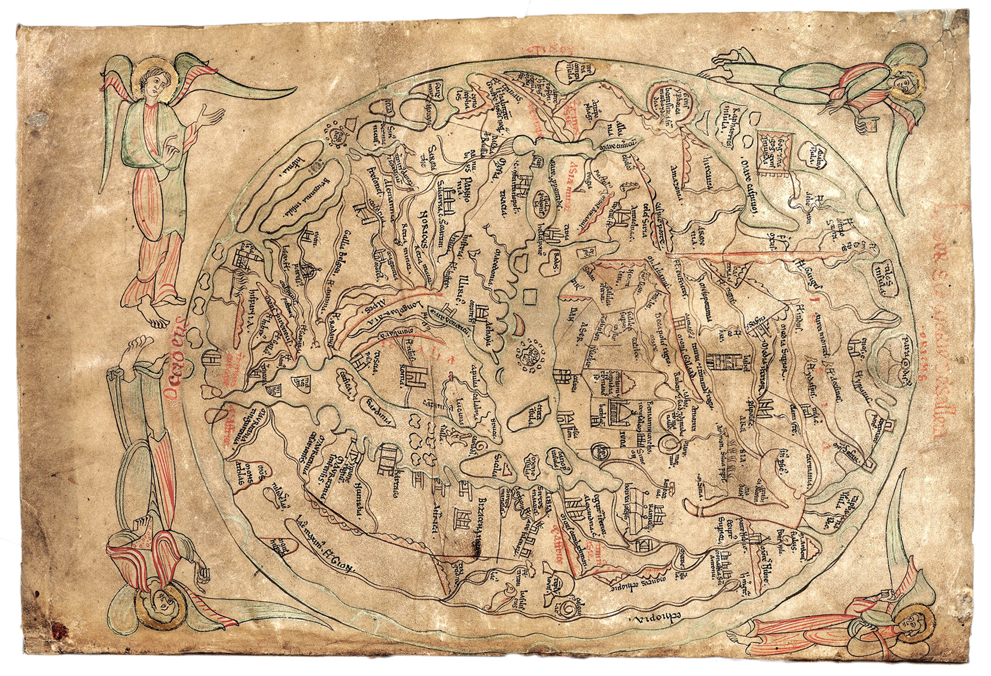
The Sawley map
1190-1210

Slide 11
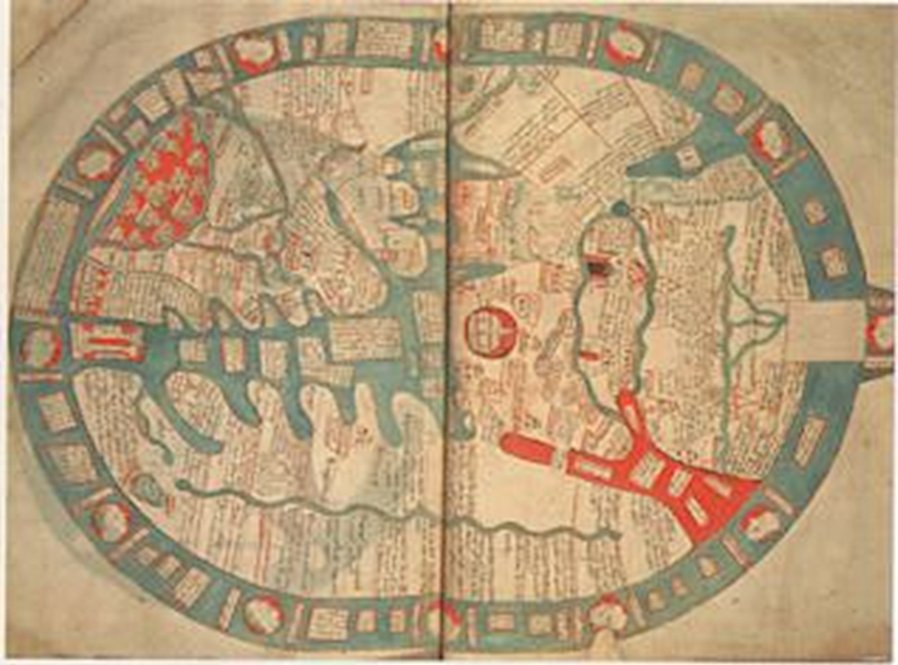
The Vercelli Map
c 1219

Slide 12
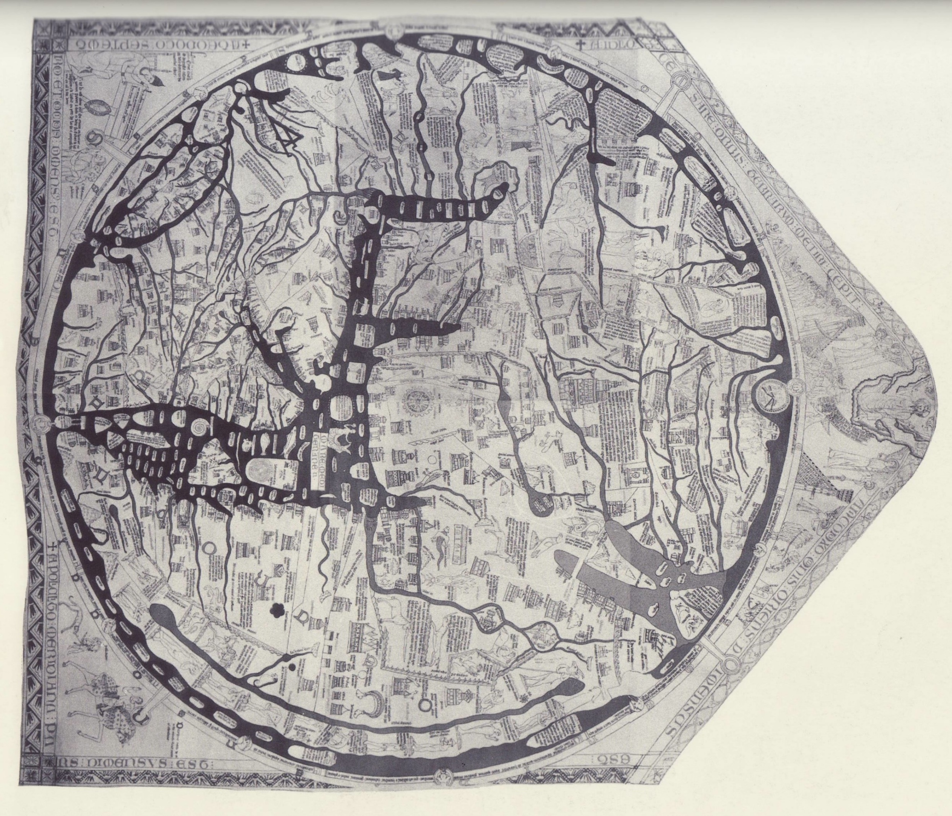
The Hereford Map
c1300

Slide 13
The Crusades,
Winning the war was easy, keeping the peace was hard and expensive

Slide 14
Crusade | Dates | What Happened? | Success?
First Crusade | 1096–1099 | Captured Jerusalem. Set up Crusader states. | ✅ Success
Second Crusade | 1147–1149 | Failed to recapture Edessa (lost 1144). | ❌ Failure
Third Crusade | 1189–1192 | Richard the Lionheart vs. Saladin. Got a truce, not Jerusalem. | ⚖️ Truce
Fourth Crusade | 1202–1204 | Never reached Holy Land. Sacked Christian Constantinople instead. | ❌ Disaster
Fifth Crusade | 1217–1221 | Invaded Egypt. Captured Damietta, then lost it. | ❌ Failur e
Sixth Crusade | 1228–1229 | Emperor Frederick II used diplomacy, not war, to regain Jerusalem. | ⚖️ Partial
Seventh Crusade | 1248–1254 | King Louis IX of France invaded Egypt. Captured and ransomed. | ❌ Failure
Eighth Crusade | 1270 | Louis IX tried again. Died in Tunis. Went nowhere. | ❌ Failure
Fall of Acre | 1291 | Muslims captured Acre, the last Crusader stronghold. | 🔚 End of Crusader states

Slide 15
The Fall of Acre (1291): The End of the Crusader Kingdoms
Isolated: By 1291, Acre was the last major Crusader stronghold in the Holy Land.
The Siege (April 6 – May 28, 1291)
Massive Mamluk Army: ~70,000 horsemen, 150,000 infantry, and over 100 catapults.
Outnumbered Defenders: ~1,000 cavalry, 14,000 infantry (including Knights Templar & Hospitaller).
The Final Assault (May 18): Walls breached; Mamluk forces poured into the city.
Massacre: Thousands of civilians & soldiers killed; survivors enslaved.
Last Stand: Templar fortress held for 10 more days before being overwhelmed.
Total Collapse: Crusader cities (Tyre, Sidon, Beirut) abandoned. 2 centuries of Crusader rule ended.
Crusaders retreated to Cyprus.
Templars lost their purpose; destroyed by France by 1312.
Hospitallers relocated to Rhodes, then Malta.
The dream of a Latin Kingdom in the East was over.

Slide 16
The Treasure Problem for the English Templars
Two propositions but each facing the same core issue: how to move the treasure without being detected.
By Sea: Safer from land-based detection, but ships could be stopped, searched, or sunk. A single ship carrying the Templar treasury would have been a prime target for pirates or hostile navies.
By Land: Required crossing through Edward II's England. Even with a low profile, moving chests of gold and silver hundreds of miles invited questions from royal officials, local sheriffs, or bandits.
A Possible Solution: Some historians have suggested the treasure was divided among multiple ships and destinations—some going directly to Scotland, others to Cornwall or Ireland—to spread the risk.

Slide 17
(Acre → Scotland → Cornwall) may have been slightly more viable because:
Scotland offered political protection from a king (Robert the Bruce) who was already excommunicated by the Pope and thus had little to lose by harbouring persecuted Templars.
The sea route directly to Scotland avoided English-controlled waters entirely, reducing the risk of interception before the treasure could be secured.
Cornwall could be reached later by a smaller, more discreet party once the political situation in England became clearer.
However, Proposition 1 (Acre → Cornwall → Scotland) has the advantage of placing the treasure on English soil sooner, potentially allowing it to be hidden in Cornwall's remote terrain before any arrests were ordered in England (which did not occur until 1308).

Slide 18
Leg | Segment | Estimated Duration | Key Considerations
1 | Acre to Cyprus | 1-2 days | Same immediate escape.
2 | Cyprus to Scotland | 8-12 weeks | A very long voyage around the Iberian Peninsula and up the western coast of Britain. Scotland's east coast ports (e.g., near Berwick or the Forth) were the primary destinations. This route avoided English-controlled Channel ports entirely.
3 | Scotland layover | 1-4 weeks | Hiding the treasure at Temple, Midlothian or other Templar properties. Bishop Lamberton of St. Andrews may have offered protection .
4 | Scotland to Cornwall | 4-6 weeks | Either by sea (around the coast) or overland through England. Overland carried the same risks as Proposition 1's final leg.
5 | Arrival in Cornwall | – | Destination: Temple, St. Ive, the Cornish preceptory.
4-5 months

Slide 19
What does the Treasure look like? The Evidence We Have Today
Archaeological Finds
Arsuf (2012): 108 gold coins (400g) found in a ceramic jug beneath a tile floor, believed to belong to the Knights Hospitaller. Some coins were minted two centuries earlier in Egypt
Jaffa (2005): An extremely rare Frankish silver half drachma minted in Acre between 1251 and 1257, imitating Islamic coinage
Montfort Castle: Excavations revealed 13th-century coins, chain mail fragments, arrowheads, glass vessels, and evidence of a forge for ironworking

Slide 20
Documentary Evidence
The Templars' banking activities are extensively documented in medieval records. They provided safe storage for sensitive diplomatic documents, managed royal treasuries, distributed pensions for monarchs, and even served Muslim rulers who "borrowed heavily from these fiscal wizards" . The fall of Acre in 1291 was a disaster not just militarily but financially—royal households across Europe were heavily in debt to the Templars, and defeat brought inevitable blame

Slide 21
The Tomar Hoard: A Direct Link to Acre
One of the most compelling pieces of evidence connecting these artifacts directly to your area of interest is the Tomar Hoard.
The Discovery: In 1960, during construction work in the Templar fortress town of Tomar, Portugal, a hoard of extraordinary religious artifacts was unearthed .
The Contents: The collection includes "highly important pieces dating from the time of the crusades," such as ritual vessels, chalices, agate inlaid with gold, altars, and stonework .
The Provenance: Crucially, experts believe that some of these pieces "originate in the Holy Land [and were] removed in 1291 following the fall of Acre" . Other items may have been taken from Constantinople during the Sack of 1204 .
The "Grail Symbology": The description of the hoard also notes "encoded grail symbology" on the items, fuelling speculation about a deeper connection to the Order's most fabled and sought-after relic .
The Tomar Hoard provides tangible proof that the Templars did evacuate some of their most sacred treasures from Acre. It demonstrates that their collection included not just gold coins, but priceless religious artifacts of immense spiritual and historical importance.

Slide 22
The primary source of the Templars' wealth was their network of rural estates, known as preceptories. While there is no record of a Templar preceptory specifically at Templeton in Inkpen parish, the fact that the land was granted to the Knights Hospitaller after 1312 strongly suggests it was originally a Templar property that was transferred . The name "Templeton" itself is a powerful clue, meaning "farmstead of the Templars."

Slide 23
Bringing the Templar goods home, to the Templars of England
(Acre → Scotland → Cornwall) may have been slightly more viable because:
Scotland offered political protection from a king (Robert the Bruce) who was already excommunicated by the Pope and thus had little to lose by harbouring persecuted Templars.
The sea route directly to Scotland avoided English-controlled waters entirely, reducing the risk of interception before the treasure could be secured.
Cornwall could be reached later by a smaller, more discreet party once the political situation in England became clearer.

Slide 24
Roger de Ingepenne
A Templar

Slide 25
Why Do the Crusades Matter for Inkpen?
Inkpen was directly connected to the Crusades through:
1. The de Inkpen family – royal servants who moved in Crusading circles
2. Templeton – a documented Templar and later Hospitaller estate
3. The Crocus Field – local tradition links the Mediterranean crocuses to returning Crusaders
4. St. Michael's Church – dedicated to the patron saint of warriors and the Templars

Slide 26
What is Inkpen?

Slide 27
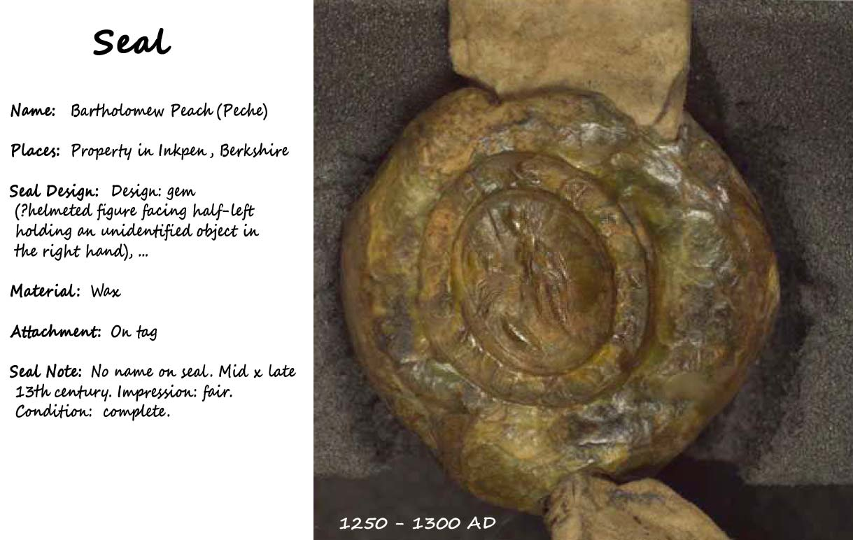

Slide 28
Sir Roger de Ingepenne
Sheriff of Cornwall
Mayor of the city of Winchester
But why live in Inkpen?

Slide 29
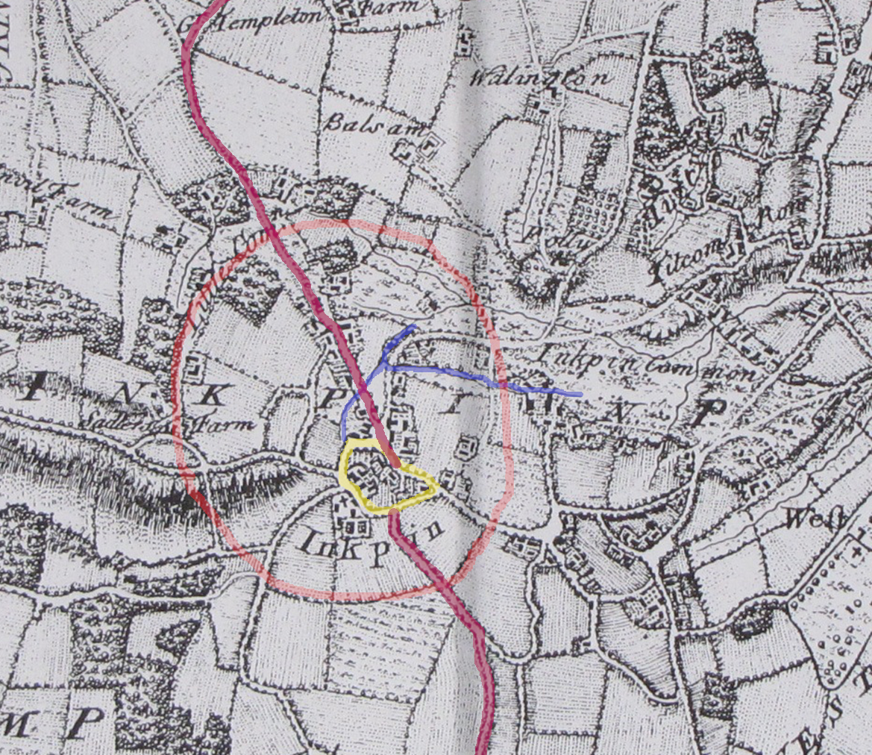

Slide 30
Inkpen
to Hurstbourne Tarrant
to St Mary Bourne
to Longparish
to West Down, Chilbolton
to Stockbridge
to Winchester

Slide 31
Sir Roger is in control of sea ports in Cornwall

Slide 32
Arundell of Lanherne and Trerice.TITLE DEEDS.CORNWALL.Lanhadron Manor. Arch'diakne, Sir Roger de Inkepenne then steward of Cornwall, and Sir Thomas de Kent, knights, Thomas de Trenpol, Robert de Tregenneu. Seal of (1) [red...Gift of land, for a deer-park Hugh de Ba = (1) Serlo de Lanladron = (2) (1) to (2), a piece of land together with (l)'s moor (una cum toto moro meo... by Henry Berdyn (que se extendit de venela de Lenewy protendente versus boscum scilicet ab angulo cuiusdam pecie terre versus occidentem que nominatur
Note: , 1/249, 1/256, 1/288-9 and 42/2). According to Mark Page, Roger de Ingepenne was sheriff and steward in 1286-87 and 1287-88, and also sheriff and...Date: Probably 1284 x 1287 or 1301 x 1303. Thomas de Trenpol occurs in 1284 (Feet of Fines 285); Serlo de Lanladron was alive in 1285-1311 (AR/1/229... steward jointly with William de Monketon in 1284-85 and 1285-86 (all from Pipe Rolls? E.372/131-133); according to Public Record Office List of Sheriffs, he was again sheriff [and possibly thus steward as well?] in 1302. "

Slide 33
Arundell of Lanherne and Trerice.TITLE DEEDS.CORNWALL.Goran Manor. (Friday before St Barnabas, 18 Edw I); at Karyheys Gift Henry de Burne and Emelina his wife = (1)-(2) Roger de Ingepenne, knight = (3) (1)-(2) to (3...), all their land of Sanctus Goronus, which they had by gift of Thomas de Sicca Villa, knight, with all appurtenances, namely buildings, curtilages... paying 10 marks yearly to Thomas de Sicca Villa, at 4 terms, for all services and demands. Sir John de Alet, Sir John de Treiagu, Sir Reginald de
Note: Arundell) dispossessed their husbands of Carhays manor in 1287-89, they both gave their shares to Roger de Ingepenne and Emmeline his wife. "

Slide 34
The Parish church shows no evidence of St. Goran's presence. The Normans, six hundred years later, built a cruciform church on this site but the only remains of their work are at the foot of the arch leading to the north transept and the font. The church now comprises a Nave and Chancel, South Aisle and a North transept and a 90ft. Tower. Parts of the North wall of the nave and the chancel are the oldest parts of the Church and follow the line of the Norman building. ln the North wall is a 13th. Century doorway now blocked but visible from the outside with carved heads at the apex and at each of the two label stops.

Slide 35
Held by: | Kresen Kernow (formerly Cornwall Record Office)
Date: | 1290
Duchy of Lancaster: Cartularies, Enrolments, Surveys and other Miscellaneous Books. COWCHERS AND CARTULARIES. Great cowcher or carte regum, II. Register of evidences of title for... , with housebote and haybote. County: [Wiltshire]. Additional people: Witnesses: Nicholas de Horton; Roger Foliot; Richard de Ingepenne [Inkpen]; Simon...Folios: 186v-187. Wiltshire. Agreement. First party: Peter, son of Hugh de St Martin. Second party: Richard Wyard, miller of Hewull. Place or subject...: Peter granted Richard half a yardland with appurtenances in the field of Coleshanneshangre, which Peter de Huppedon once held from Hugh, Peter's

Slide 36
Arundell of Lanherne and Trerice.TITLE DEEDS.CORNWALL.Goran Manor. . Sir John de Alet, Sir Ralph de Tregot, Sir John de Treiagu, Sir Roger de Ingepenne, knights, Stephen de Bello Prato, Richard de Chaumbernon, Thomas...(St Peter's Chains, 18 Edw I); at Lostwythiel Quitclaim Thomas de Sicca Villa, son and heir of Philip de Sicca Villa = (1) Serlo de Nansladron = (2... de Tregemynyon. Seal of (1) [brown, armorial; same matrix as in AR/1/276-7 and 1/283]. Tregemynyon [in Tywardreath, presumably] Same hand as AR/1/283.

Slide 37
TITLE DEEDS.CORNWALL.Lanhadron Manor. Arch'diakne, Sir Roger de Inkepenne then steward of Cornwall
TITLE DEEDS.CORNWALL.Goran Manor. (Friday before St Barnabas, 18 Edw I); at Karyheys Gift Henry de Burne and Emelina his wife = (1)-(2) Roger de Ingepenne, knight = (3) (1)-(2) to (3...), all their land of Sanctus Goronus, which they had by gift of Thomas de Sicca Villa, knight
…..Arundell) dispossessed their husbands of Carhays manor in 1287-89, they both gave their shares to Roger de Ingepenne and Emmeline his wife. "
(Caerhays Castle is an English Heritage Grade 1 Listed Building
From 1370 – 1840 Caerhays had been owned by the Trevanion family.)
Roger de Ingepenne was sheriff and steward in 1286-87 and 1287-88, and also sheriff and...Date: Probably 1284 x 1287 or 1301 x 1303

Slide 38
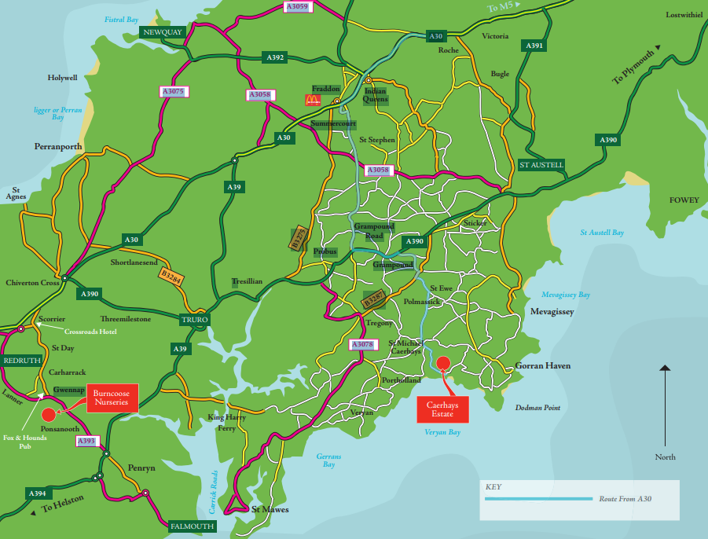

Slide 39
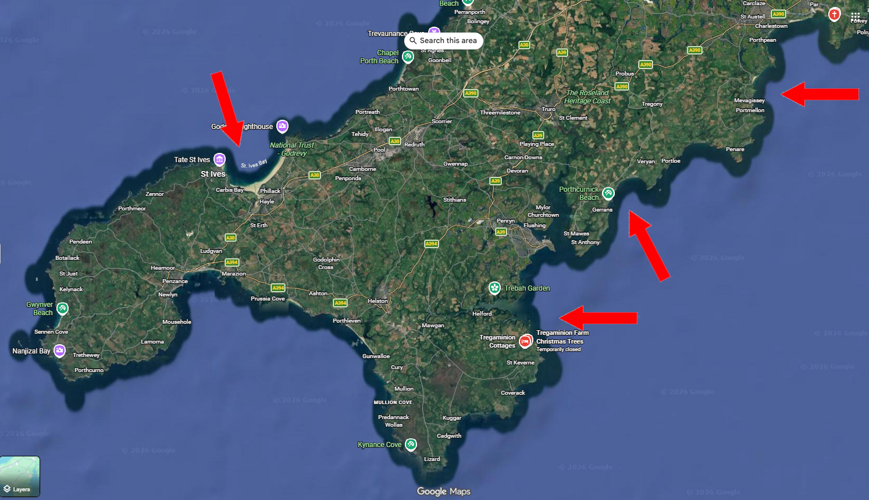

Slide 40
Key Templar Links to Scotland (1280–1300)
Administrative Hubs: Balantrodoch (Temple) was the principal seat of the Templars in Scotland.
Financial & Royal Role: Templars held extensive lands across Scotland and acted as the King's almoners, managing financial resources.
Scottish Records: By 1291 (following the fall of Acre), the Templars were refocusing their efforts, and Scottish records indicate they were active in the region, with the Master of the Scottish Templars active around this time.
Wars of Independence Period: During the initial conflict with England (1296 onwards), the Order in Scotland was in a unique position as they were not immediately suppressed, unlike their counterparts elsewhere.

Slide 41
West Coast (Argyll/Ayrshire): Templar connections in Argyll suggest usage of ports around Loch Sween, a potential landing area. Templar activity also existed in Ayrshire near Loudoun Hill and Kilwinning.

Slide 42
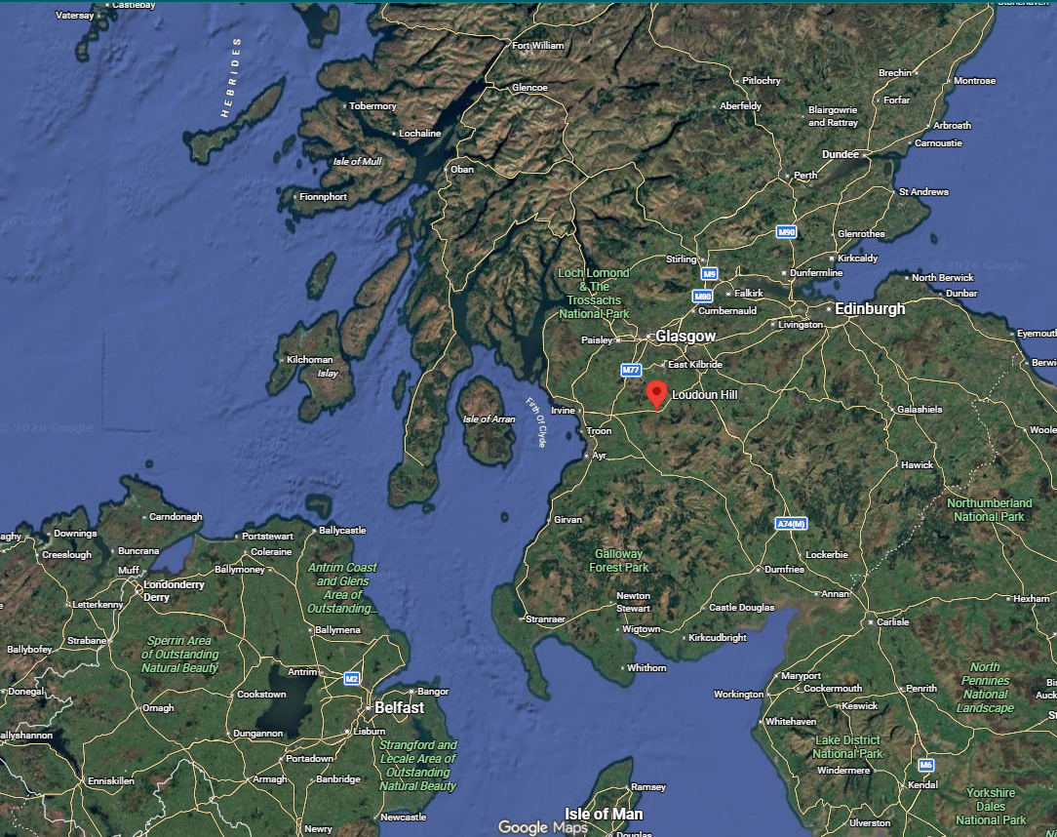

Slide 44
Inkpen Artifacts of the 13th century

Slide 45
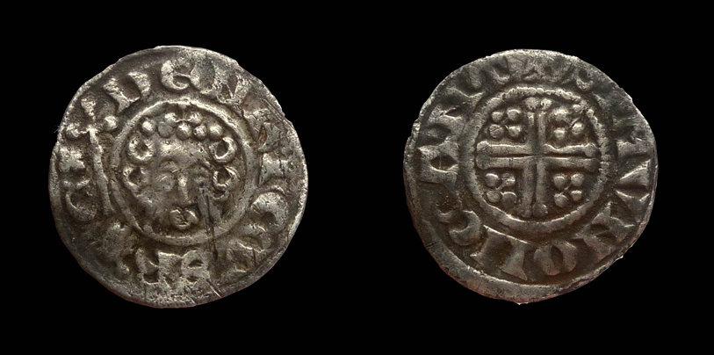
HENRY III (1247-72) (Plantagenet)
PENNY - Canterbury mint

Slide 46
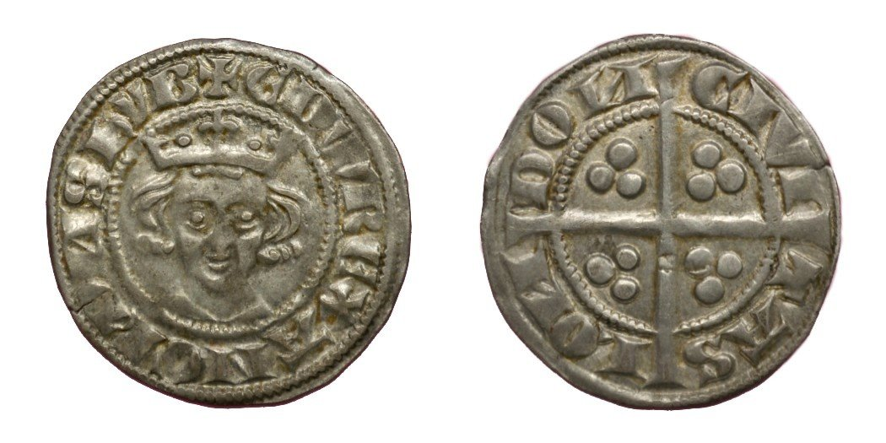
Edward l (Longshanks)
silver hammered penny 1272-1307

Slide 47
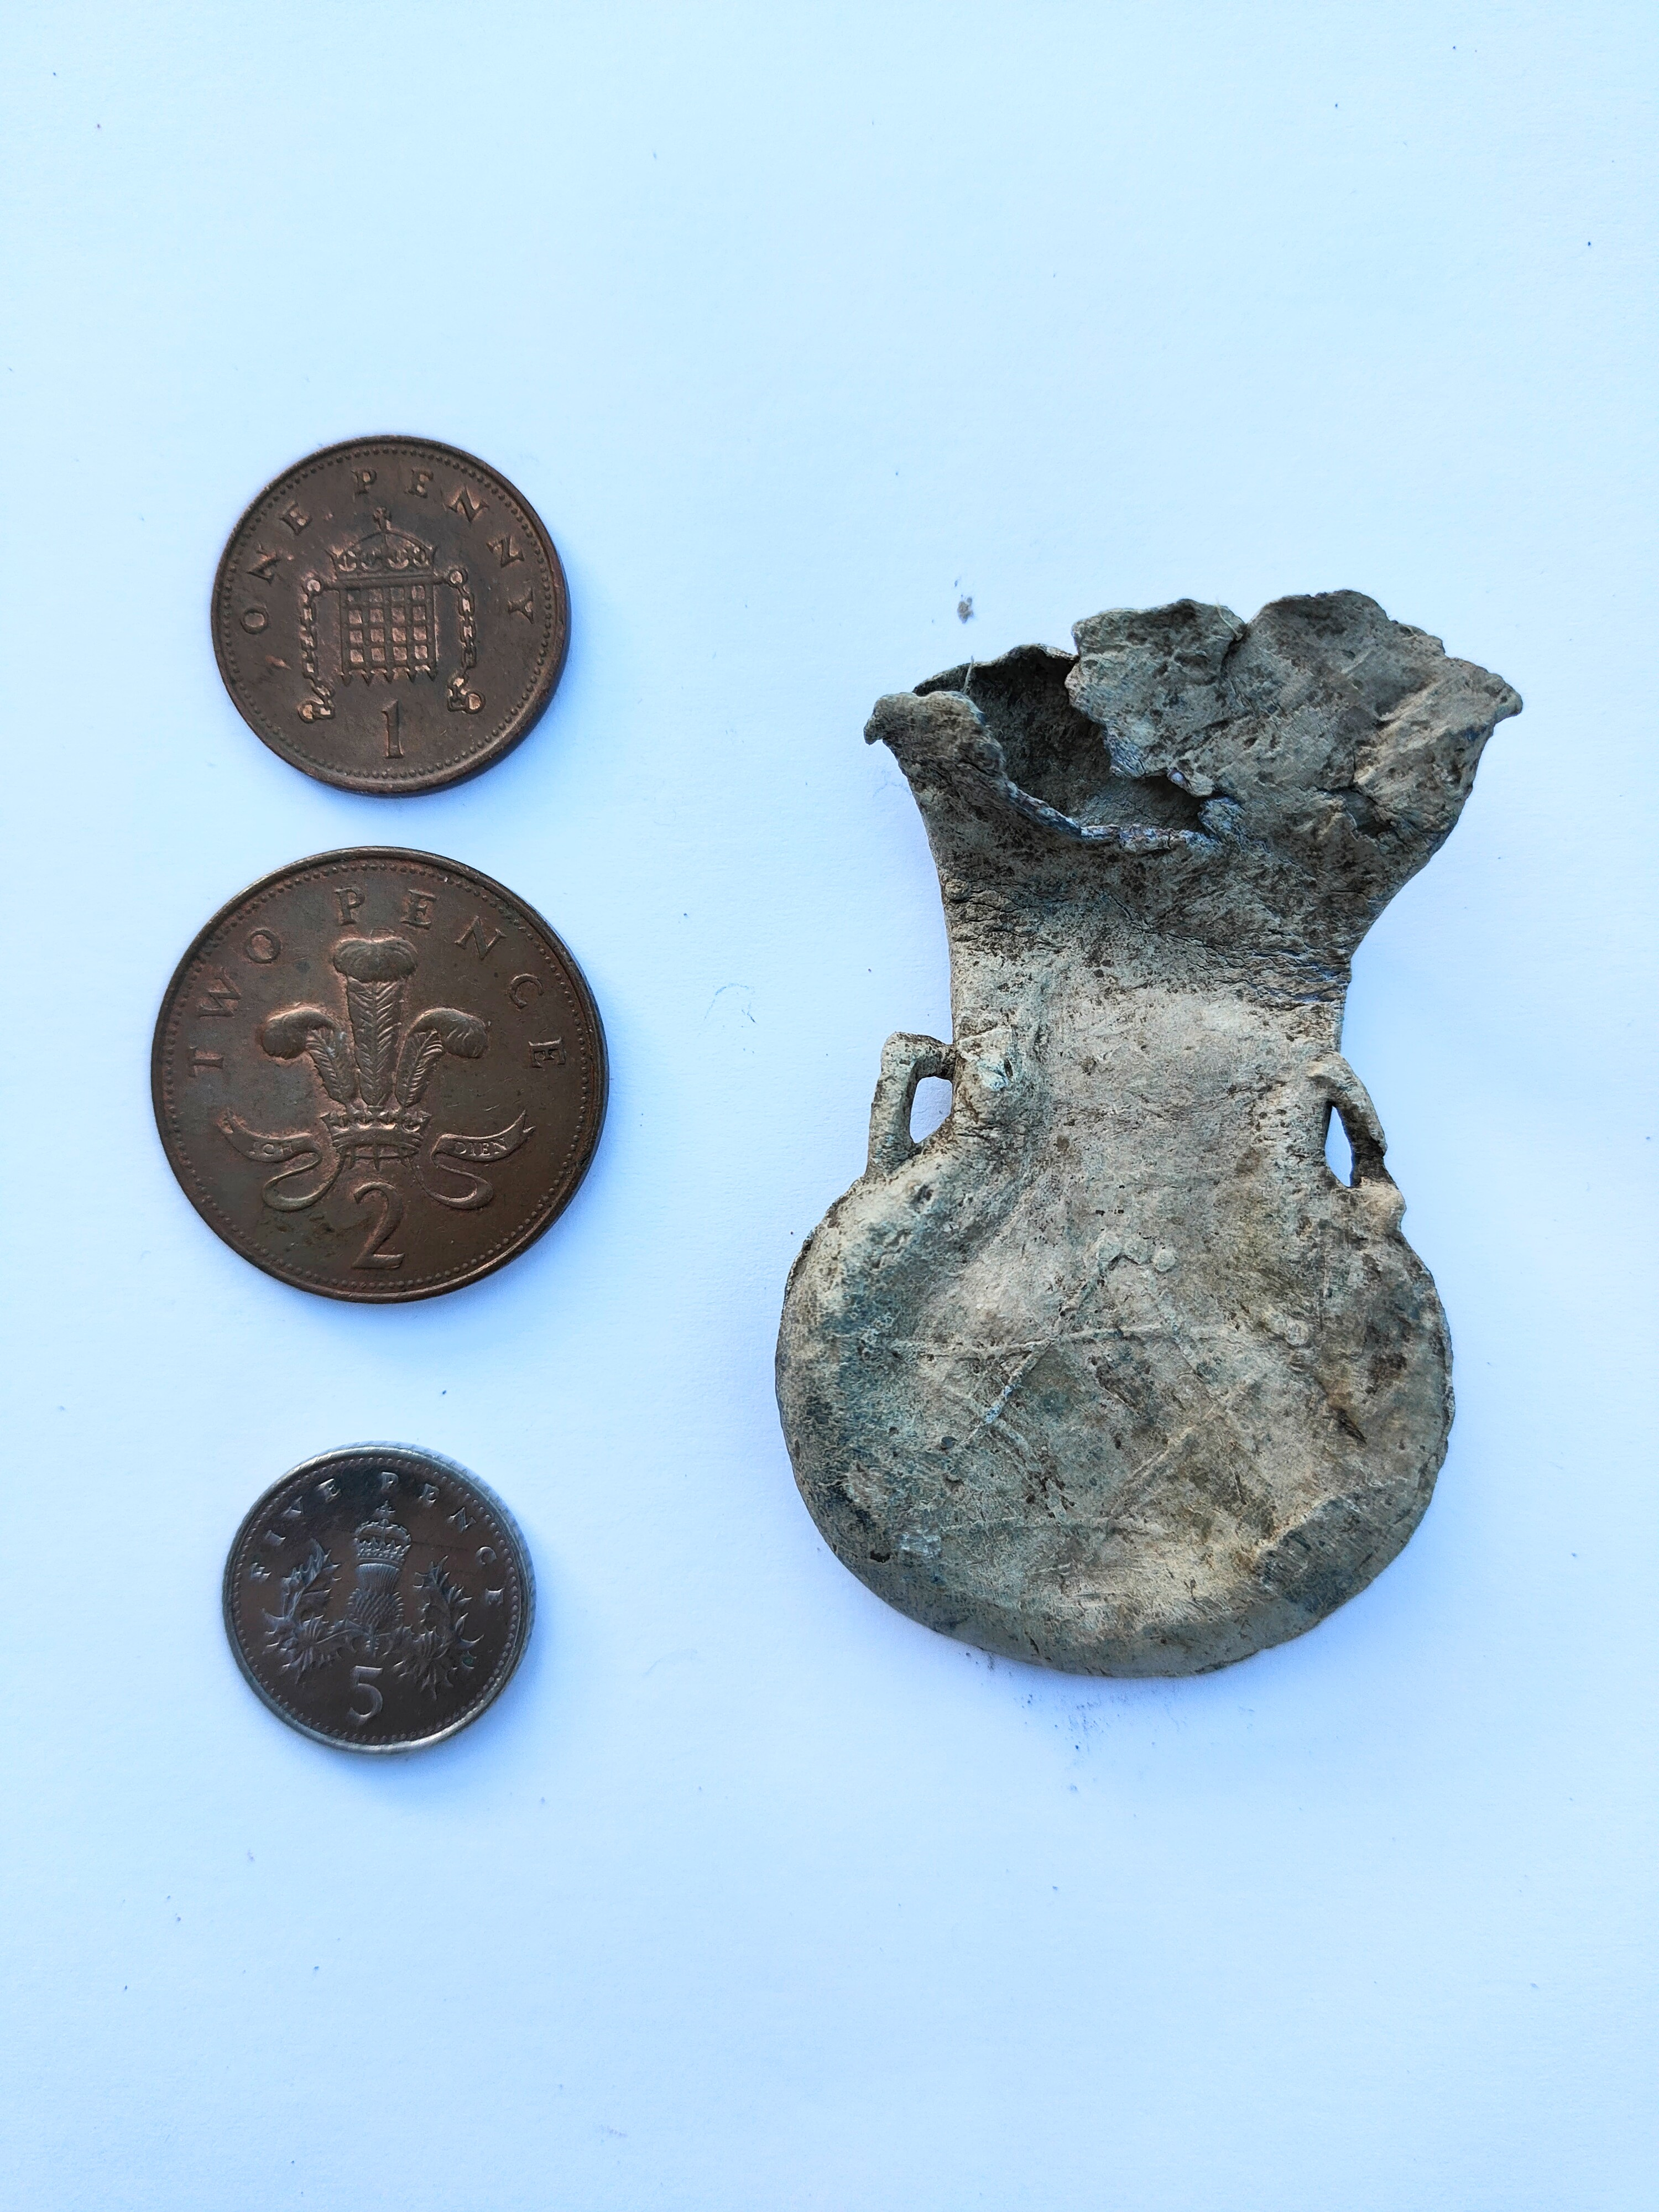
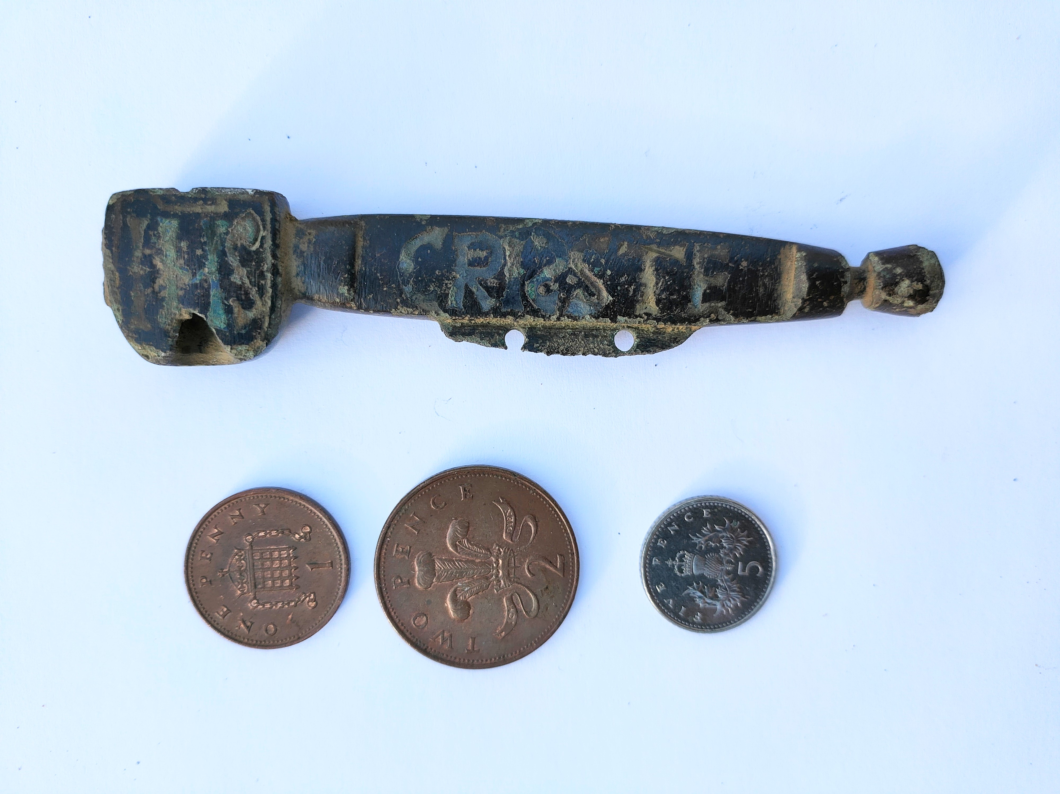

Slide 48
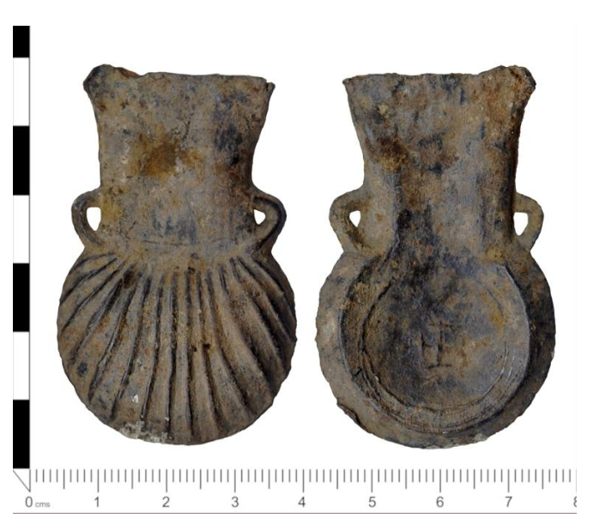

Slide 49
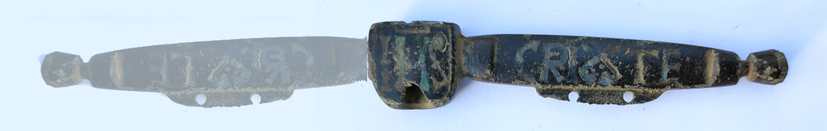
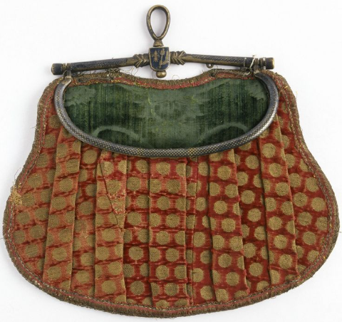
Purse Bar

Slide 50
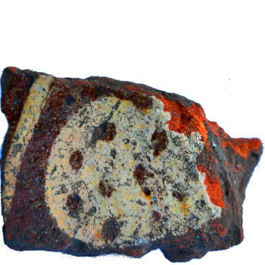

Slide 51
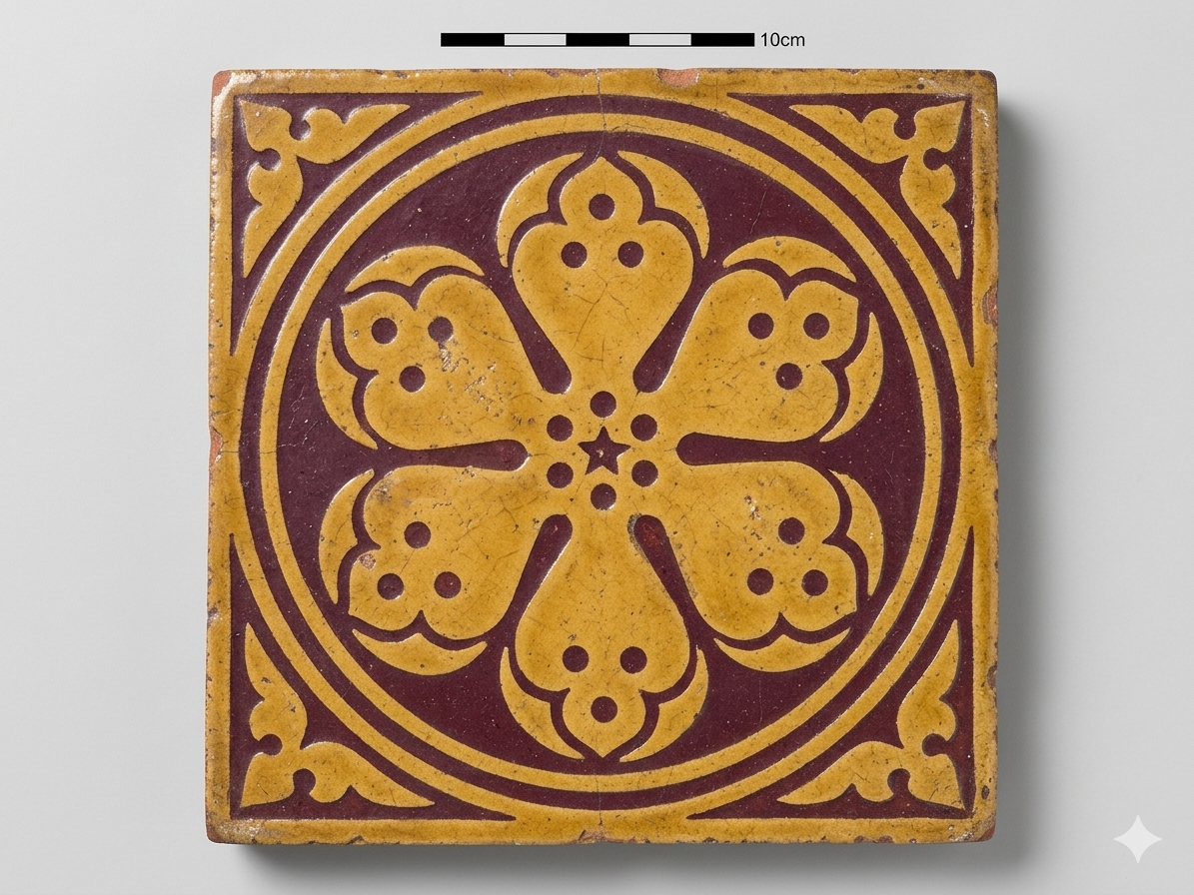

Slide 52
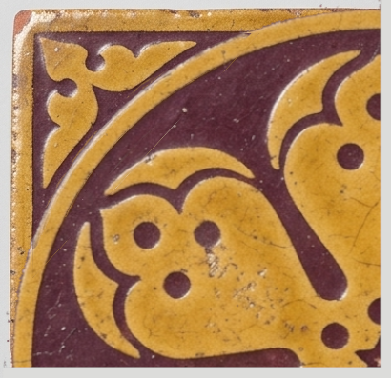

Slide 53
Archaeology

Slide 54
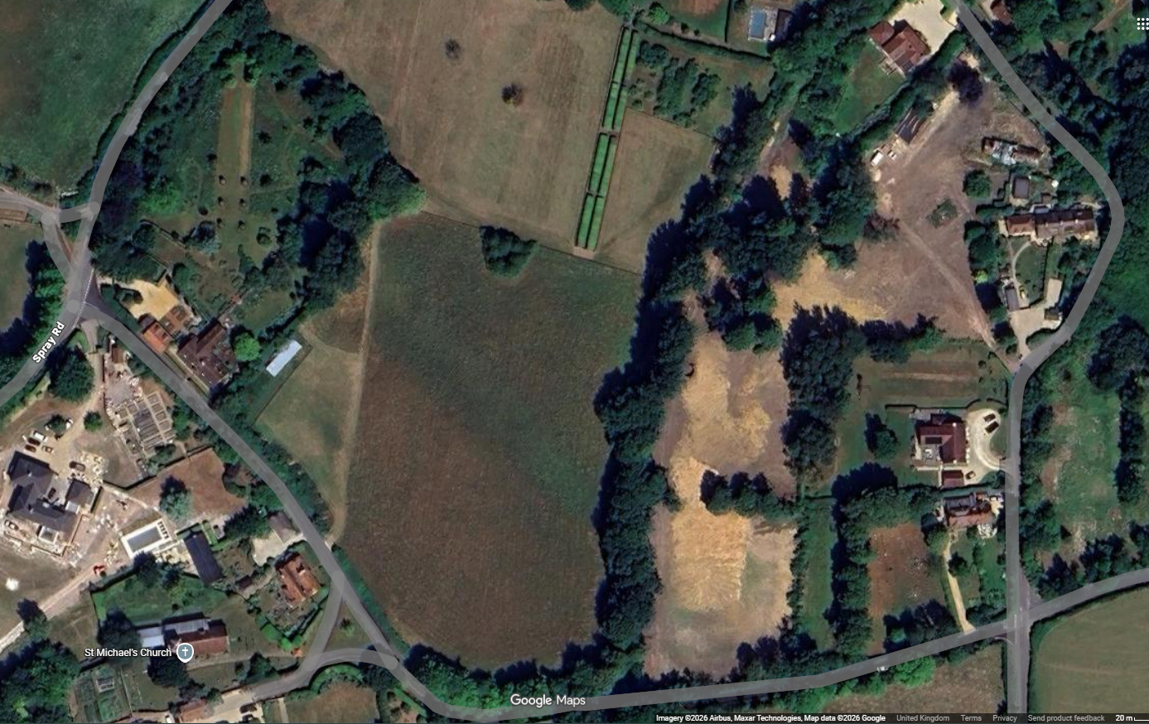

Slide 55
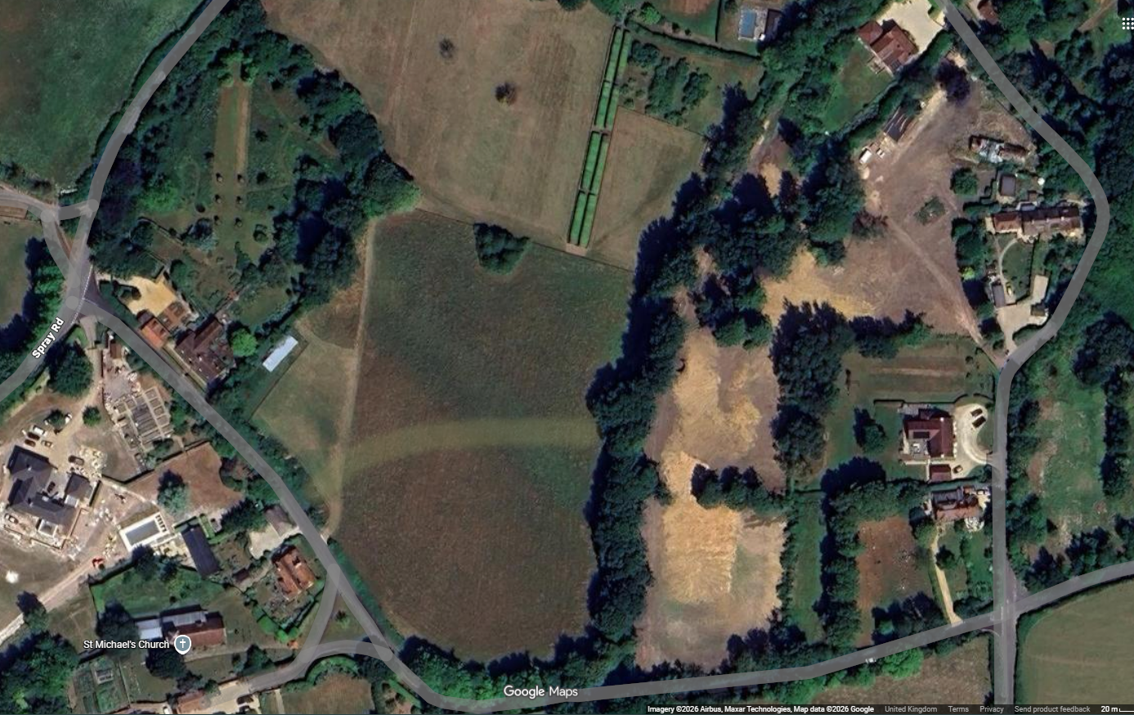

Slide 56
St Michael’s Church

Slide 57
Here are the specific details regarding the effigies at Inkpen:
Previous Abuse: In the early 1700s, a previous rector had removed a 13th-century knightly effigy from the church and thrown it into a nearby farmyard to make space for a family pew.
Rescue and Restoration: The effigy was later rescued from the farmyard. During the 1896 restoration led by Reverend Henry Butler and architect C.C. Rolfe, this and other tomb covers were officially recognized as historically significant and placed in the chancel.
The Effigies: The two tomb covers (one being the knight, the other possibly a seafarer/captain of a vessel transporting Crusaders) were preserved as part of the chancel, despite the "heavy restoration" of the rest of the church, which included a new arcade and north wall.
Current State: The knightly effigy is described as "weathered," with significant damage to its lower portion from its time in the farmyard, but it remains a key, protected feature within the church.

Slide 58
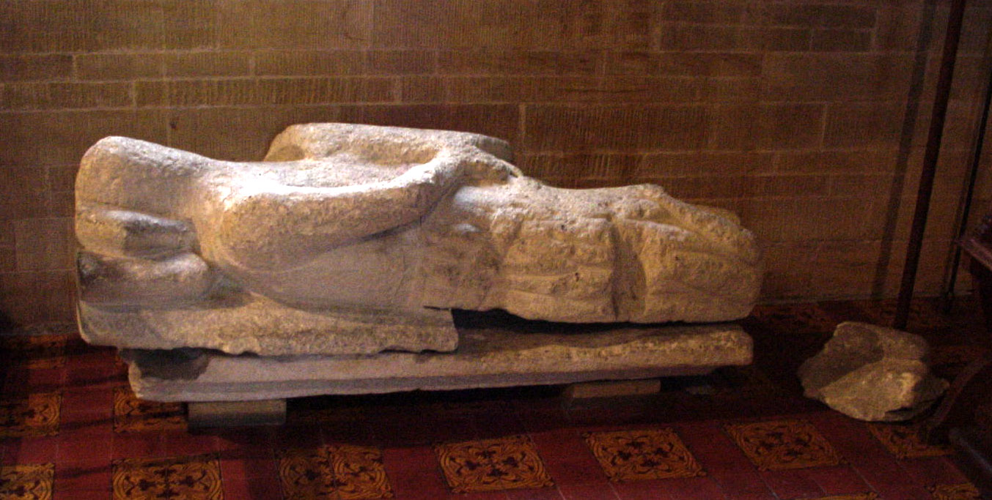
Effigy of Richard de Inkpen

Slide 59
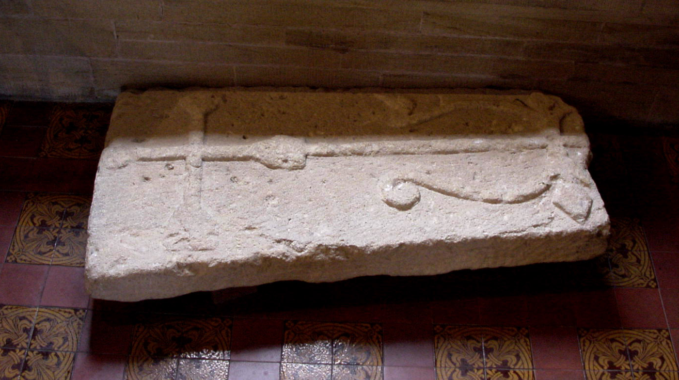
Tomb Top - Partial

Slide 60
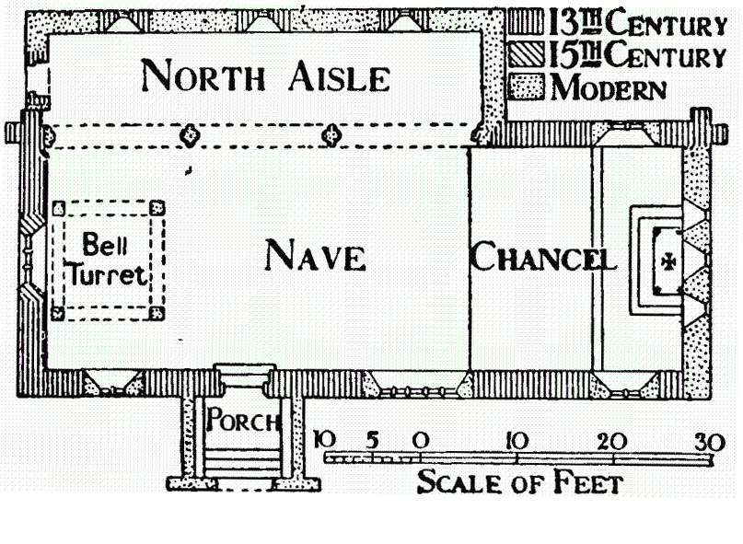

Slide 61
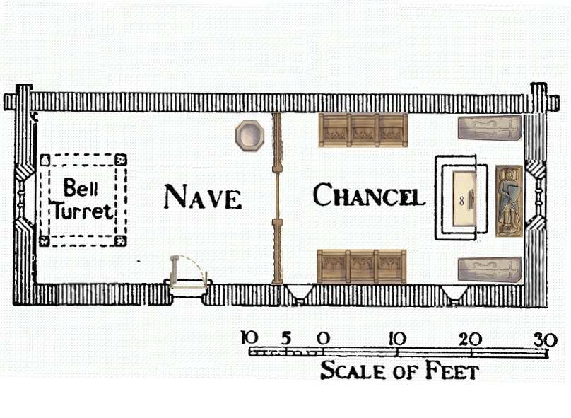

Slide 62
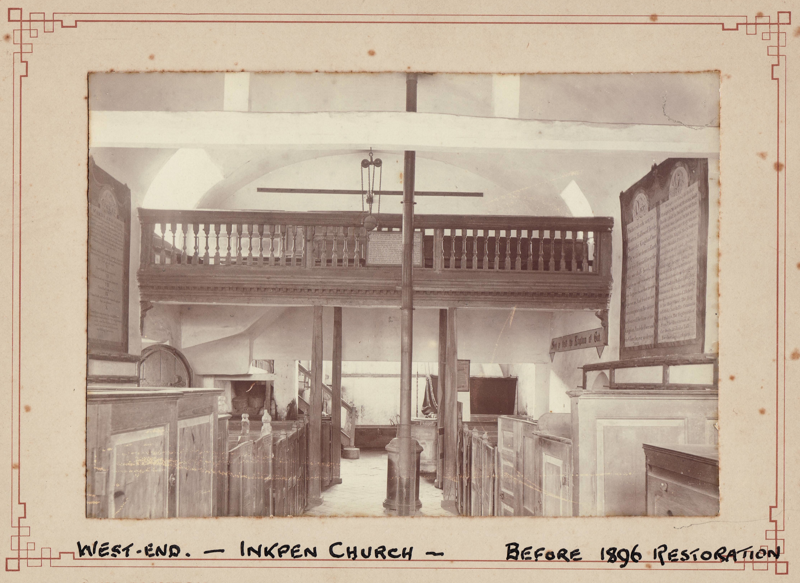

Slide 63
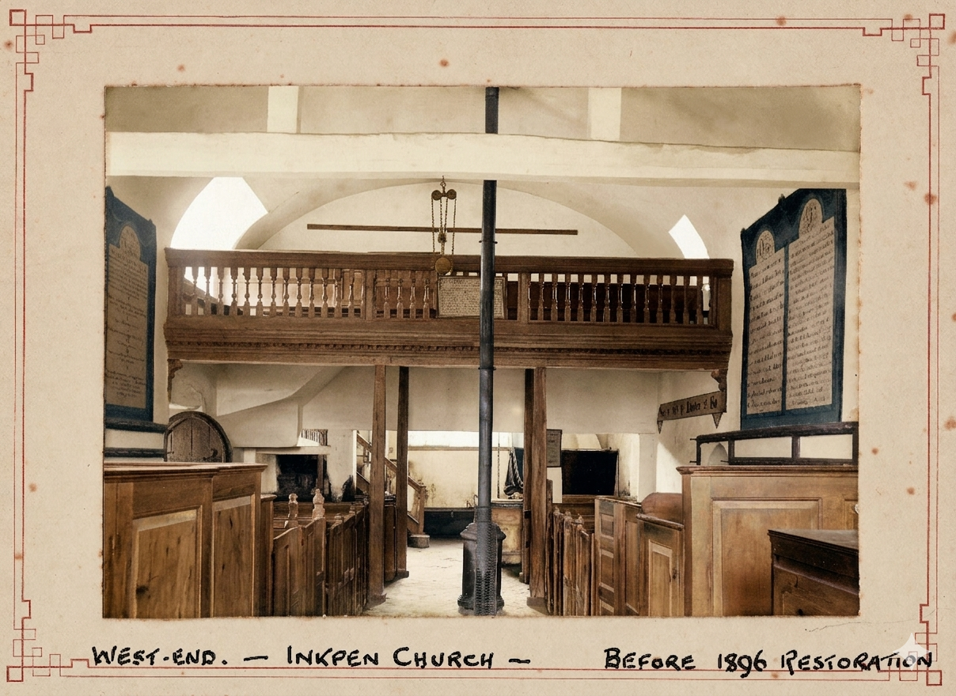

Slide 64
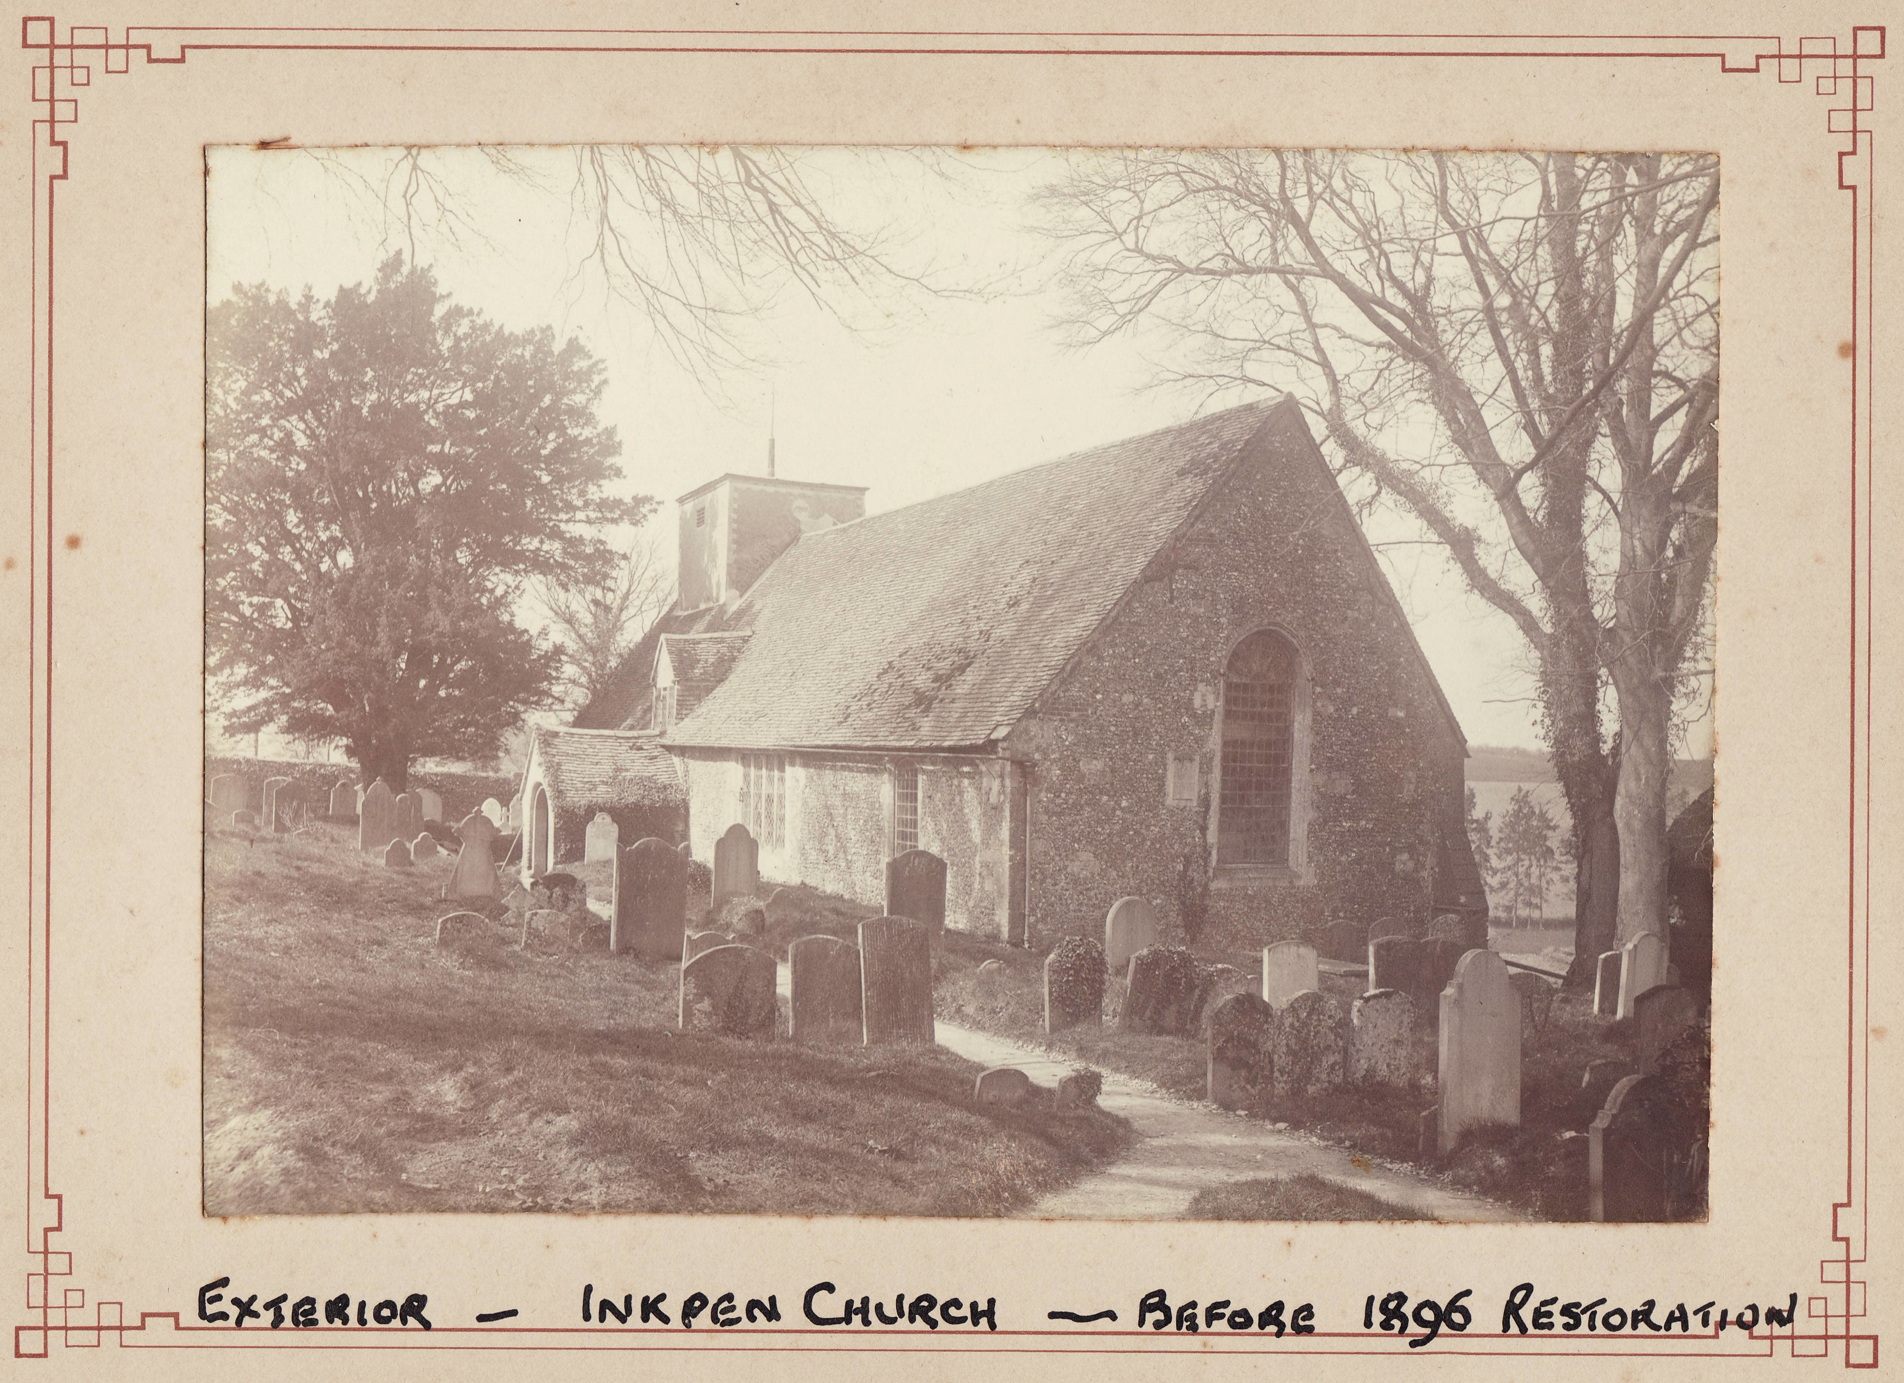

Slide 65
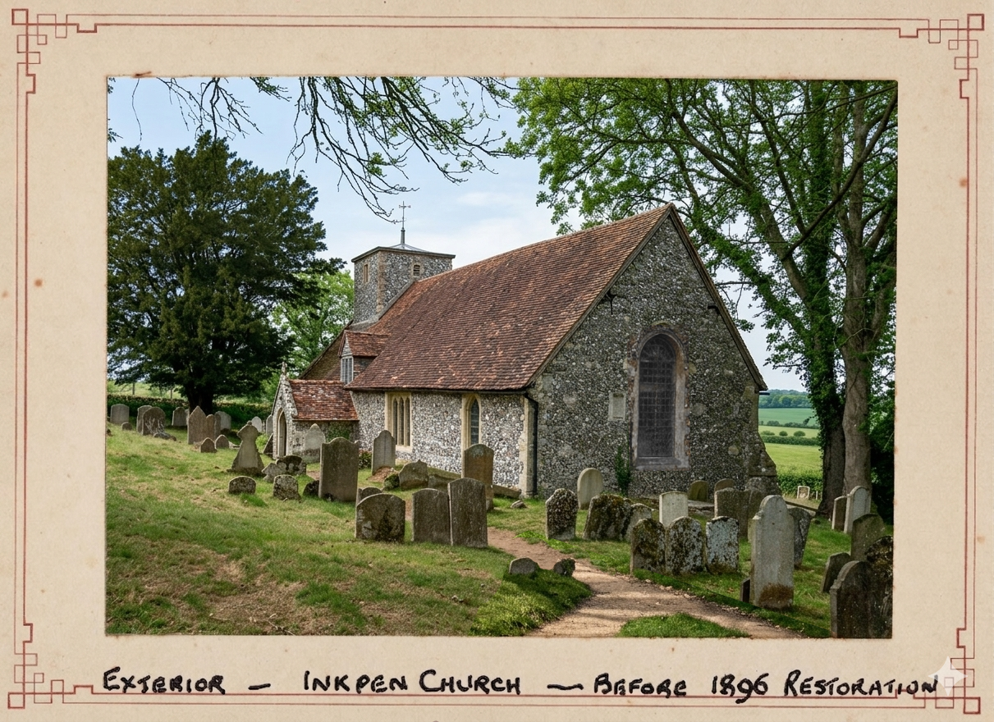

Slide 66
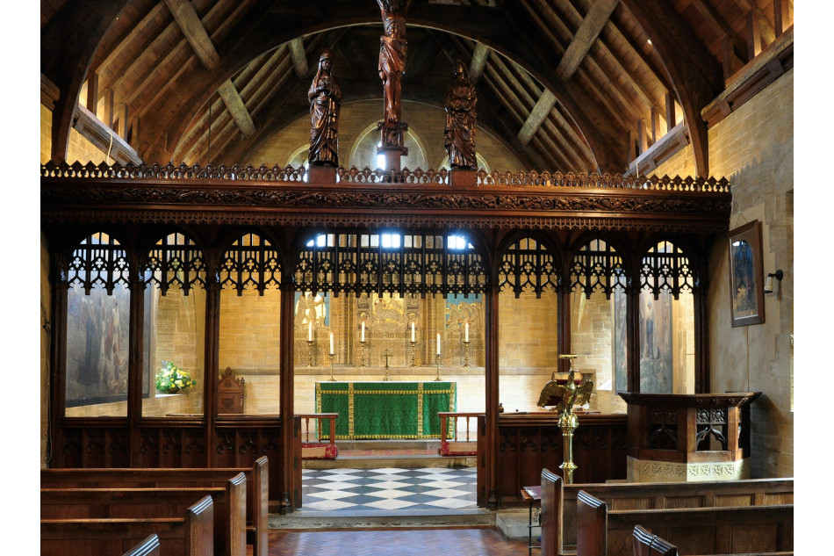

Slide 67
1. Most of the windows have been changed over time, except maybe for the West window.
2. There would have been no porch.
3. There was supposedly a crypt.

Slide 68
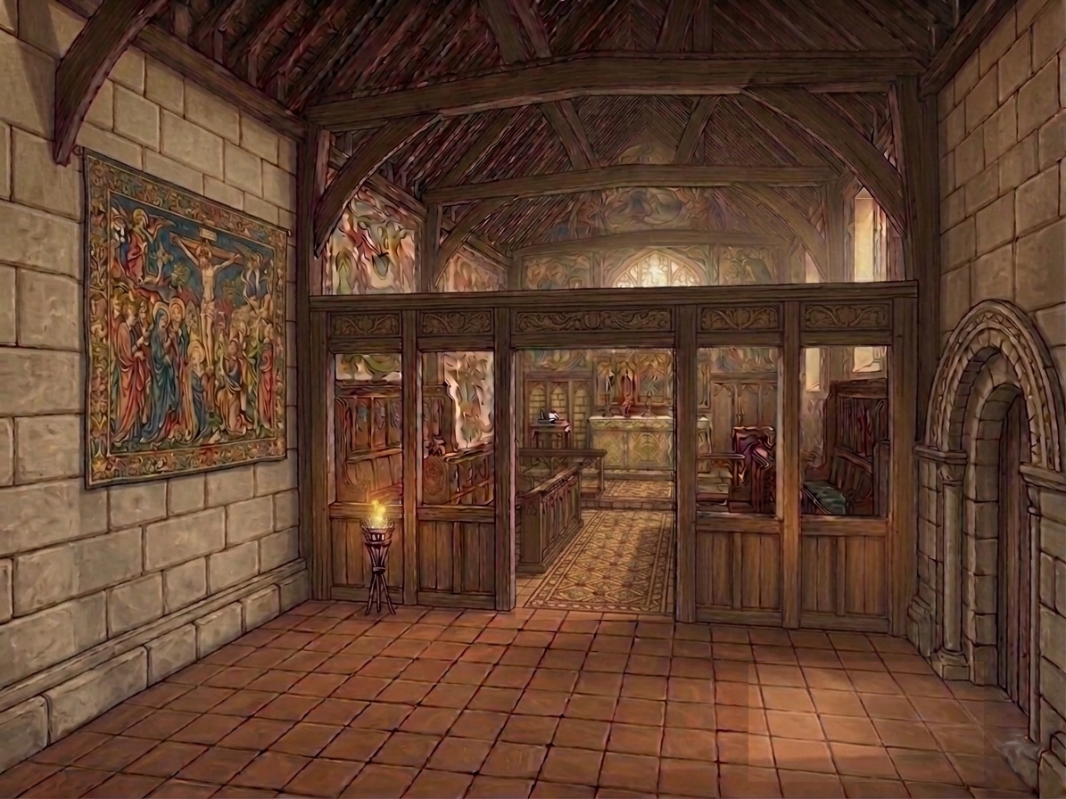

Slide 70
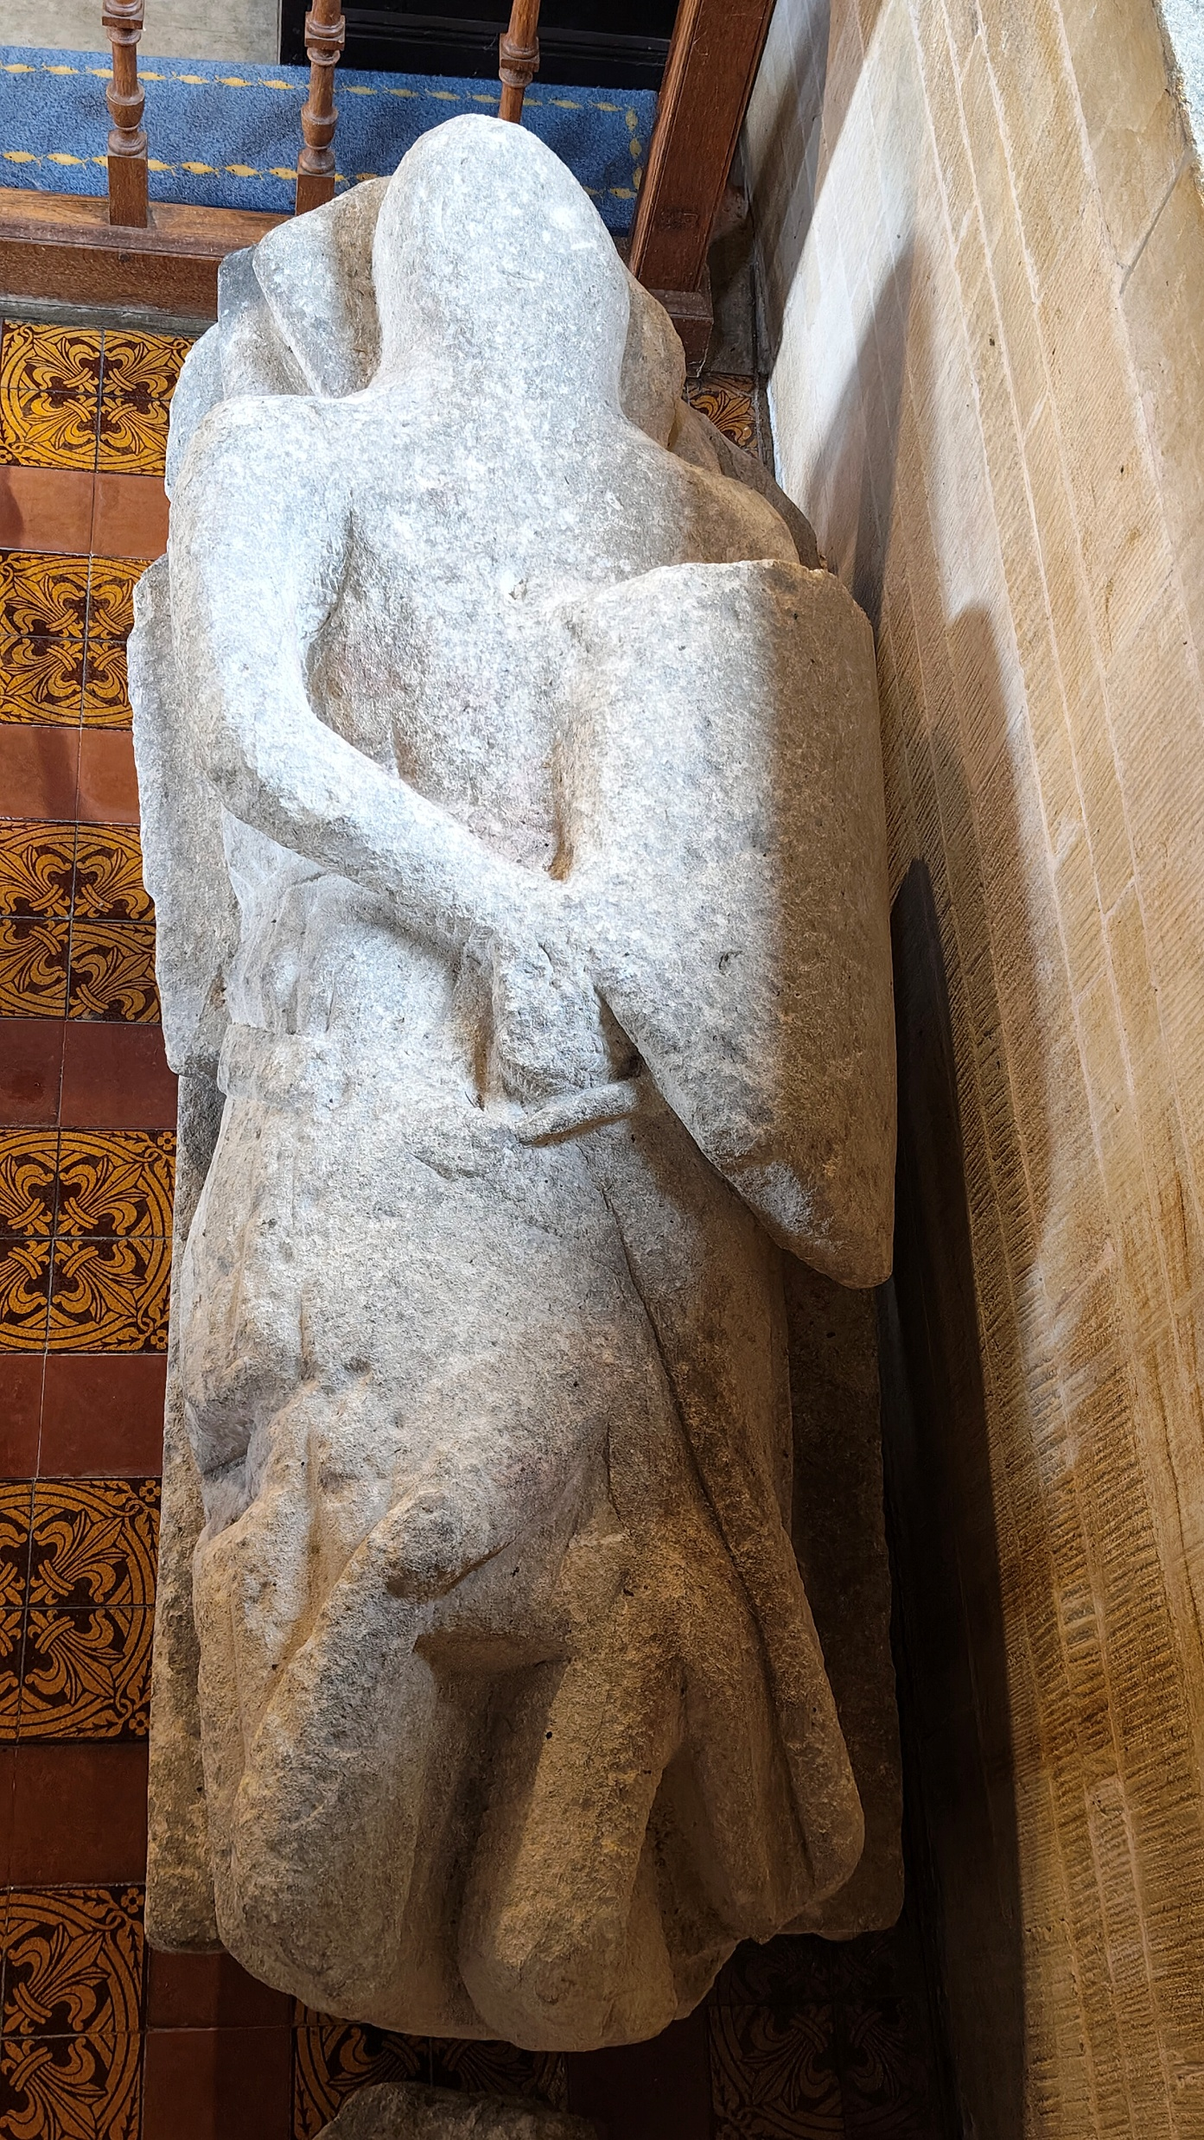
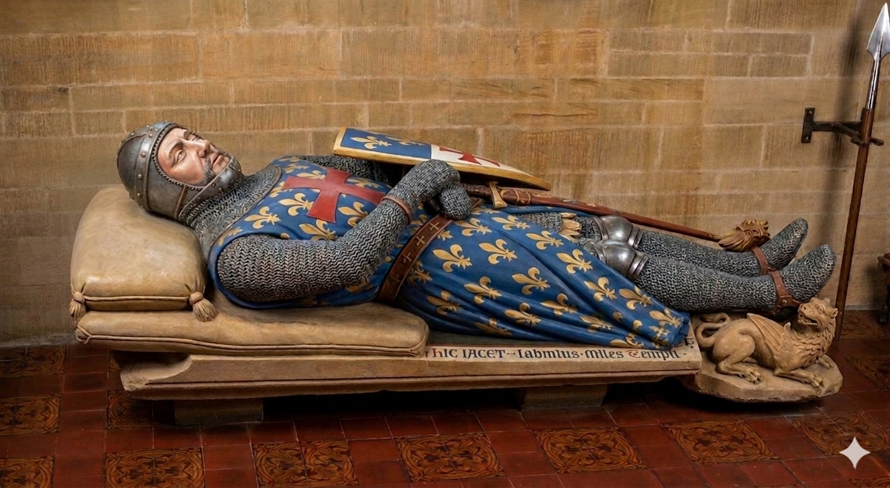

Slide 71
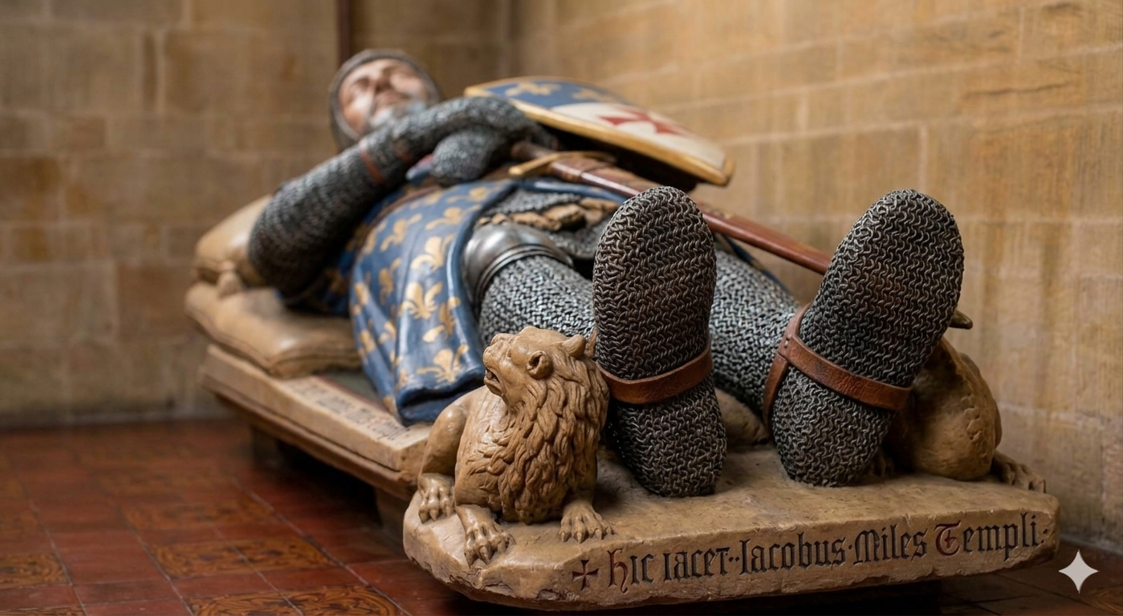

Slide 72
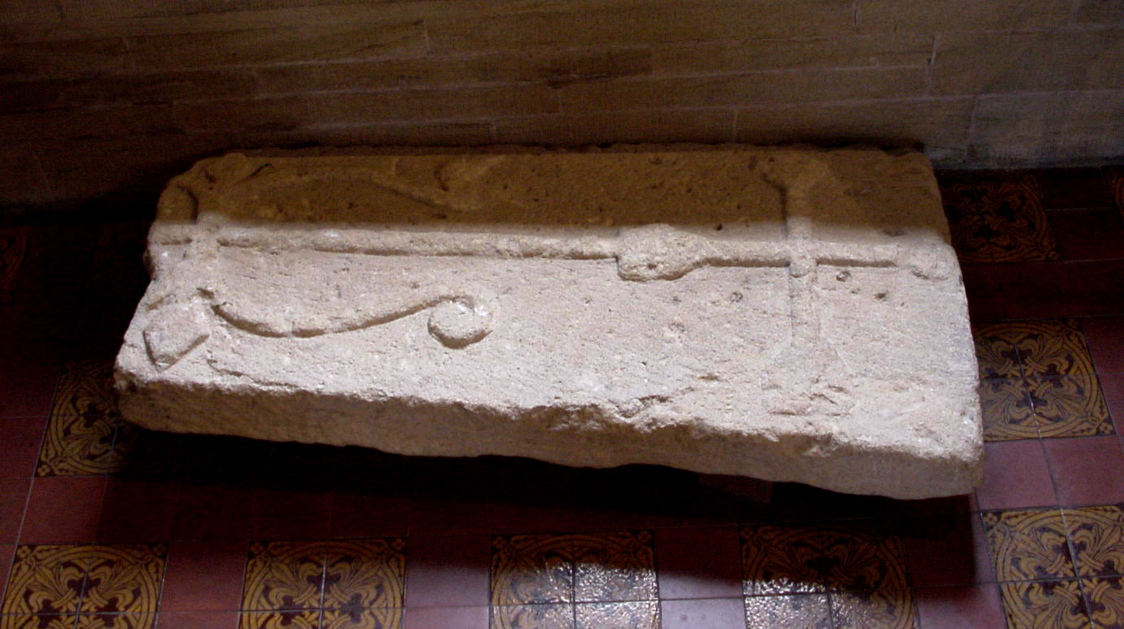
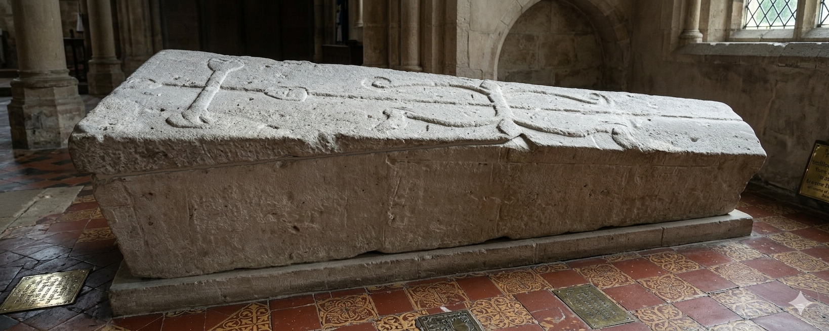

Slide 73
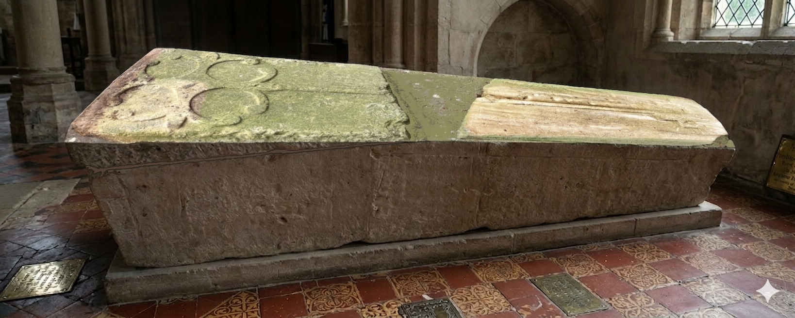

Slide 74
Outside of St. Michael’s

Slide 75


Slide 77
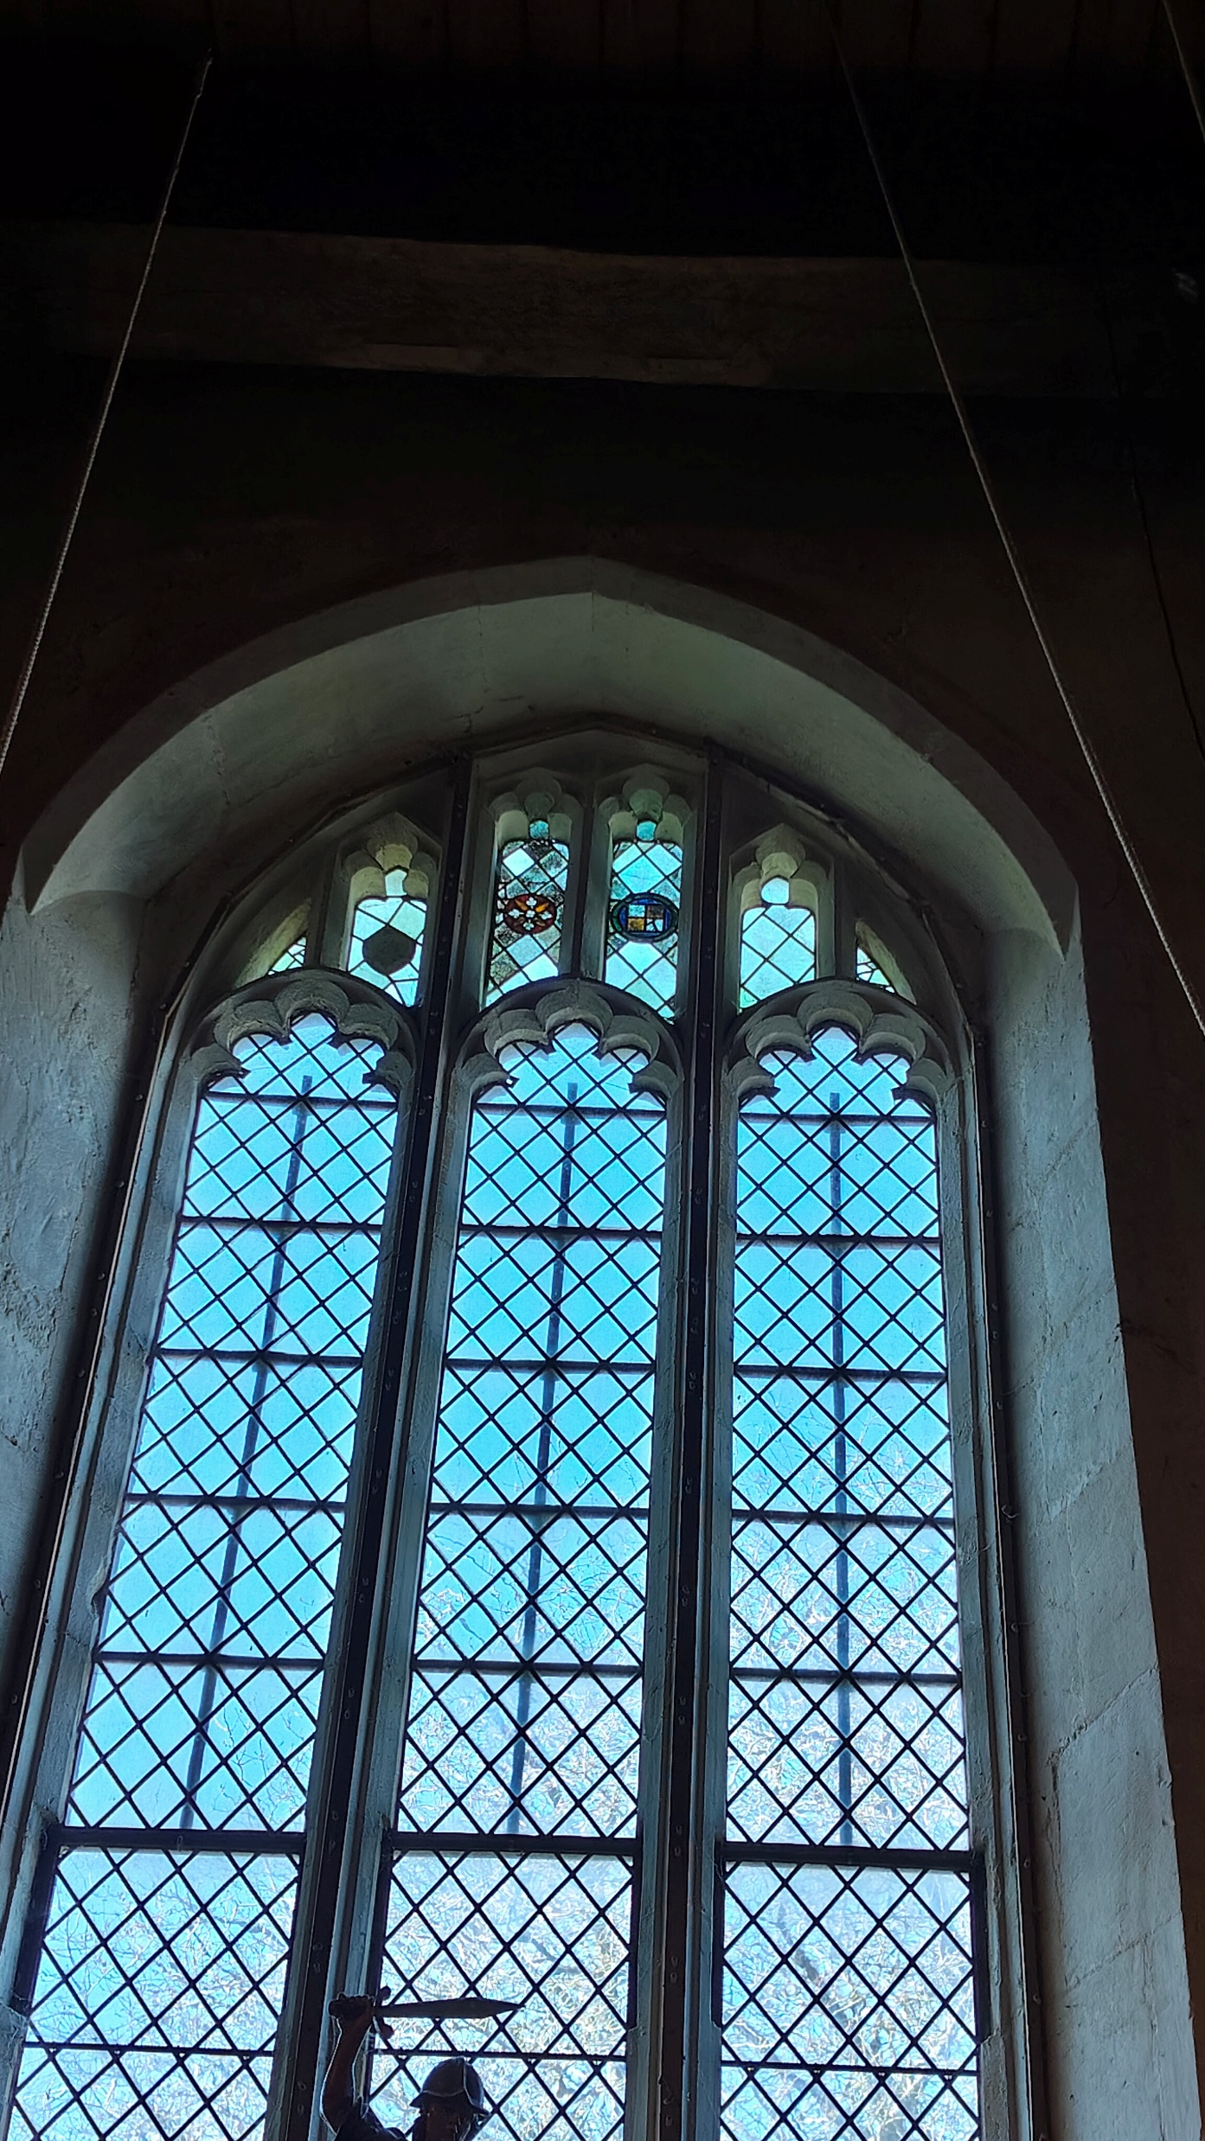
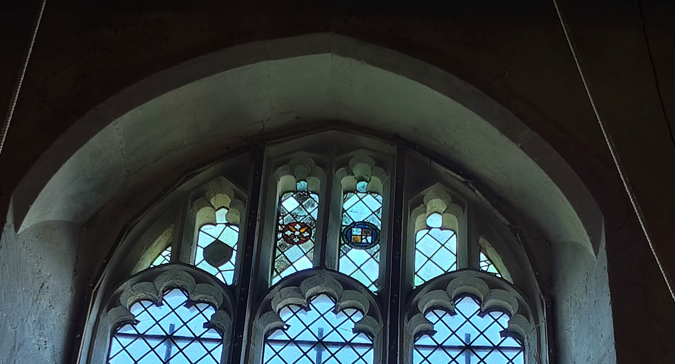

Slide 78
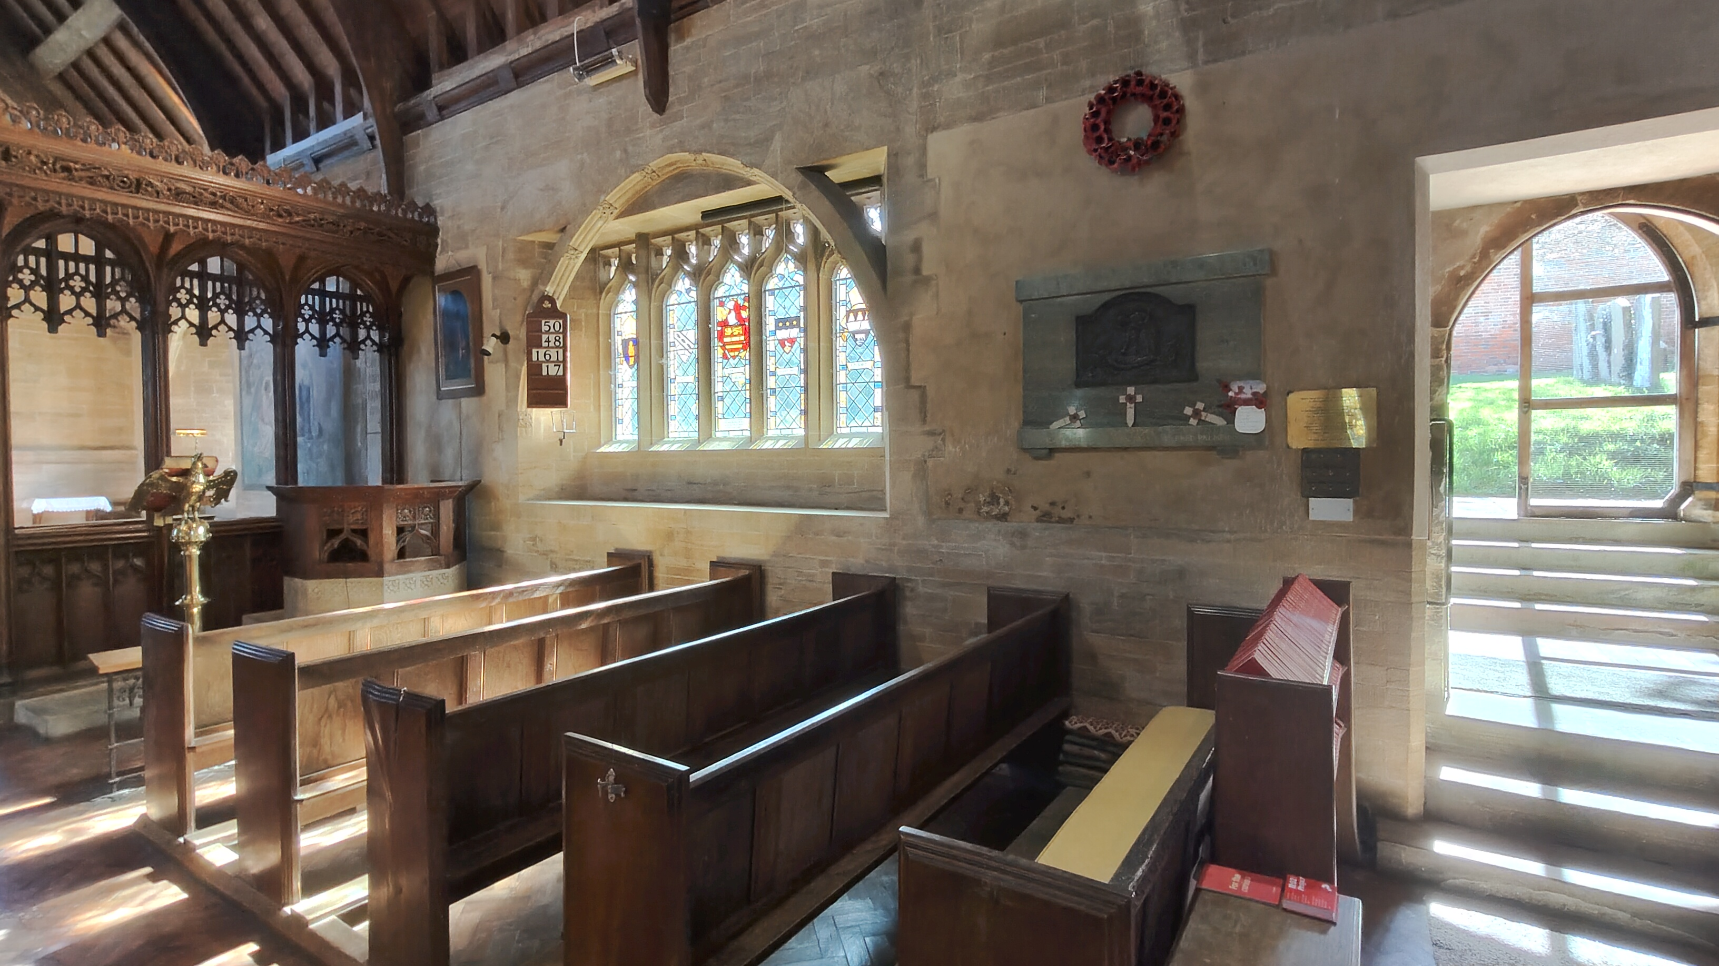

Slide 79
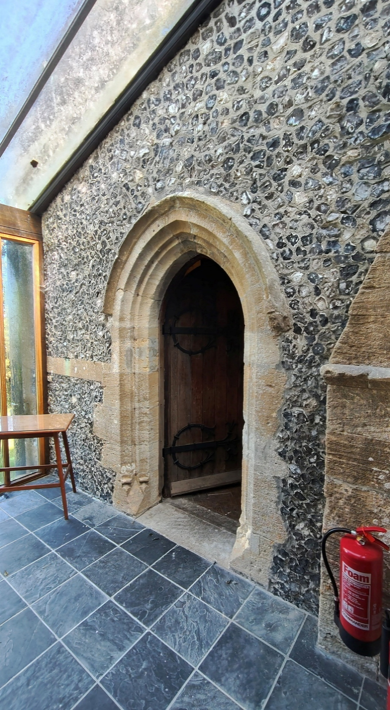
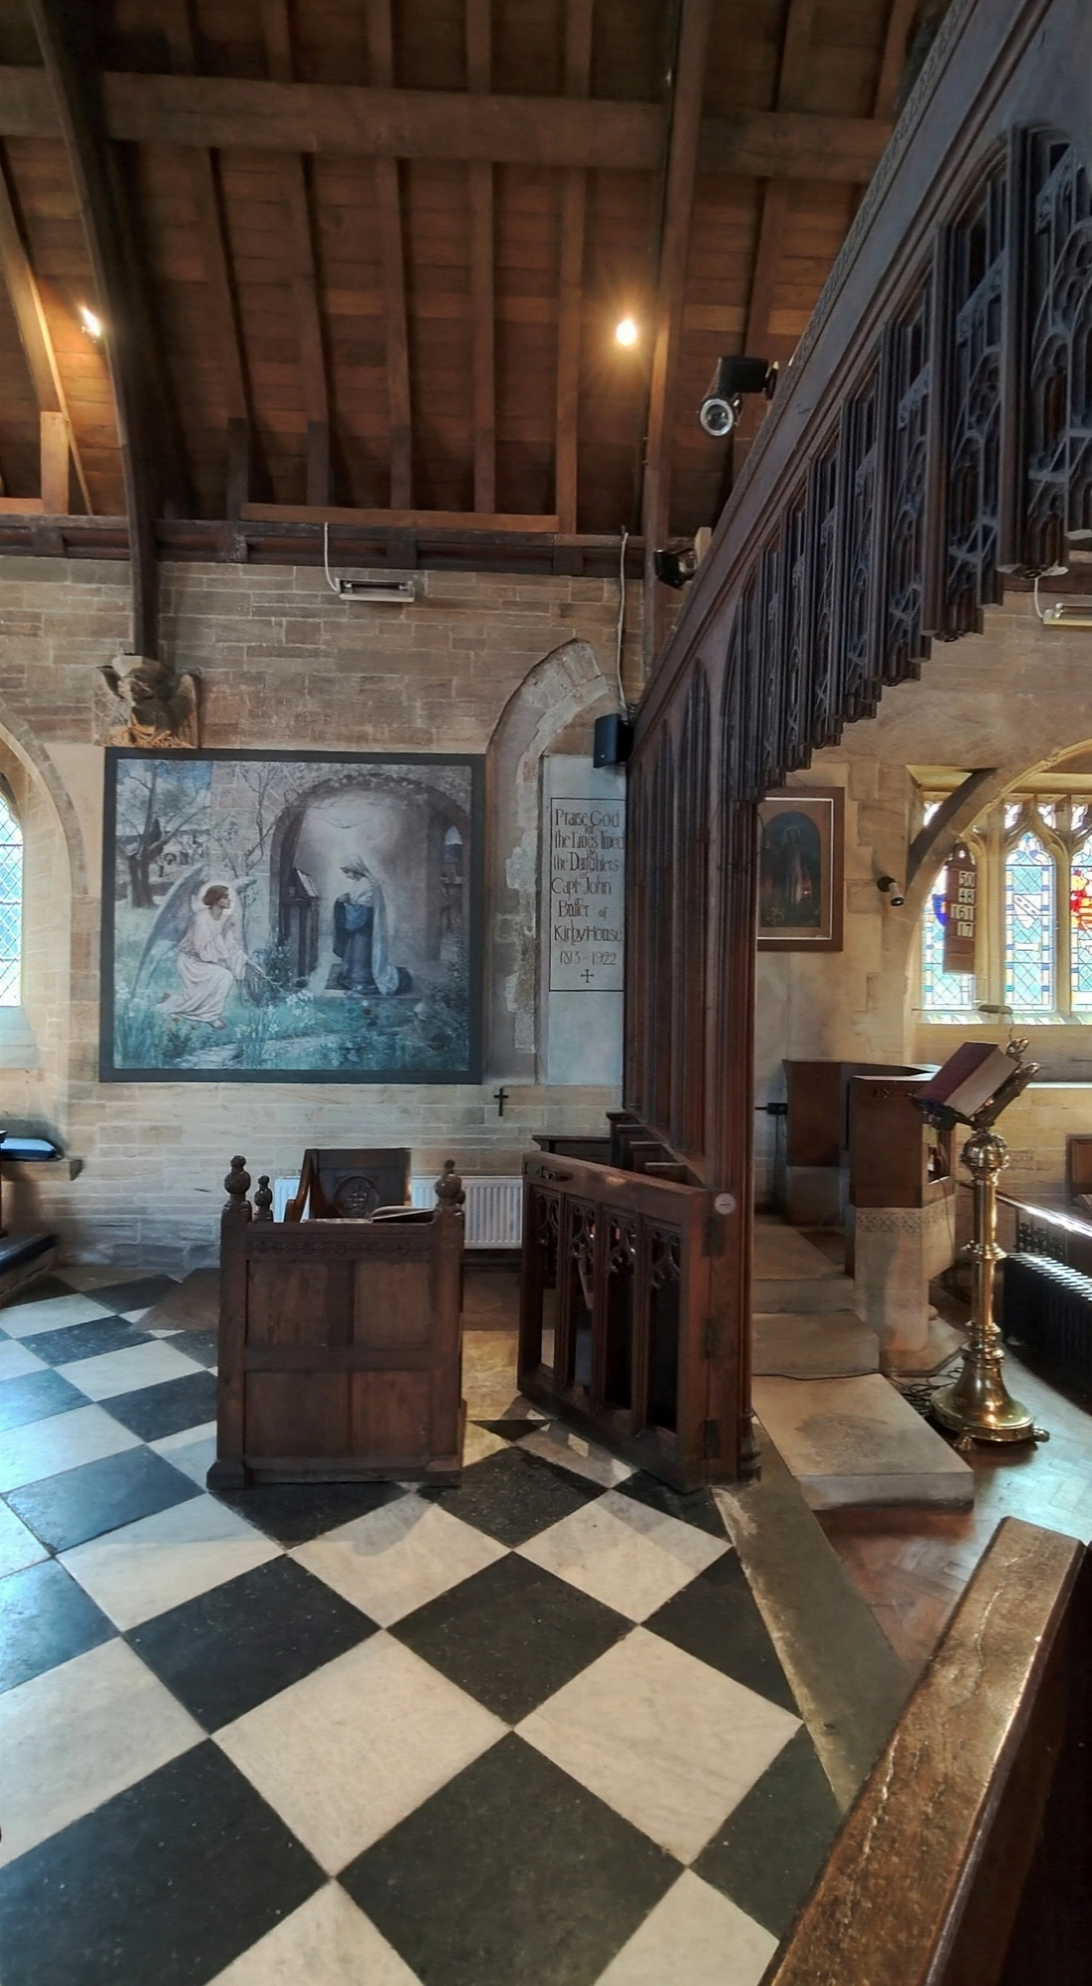
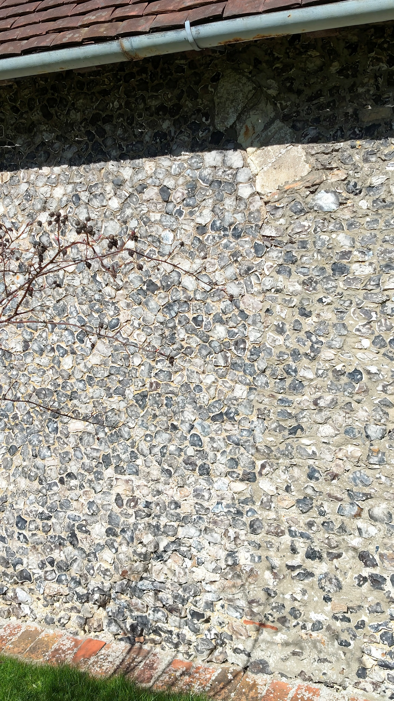

Slide 80
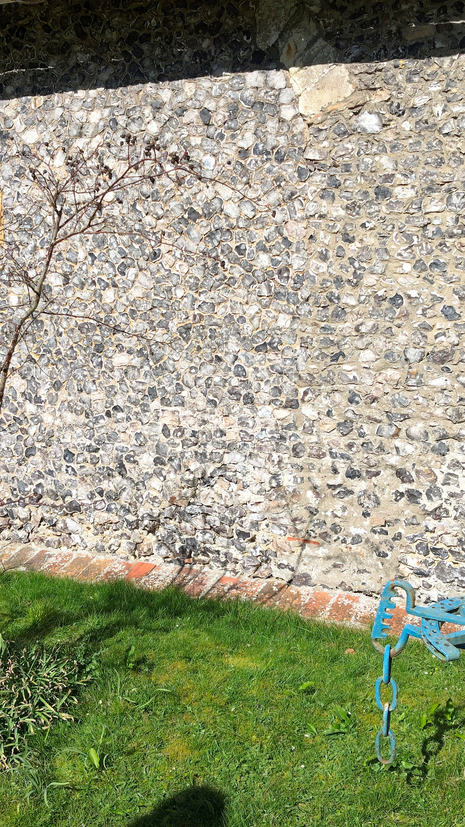
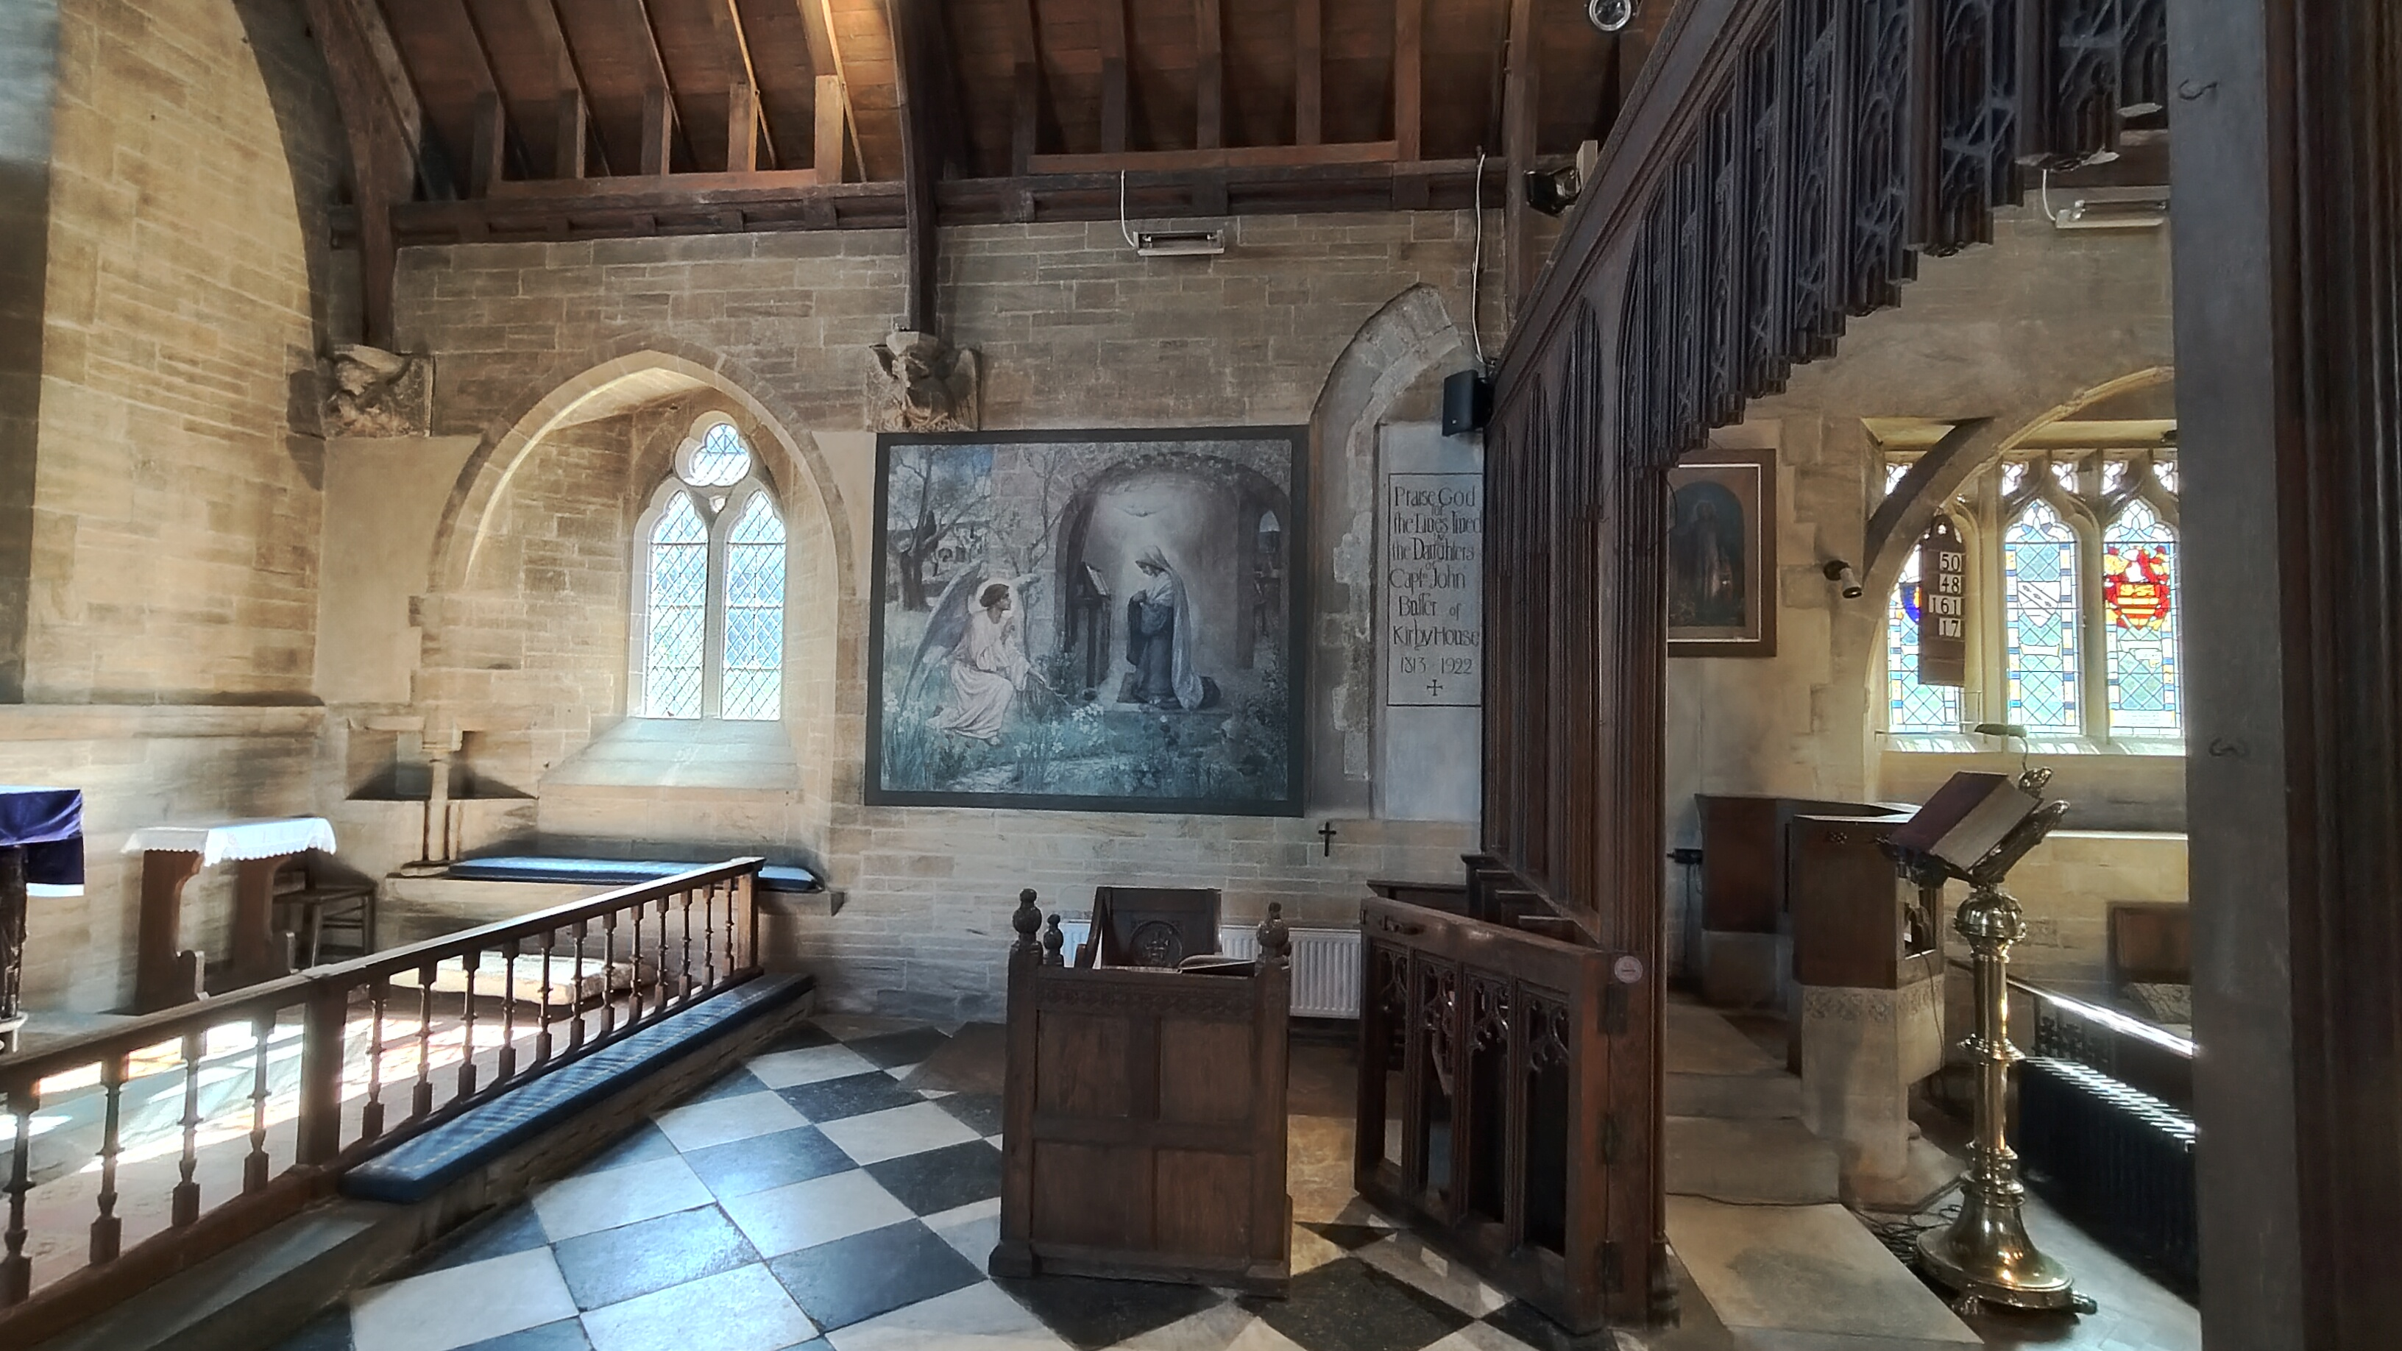

Slide 81
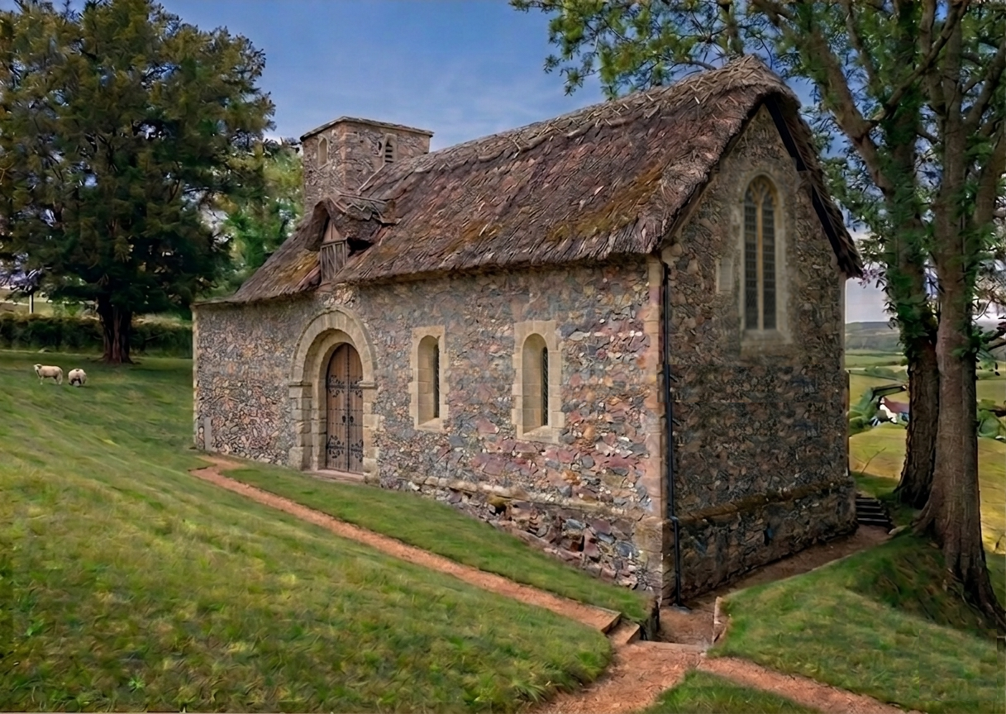

Slide 82
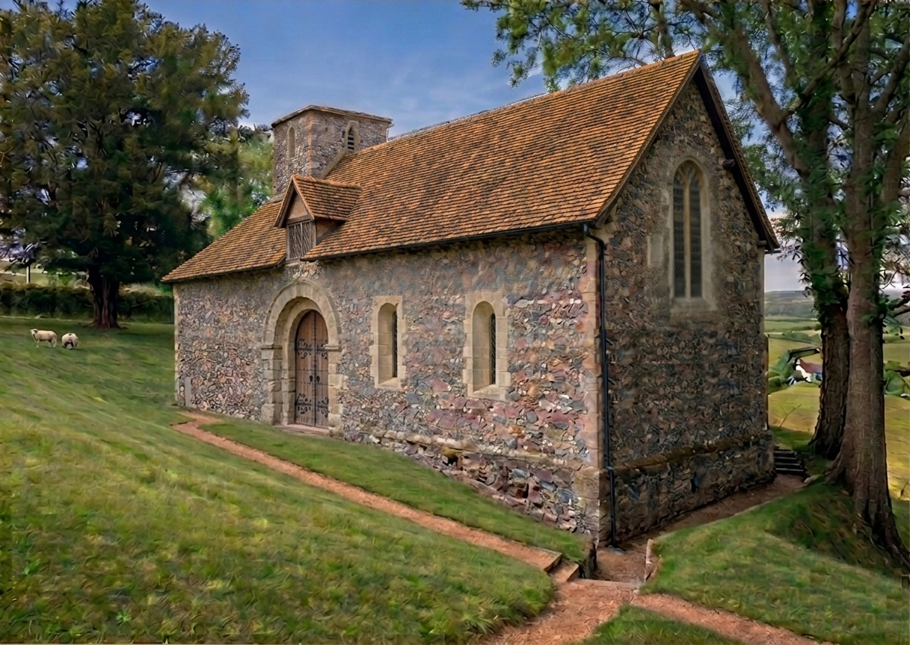

Slide 83


Slide 84
A papal sanction was obtained for Roger de Inkepen, a wealthy and beneficent citizen of Winchester, to found and endow a chapel in the cemetery of Nunnaminster, to be served by two priests, the patronage of which was to belong to him and his heirs. This chapel was dedicated to the Holy Trinity; one of the priests was termed the warden and the other the chaplain; they lived together and had a common table; they were ordered to say daily mattins and evensong in the chapel in addition to the masses.

Slide 85


Slide 86
The Dig

Slide 87


Slide 88


Slide 89


Slide 91
The End

